Slide 1
Events API Example
Publishing events to www.eventful.com

Slide 2
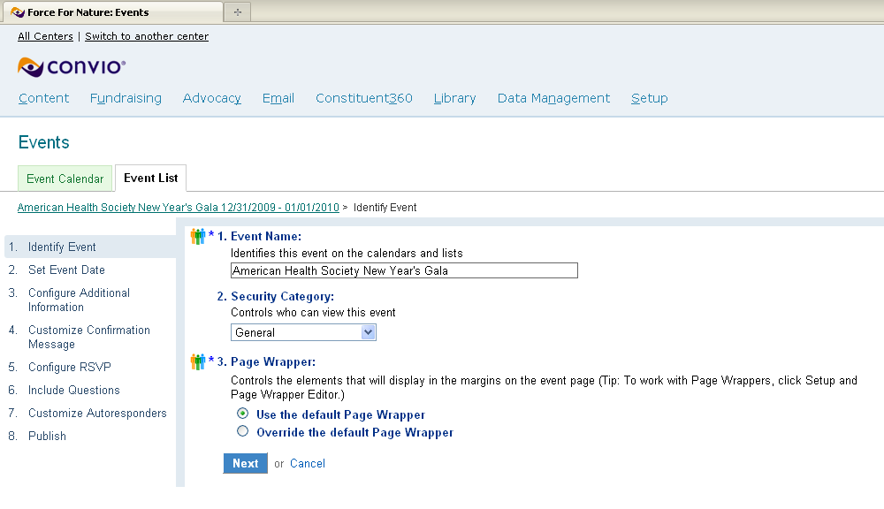
Create the event

Slide 3
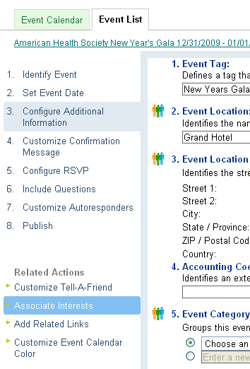
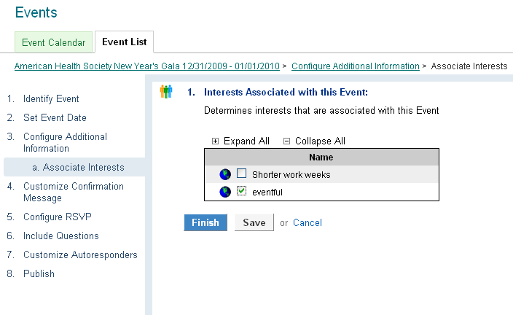
Add an Interest to the event

Slide 4
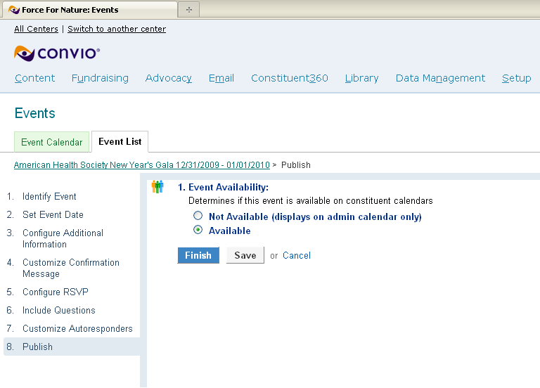
Publish the event

Slide 5
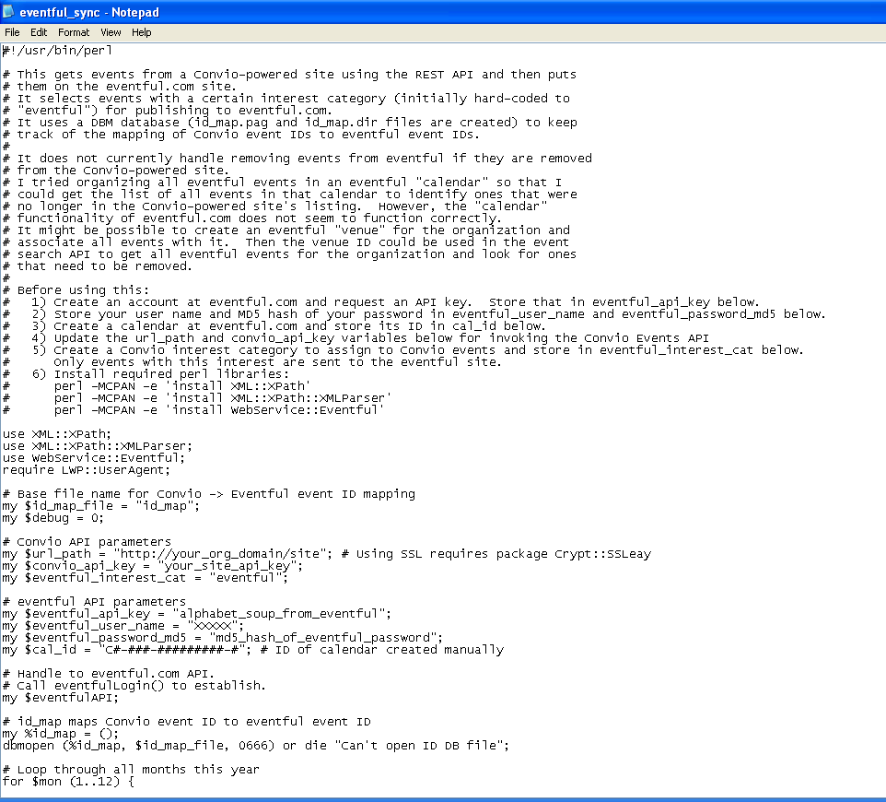
Run the Perl script
Link to the script document in the client community
http://community.customer.convio.com/docs/DOC-2632

Slide 6
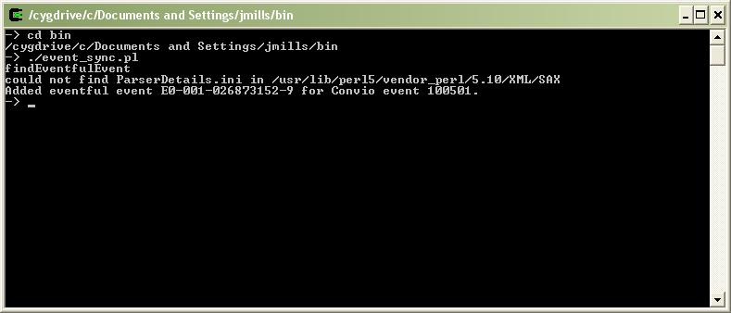
View of the command line response

Slide 7
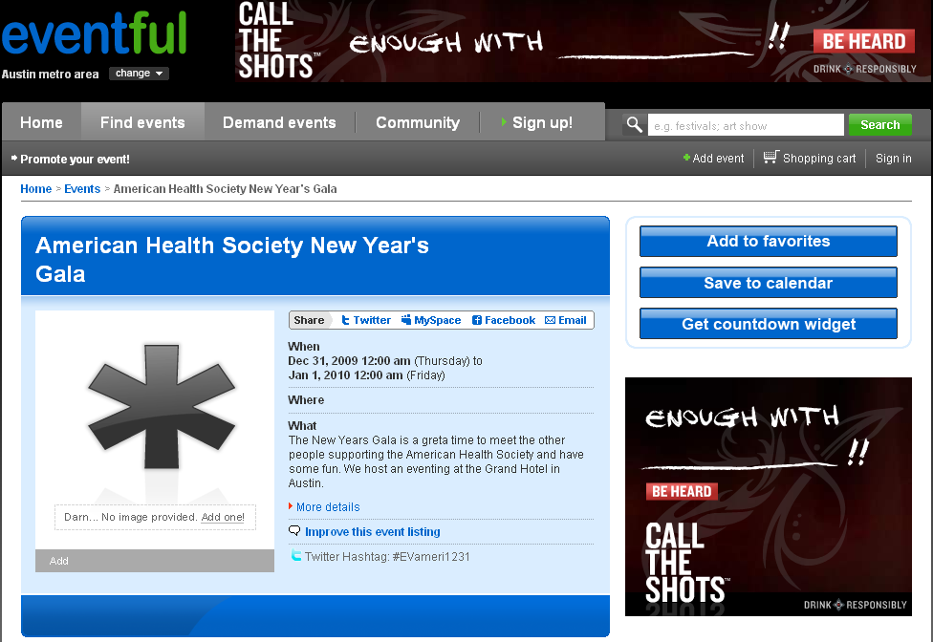
Find the event on www.eventful.com

Slide 8
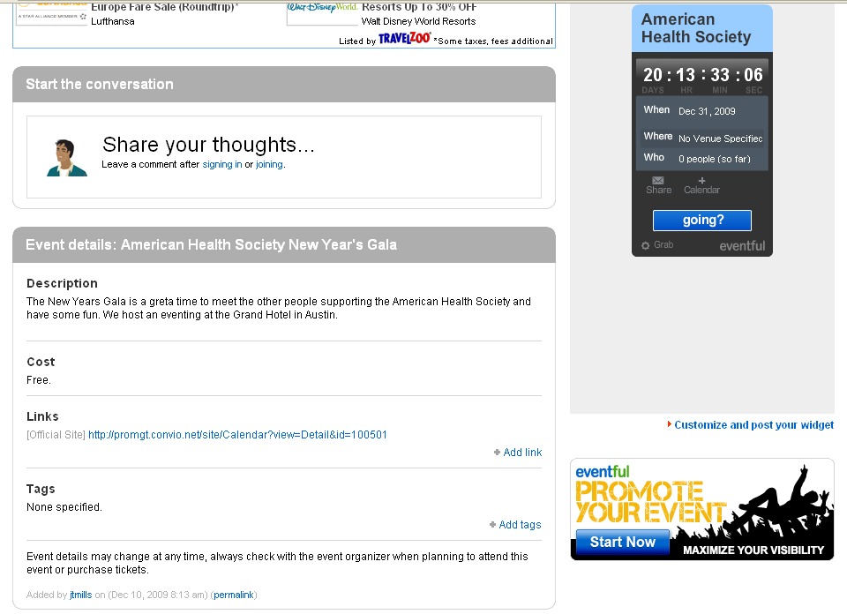
See the event link

Slide 9
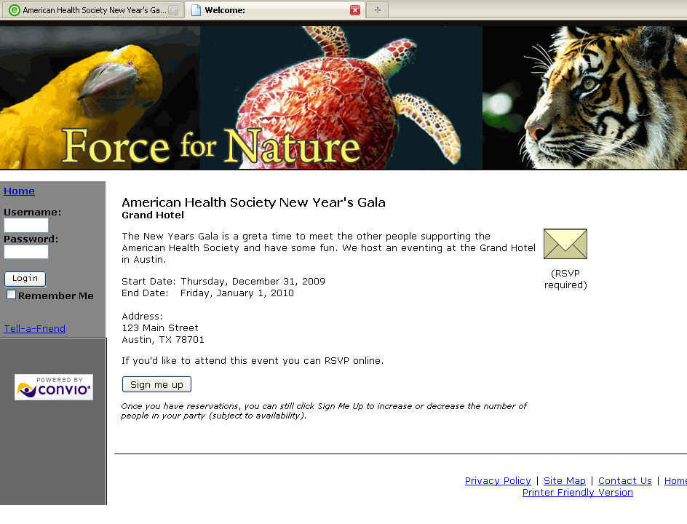
Sign up for the event

