Slide 1
Mobile-friendly BBIS
A practical guide

Slide 2
What We’ll Talk About
How to create a mobile-friendly page in BBIS 2.94
What does “mobile-friendly” mean?
Terms you may have heard:
mobile-friendly
responsive
adaptive
device-agnostic
multi-channel
Tips for working with Event Registration Parts (OOB)
First Look: site before and after
Questions?

Slide 3
Step One
(just kidding….)

Slide 4
Step One: Get Organized
naming conventions & file structure
mimic file structure in a folder
open code editor
login & open tabs:
stylesheets
layouts
templates/pages
parts
tip: use the same tab order every time for faster development!

Slide 5
Step Two: Stylesheet
create a blank stylesheet
Stylesheet: Blank
tip: add a description so you (and everyone else) will know it’s supposed to be blank and stay blank.

Slide 6
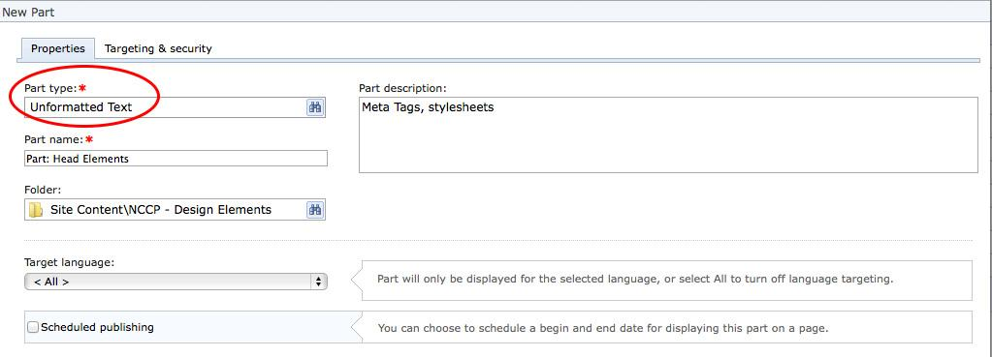
Step Three: Parts
create a new part

Slide 7
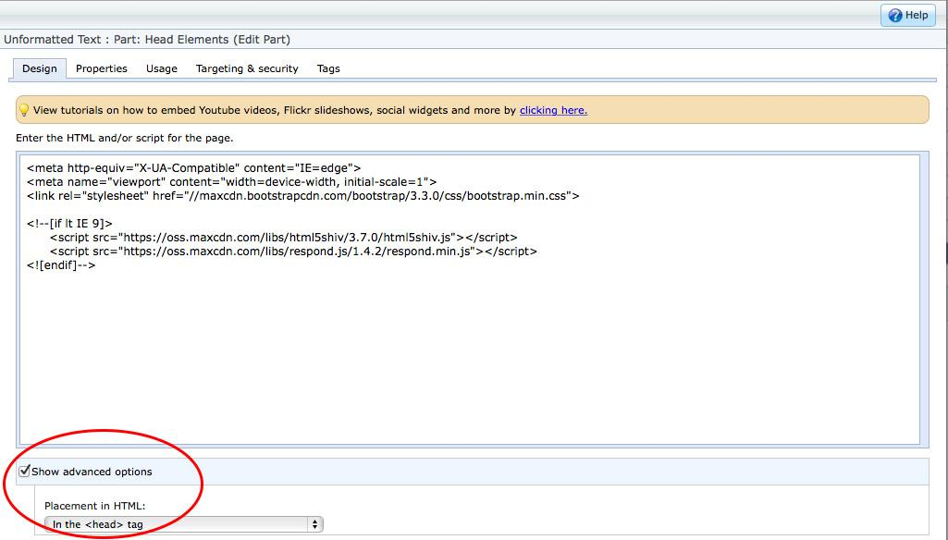
create a new part (continued)

Slide 8
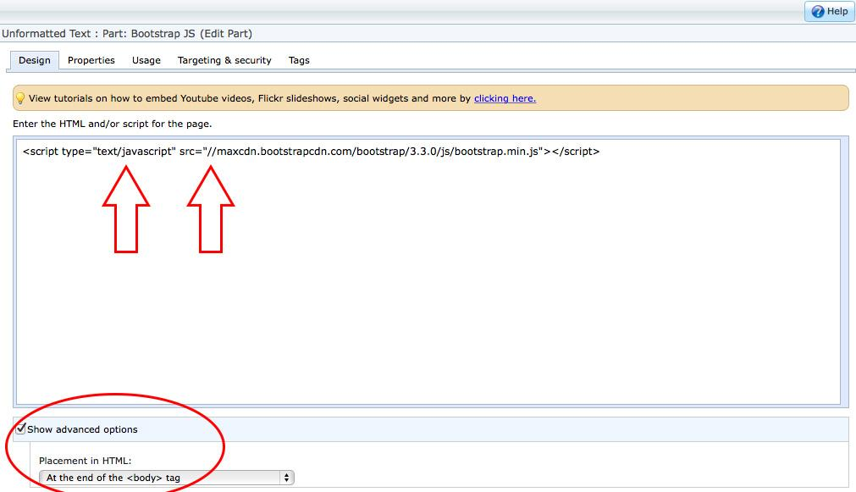
Step Three: Parts
create (another) new part:

Slide 9
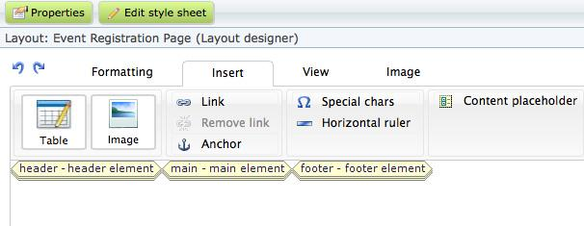
Step Four: Layout
create a layout
use the blank stylesheet
click on the Insert tab
insert three (3) content placeholders:

Slide 10
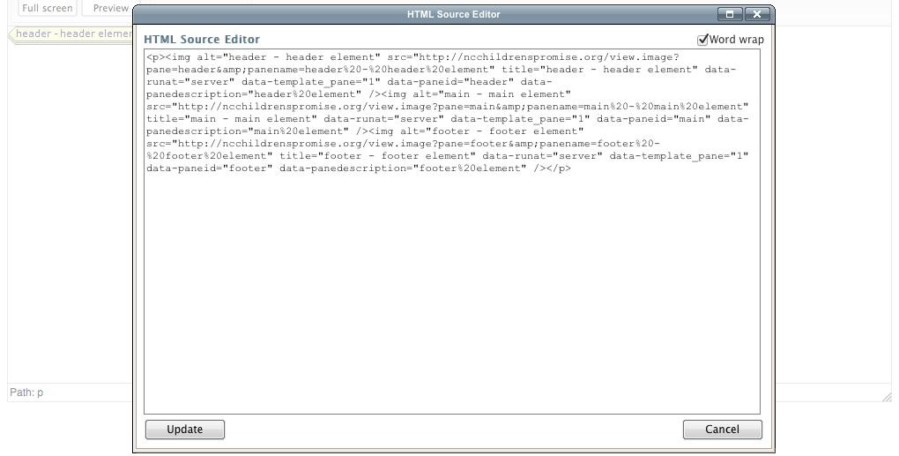
create a layout (continued)
click on the View tab
click on the HTML code button

Slide 11
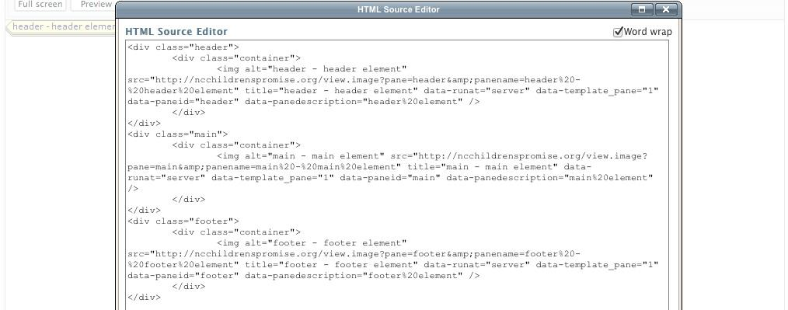
create a layout (continued)
remove paragraph (<p>, </p>) tags
insert div elements around placeholders
quirk alert: use classes instead of elements - i.e., <div class="header"> instead of <header>
quirk alert: use your code editor- you may have to copy/paste code in and save again for the changes to stick

Slide 12
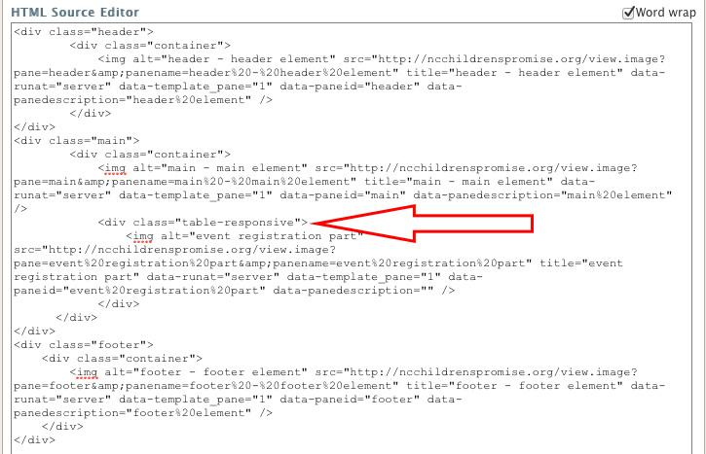
Step Five: If Events, then...
create an event registration layout
additional code: add <div class="table-responsive"> around a placeholder

Slide 13
Step Six: Template
create a template
in header content pane, insert part
Part: Head Elements
in footer content pane, insert part
Part: Bootstrap JS
note: this is just the Bootstrap JS- BBIS already implements a jQuery so you don’t have to.
additional CSS styles part (implementation varies)

Slide 14
Step Seven: Page
create new page
may need to insert page-specific CSS
use unformatted text part type
remember to check “Show Advanced Options” and choose “In the <head> tag”

Slide 15
Making it Mobile-Friendly
Unformatted Text Parts
Bootstrap does most of the heavy lifting:
count to 12 (more than 12 will break to next row)
.col-sm-3 + .col-sm-9 = okay!
rows (and more columns) can be nested
container/container-fluid cannot be nested (which is why they’re in the layout)
awesome helper classes:
.hidden-xs
.center-block

Slide 16
in custom CSS, remember media queries:
code .class for mobile first
follow by @media (min-width: 768px) { .class {} }
follow by @media (min-width: 992px) { .class {} }

Slide 17
A Little JS Magic...
To remove inline styles, add an unformatted text part to your page:
<script type="text/javascript">
$("table").removeAttr("style");
$("table").addClass("table table-condensed");
$("td").removeAttr("style");
</script>

Slide 18
Or, if event registration part:
<script type="text/javascript">
var prm = Sys.WebForms.PageRequestManager.getInstance();
prm.add_endRequest(EndRequest);
function EndRequest(sender, args) {
TableCustomizations();
}
$(document).ready(function () {
TableCustomizations();
});
function TableCustomizations() {
$("table").removeAttr("style");
$("table").addClass("table table-condensed");
$("td").removeAttr("style");
}
</script>

Slide 19
Work In Progress
Remaining Challenges:
navigation menus

Slide 20
First Look: Before and After
Existing site:
http://medicalfoundationofnc.org
Mobile-friendly version:
http://medicalfoundationofnc.org/14/home

Slide 21
Any Questions?

