Slide 1
Troubleshooting Permissions Issues
Your Trainers: Caroline Boegel & Michael Ward

Slide 2
Objectives
By the end of this session, users will:
Be able to identify and create system roles.
Be able to list strategies for troubleshooting permissions problems.
Be able to resolve a variety of permissions errors and problems.

Slide 3
System Roles
Central management system where we configure all of the items and features to which a role has access.
Allows us to assign the same set of permissions to a group of users efficiently and consistently.
Users can have as many roles as needed.
Let’s take a look at creating a role:
Notes:
Use 2.94 sample, walk through adding a new system role
Discuss tabs of role, and adding users to it.

Slide 4
Identifying Permissions problems
What to look for?
Users can’t see a specific form or task
Error: The current user does not have rights to use this datalist.
Error: The current user does not have rights to use this form.
Error: The current user does not have rights to use this feature in the context of this specific record.
In Web Shell, users can’t see a form that they used to be able to see in Click Once.

Slide 5
Identifying Permissions problems
How to troubleshoot? (*overview)
Ensure that functionality is available for a system administrator
Check in Design Mode to see if the missing piece is defined there.
Create an “ALL RIGHTS” role and grant all tasks and features to it – that way, you can always grant this role for a user to confirm that the missing piece is something that you can assign to the user.
Create a “TEST” role that you can use to add to users that are missing a permission that they need. We don’t want to start changing our existing system roles in order to troubleshoot – use a system role that is purely for testing purposes, so you can add and remove features as needed.
While there are strategies to discover to exact missing features, sometimes we just need to use trial and error (that’s how we do it in Support, too!)

Slide 6
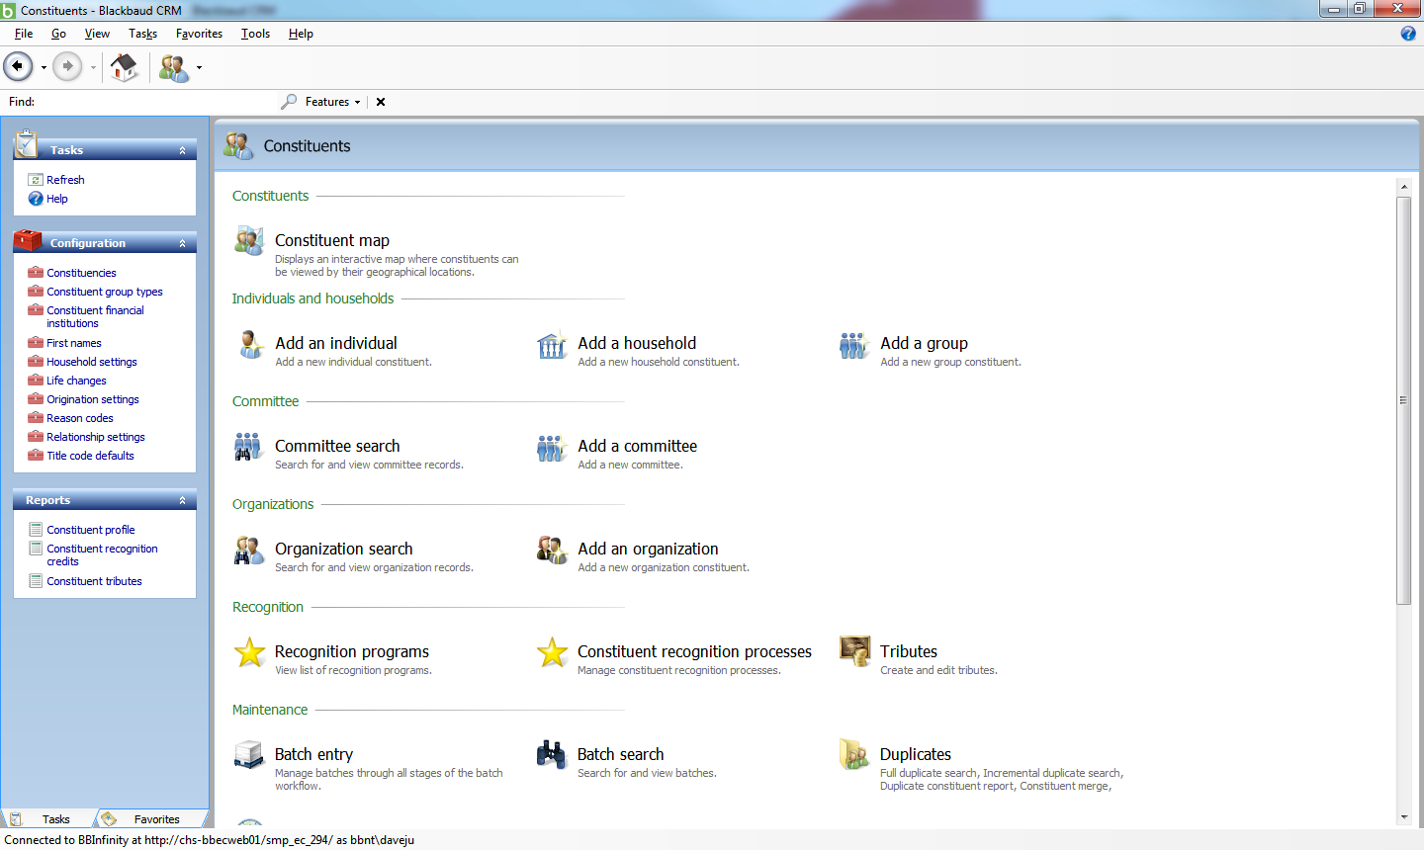
Let’s dive in!
Example #1
We have a user who only works in the Constituents functional area, but when they log in, they’re unable to see the Constituent search:
Where do we start??
Notes:
-System role is Class Example 1.
-User is BBNT\DaveJu.
-Missing task – Constituent search. Grant it for this role.

Slide 7
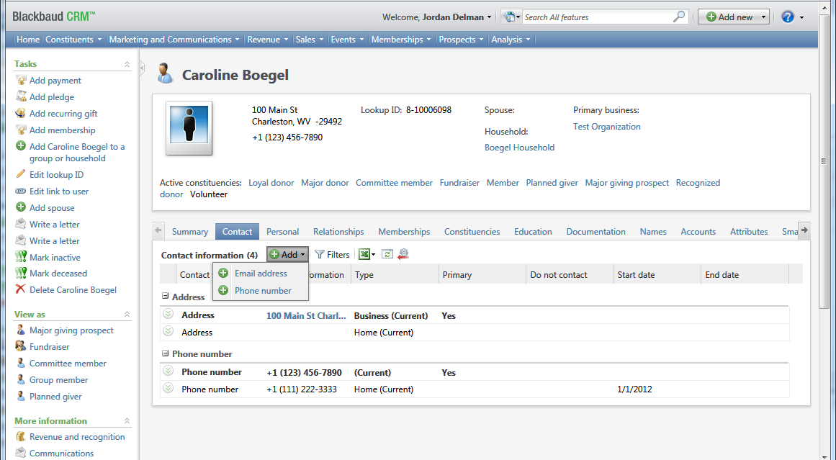
Let’s dive in!
Example #2
We have a user who needs to be able to add new addresses to constituents, but they don’t see the “Address” option when they click the Add button on the constituent’s Contact tab:
Where would you look first?
Notes:
-System role is Class Example 2.
-User is BLACKBAUD\JordanDe
-To resolve: Log in as a system admin.
Go to design mode and view the actions collection for the Add button.
The Address add form is “Address Add Form 2”
Grant this feature.

Slide 8
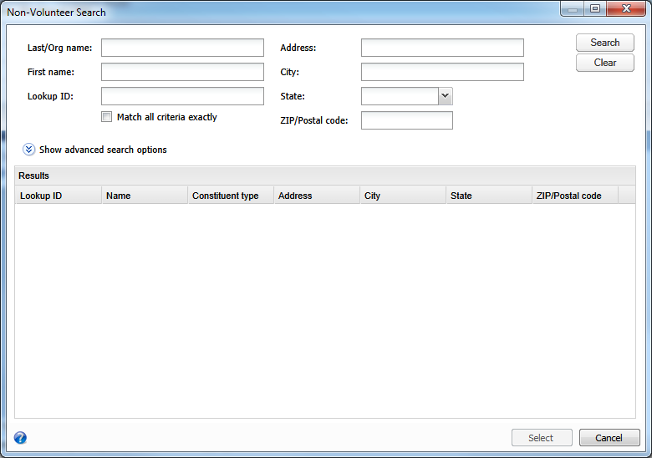
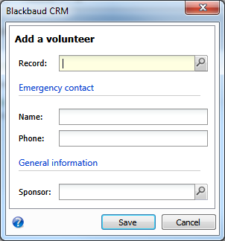
Let’s dive in!
Example #3
Let’s try something a little more complicated now. What if we can’t find what we need in Design Mode?
Our data entry person is adding volunteers to the database. Some already exist as constituents, and some do not. So sometimes, we need to search to see if the constituent exists, and if not, add them. However, the button to add new individuals or organizations is missing!
Go to Volunteers > Add a volunteer.
Click the Search icon for a record.
Your record isn’t there, so you need to add a
new Individual – note that the Add button is not
available!
Where would you look first?
Notes:
-System role is Class Example 3.
-User is BLACKBAUD\MichaelPe
-Problem features are:
Record > Individual Record Add Data Form
Record > Organization Record Add Data Form

Slide 9
Let’s dive in!
Example #4
There are some features that were built uniquely for the Web Shell. There are new forms and features that had to be built to be compatible with the web-based version of the application, so sometimes we’ll see something completely different in Click Once and in Web Shell.
The new Events landing page is a good example!
If you think you’ve found the missing feature and your user still doesn’t see what they need, make sure you check to see whether they’re using Click Once or Web Shell! It’s worth being aware of from the beginning, just so you don’t waste time troubleshooting the wrong thing.
Let’s take a look!
Notes:
-System Role is Class Example 4
-User is BLACKBAUD\JustinHo

Slide 10
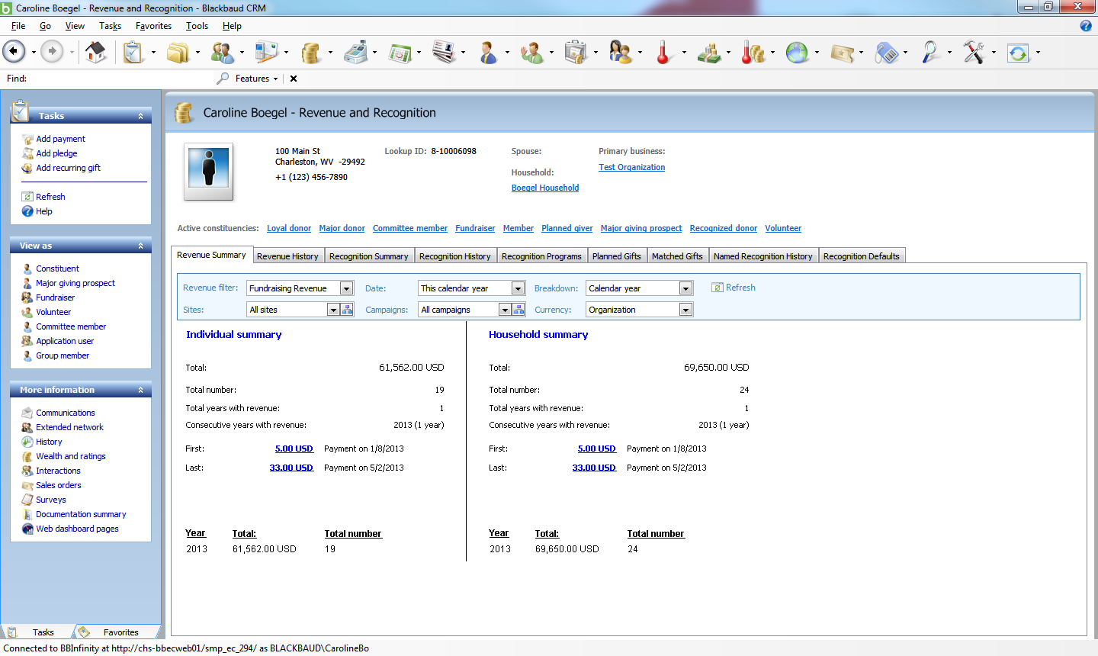
Let’s dive in!
You as Administrator, in Click Once
Notes:
-System Role is Class Example 4
-User is BLACKBAUD\JustinHo
(Revenue filters are what’s missing)

Slide 11
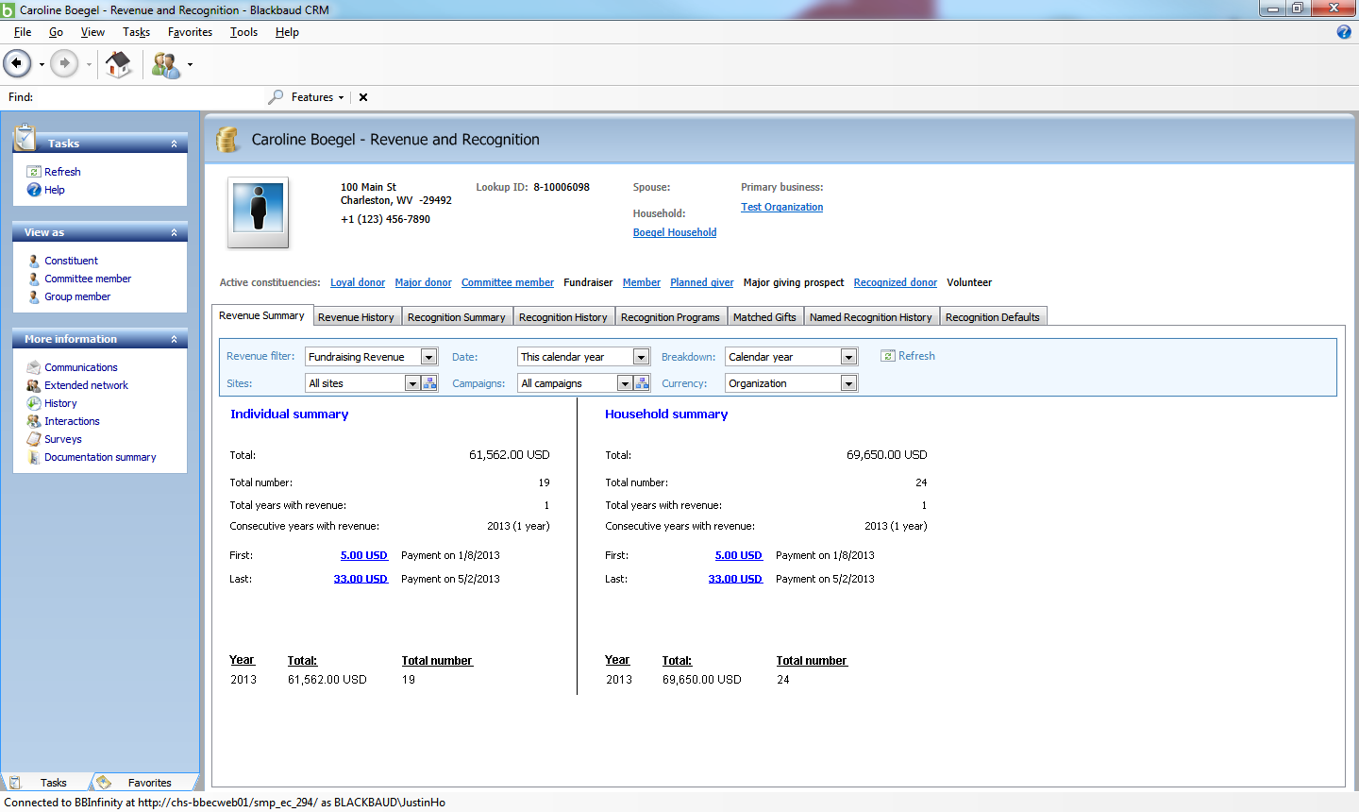
Let’s dive in!
Non-Administrator User, in Click Once
Notes:
-System Role is Class Example 4
-User is BLACKBAUD\JustinHo

Slide 12
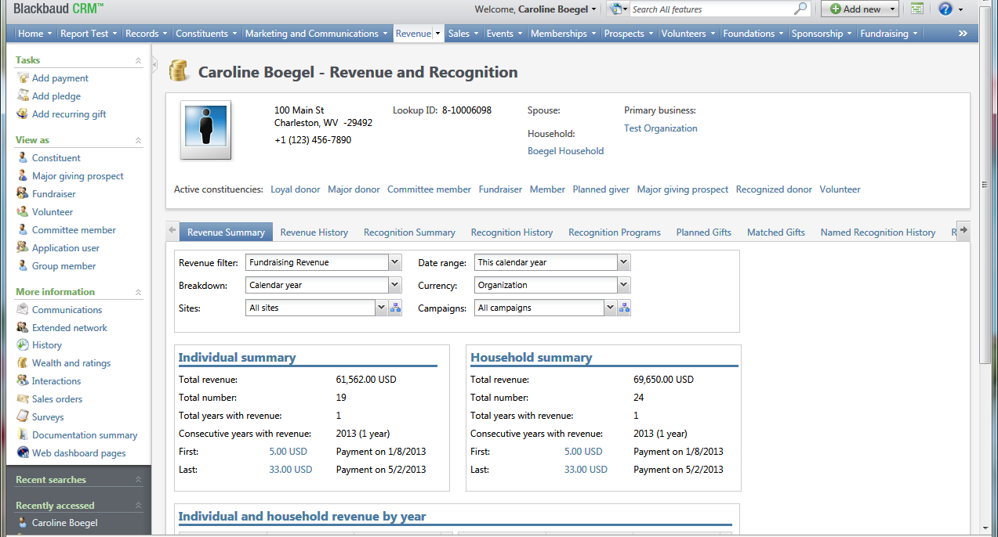
Let’s dive in!
You as Administrator, in Web Shell
Notes:
-System Role is Class Example 4
-User is BLACKBAUD\JustinHo

Slide 13
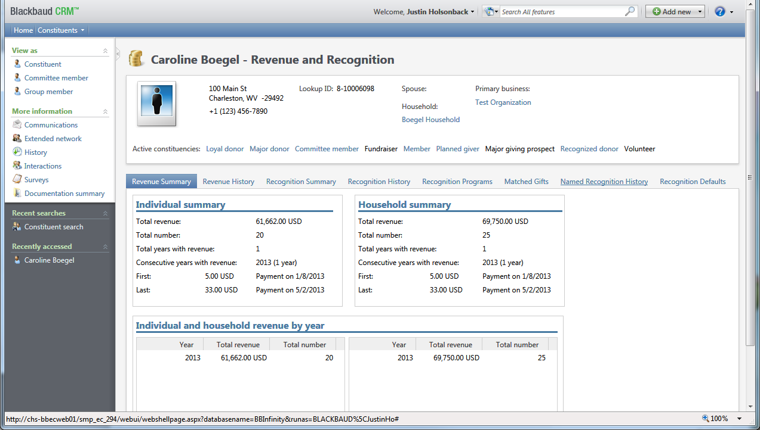
Let’s dive in!
Non-Administrator User, in Web Shell
What’s missing? Where do we start this time?
Notes:
-System Role is Class Example 4
-User is BLACKBAUD\JustinHo
-Missing feature:
Constituents > Constituent Revenue Summary Parameters (view form)

Slide 14
What if I do all of this, and still Can’t figure out the problem??
Contact Support! We’re here to help.
Things to include in your case (to help us fix it for you faster):
Export the system roles you’re testing with and attach them to the case.
What’s the problem? Error message, or something missing or not working?
3. Step-by-step instructions to view the problem.
4. Let us know what you’ve tried so far!
Created a role with ALL Rights and tested that?
Have you tested in Web Shell and Click Once?

Slide 15
Want some Practice to share with your HelpDesk and other users?
We’ll be sending a follow up email after the meeting. This presentation and all system roles used will be attached. You can take the following steps:
Upload the system roles to a non-production environment.
Assign them to a test user account.
Duplicate the error as described.
Use what you’ve learned to troubleshoot and resolve the permissions problem!

Slide 16
Questions? Concerns? Comments?
If you’d prefer, feel free to contact me directly at: caroline.boegel@blackbaud.com

