Slide 1
Power Configuration Tools in Blackbaud CRM
Presented By: Jim Ballou
Moderator: Caroline Barnes

Slide 2
Before we Begin…
I will keep the lines open so that you can ask questions live.
Consider putting yourself on mute from your phone so we don’t have any background discussion
Feel free to ask questions via Chat as well
I will create a follow up Q&A document to address any questions that we aren’t able to answer during the session, for all questions asked live and on Chat
I will be uploading the recording to YouTube following the presentation.
All registrants will receive a follow up email with the following:
PowerPoint slides
Q&A document
Link to YouTube recording
Notes:
Caroline

Slide 3
Screen Designer
Intended for Power Users
NOT for User Preferences
System-wide impact
Ability to clone existing pages
Full control for security and behavior

Slide 4
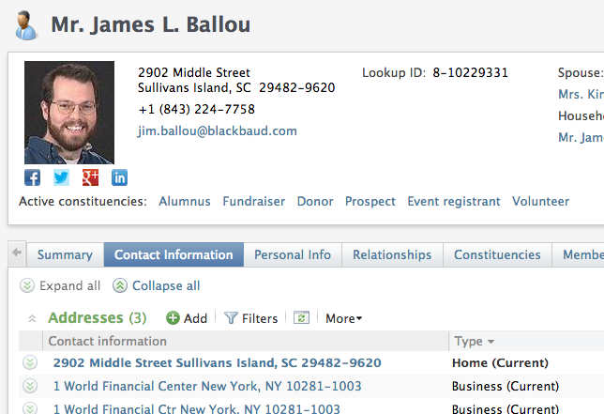
Page Anatomy
All Pages have a standard set of features available
Summary Panel
Tabs
Actions
Page Sections

Slide 5
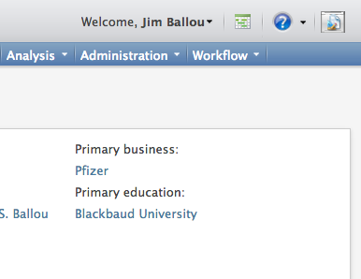
Accessing Page designer mode
Toggle button on top right corner of a page
Not all pages support all aspects of Design Mode

Slide 6
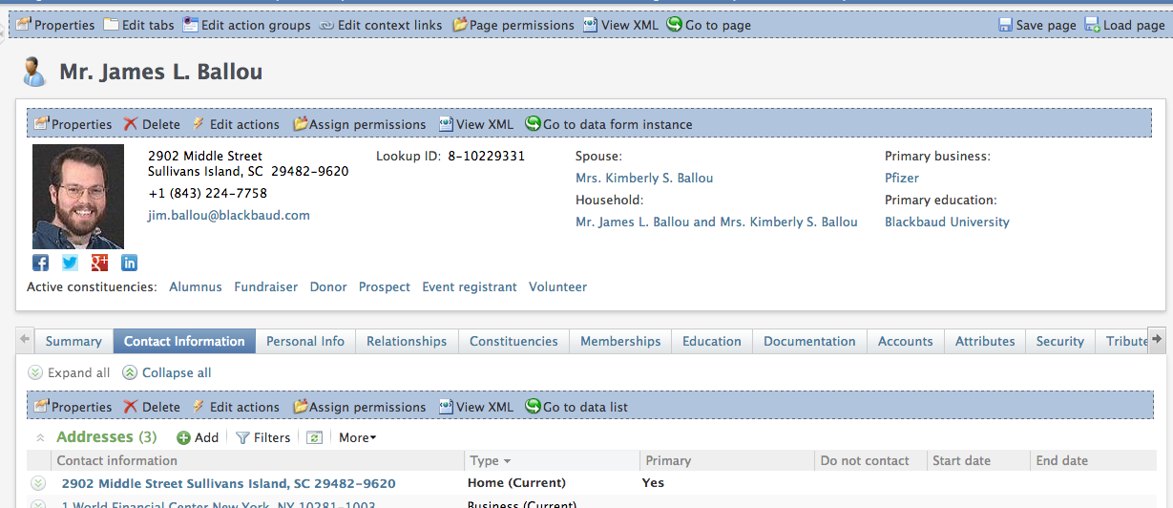
In Design mode
In design mode, configuration and security tools surface

Slide 7
Scenario #1: adding a tab

Slide 8
Scenario #2: custom data Lists

Slide 9
Scenario #3: Creating new pages

Slide 10
Real world examples

Slide 11
resources
https://www.blackbaud.com/files/support/guides/infinitydevguide/Subsystems/infpage-developer-help/Content/InfinityPages/WelcomeInfinityPages.htm
https://www.blackbaud.com/files/support/guides/infinitydevguide/Subsystems/infpage-developer-help/Content/InfinityPageDesigner/coUsingDesignModeToExploreAPageSpec.htm

Slide 12
Questions? Concerns? Comments?
If you’d prefer, feel free to contact us directly at:
Jim.Ballou@blackbaud.com
Caroline.Barnes@blackbaud.com

