Slide 1

API Workshop
Dave Hart: CTO, Convio
Bruce Keilin: Principal Consultant, Convio
November 16, 2009
© 2008 Convio, Inc.
Notes:
Intro/Welcome. I’m Bruce, he’s Dave, but he’s not here…

Slide 2
Agenda
SSO
  Review PHP example in EC2
Donation Kiosk
  JavaScript example showing cross-domain access
AJAX Proxy
  Adding a currency converter to a donation form
Notes:
AJAX Proxy (
Y! search example

Slide 3

Notes:
I really like presentations that are only pictures and no bulleted lists, but it’s really hard when teaching how-to stuff. Bear with me.

Slide 4
Single Sign On
What is it?

Slide 5

Notes:
What is Single Sign On?
Two web sites cooperate to the point that if one site says “I verified that this user is The Dali Lama”, the other site trusts that the user is in fact The Dali Lama.
Both web sites will maintain a user profile and may or may not keep them in synch or share other data.

Slide 6
Single Sign On
What are the basics?

Slide 7

Notes:
Basics of Single Sign On
A clean single sign on requires establishing a relationship between the client browser and both of the web sites involved
Passwords should not pass through one site to be authenticated on the other site

Slide 8


SSO Standards
Notes:
OpenID
Supported by Yahoo, endorsed by Google, Facebook
Allows a user to authenticate using another source
Allows relying party to retrieve some information from the identity provider
The relying party must maintain a linkage of its account ID to the OpenID
SAML
Relying party generates a request for authentication in its response to a request from the user-agent
Identity Provider passes assertions regarding authentication, authorization and attributes in HTTP headers

Slide 9
Issues with SSO Standards
Notes:
Most (probably all) standard implementations redirect to the authenticating party site for the login process whereas most Convio partnerships are creating a seamless web site experience across 2 technologies within the same org.
Most standard implementations do not allow for the creation of new accounts on the fly.
Most don’t support the notion of login not being required but merely a convenience to add personalization to the experience.

Slide 10
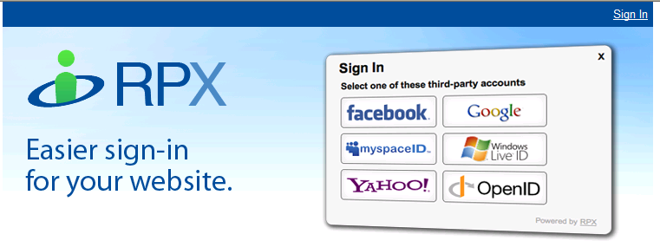
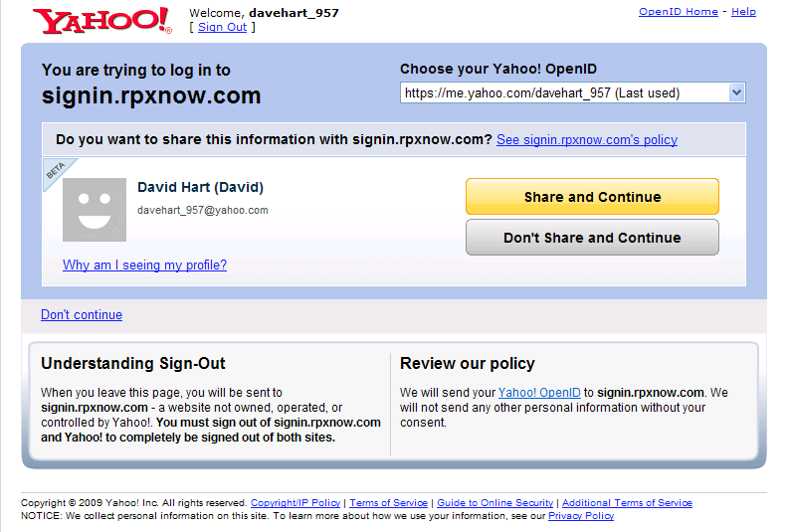
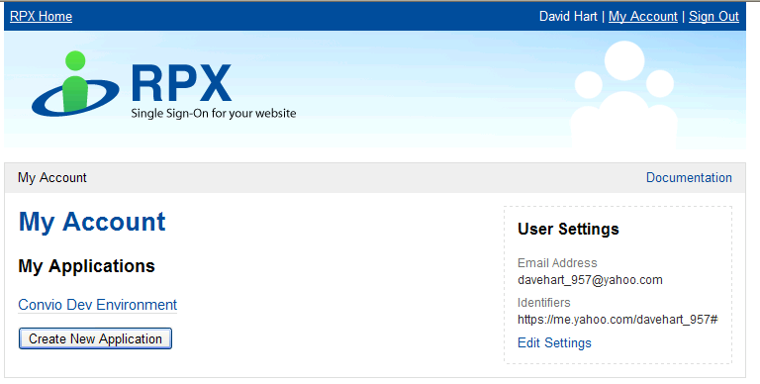
OpenID example
Notes:
Note the redirect to the authenticating party website (Yahoo)

Slide 11

SSO: Convio as master
Notes:
Gratuitous master lock image…

Slide 12

Evolution of SSO: Convio as Master
First generation used shared cookies
Second generation used signed redirects
Current generation signed redirect designs and Convio Open APIs
Notes:
First generation of SSO solutions using Convio as a master depended on sites running in same domain and used shared cookies
Solution was exceptionally brittle
Hacked PageBuilder page simulated the Constituent API
Second generation of SSO used a process of signing redirect URLs created using the NEXTURL feature of the UserLogin process
Solution was much more robust but kludgy to implement (used PageBuilder page with exotic template tags to sign the redirect URL)
The solution also only worked well in the case of a successful login. Errors or forgotten passwords threw the user into the generic Convio login page and resulted in a choppy experience
Latest generation of SSO uses the same basic signed redirect design but all the pieces are implemented in the Convio Open APIs
New methods in the constituent API
New features for using all client APIs
Coverage of a full set of scenarios around login processing

Slide 13
SSO: Previous Generation
Partner site
User Name:
Password:
Login
Convio Server logs user in
PageBuilder page
(hidden from user)
Partner site
Notes:
Form on a partner site is submitted to the UserLogin servlet on a Convio-powered site.
2. NEXTURL argument redirects to second Convio-powered page that reforms the URL pointing back to the partner site.
Convio-powered page uses a JavaScript onload or a meta refresh to pass additional arguments to a URL on the partner-powered site:
t=[timestamp generated by Convio server]
cons_id=[ID of the constituent who is logging in]
sig=[MD5 hash of the other two plus a shared secret]

Slide 14

SSO: Modern Approach Advantages
Notes:
Advantages
Partner system uses APIs not UserLogin servlet
Completely productized and supported
Partner site controls error processing
No need for PageBuilder hack
No visible client-side redirection during login process
Support for logout and forgotten password
Support for testing to see if user is already logged in or has “remember me” cookie
Leverages same basic flow, so easy to convert old model SSO using signed redirects
Login API is secure and POST-only ensuring that passwords are kept confidential
Proper use establishes session cookies on both secure and insecure channels automatically

Slide 15
SSO: Latest Generation
Partner site
LoginTest API
Partner site
User Name:
Password:
Login
Login API
Redirector
Partner site
Notes:
Partner site first does a loginTest call to see if the user is already logged in or has remember me set.
If not, the partner site displays a login box.
The form submits to CRConsAPI with method=login and success_redirect and error_redirect arguments pointing back to partner site.
The login method processes the login and throws a double redirect through the insecure channel to make sure that a session is established back to the partner site.
The partner site verifies the signature and timestamp of the redirect URL and processes the cons_id that is returned.

Slide 16
SSO methods in Constituent API
Login
Login (send_user_name=true)
Logout
LoginTest
AuthenticateUser
Notes:
Login
This method takes a user_name and password argument and authenticates them against the Convio database
Client version of the API will actually create a logged in session and return the cons_id to the caller (via the redirect URL)
Login (send_user_name=true)
This method takes an email address argument and sends an email to that address containing the user_name and password if the user has previously registered
Logout
Logs the user out of the Convio system
LoginTest
Client-only method that returns a cons_id if the user is already logged in or could be logged in because of a “remember me” cookie.
Supports HTTP GET requests so that it can be invoked via a redirect
Should be invoked on insecure channel since that is most likely channel for an already established session
AuthenticateUser
Similar to login, but uses an organization-specific combination of attributes (e.g. membership number and zip) to authenticate the user.

Slide 17
Useful features in all client APIs
Signing redirect URLs
Automatic redirection via insecure channel
Substitution of request parameters in redirect URLs
Substitution of response elements in redirect URLs
Notes:
Signing redirect URLs
All client APIs allow specification of redirect URLs so that the APIs can be invoked without using AJAX
All client APIs support specification of a success_redirect and an error_redirect
The sign_redirects option allows the target to verify that the request did in fact come from the Convio-powered system
The URL is signed by adding a timestamp to the query string, then calculating an MD5 hash of the URL query string plus the CONVIO_API_SECRET_KEY and appending that to the query string
Site can also be configured to use SHA-1 encryption (as of Shasta)
Automatic redirection via insecure channel
Fixes a common problem in that calling the secure API does not establish a session on the insecure channel
Substitution of request params in redirect URLs
Request parameters can be substituted into the redirect URL by specifying ${paramname} as the value of a query string parameter in the URL
Useful for redisplaying the data that was entered
Does not allow password, credit_card, etc. to be passed in the URL
Substitution of response elements in redirect URLs
Any value that would normally be returned in the response XML can be substituted into the redirect URL
Response values use xpath syntax to identify the value from the response XML (e.g. error_code=${erorResponse/code})
Necessary for error handling, displaying confirmation codes, retrieving cons_id

Slide 18

Time to read code!

Slide 19
Scenario 1: Establishing a session
Problem:
First visit to partner site. Need to establish a session.
Solution:
Redirect to:
  http://[org]/site/CRConsAPI?method=loginTest
  &api_key=<key>&v=1.0
  &sign_redirects=true
  &success_redirect=<page>?cons_id=${loginResponse/cons_id}
  &error_redirect=<page>?cons_id=0
Upon return, verify signature and, if cons_id != 0, log the user in
Notes:
(Problem:) When a user comes to the partner system for the first time, the system establishes an initial session
It wants to check with Convio to see if the user can be logged in via “remember me” cookie or if the user was already logged in to the Convio system
Show PHP example:
1. http://ec2-174-129-91-236.compute-1.amazonaws.com/ shows Guest.
2. Login to CRM @ http://cmss.convio.net/site/UserLogin
3. Clear ec2 cookie
4. Reload; shows Bruce

Slide 20
Scenario 2: Access to restricted content
Problem:
User requests protected resource.
Solution:
Redirect to:
  http://[org]/site/CRConsAPI?method=loginTest
  &api_key=<key>&v=1.0
  &sign_redirects=true
  &success_redirect=<page>?cons_id=${loginResponse/cons_id}
  &error_redirect=<login page>
Upon return, verify signature and, if cons_id != 0, log the user in
If still not logged in, redirects to a login page on the partner site
Notes:
(Problem) A user makes a request for content that is only available to registered users and is not currently logged in
Partner system wants to check with Convio to see if the user can be logged in via “remember me” cookie or if the user was already logged in to the Convio system
Click on members only link (http://ec2-174-129-91-236.compute-1.amazonaws.com/protected.php)
It pops up the sign-in form

Slide 21
Scenario 3: Login Process
Problem:
Need to authenticate username/password.
Solution:
Form should post to this URL:
  https://securex.convio.net/[org]/site/CRConsAPI
Hidden inputs
  api_key=<key>,v=1.0,method=login,sign_redirects=true
  success_redirect=<page>?cons_id=${loginResponse/cons_id}
  error_redirect=<login page>
  ?code=${errorResponse/code}
  &message=${errorResponse/message}
Input fields
  <input name=user_name type=text>
  <input name=password type=password>
  <input name=remember_me type=checkbox>
Notes:
(Problem) A user enters a username and password on a page rendered by the partner site. The partner wants to authenticate with Convio and redirect to a content page if successful and back to the login page if the authentication was not successful.
Show PHP code:
1. Login page: from previous step
2. Submit form

Slide 22
Scenario 4: Logout Process
Problem:
Use logs out of partner site
Solution:
Form should post to this URL:
  https://securex.convio.net/[org]/site/CRConsAPI
Hidden inputs
  api_key=<key>,v=1.0,method=logout,sign_redirects=true
  success_redirect=<logout processor>
  error_redirect=<logout processor>
Upon return, partner system should process its logout and then redirect the user to some appropriate page
Notes:
(Problem) A user wants to logout of the partner system and expects to be logged out of the Convio system at the same time.
Show PHP code
1. Click logout button at bottom of page

Slide 23
Scenario 5: Forgotten Username/Password
Problem:
User forgot password.
Solution:
Form should post to this URL:
  https://securex.convio.net/[org]/site/CRConsAPI
Hidden inputs
  api_key=<key>,v=1.0,method=login,sign_redirects=true
  send_user_name=true
  success_redirect=<login page>?password_sent=true
  error_redirect=<login page>
  ?code=${erorResponse/code}
  &message=${errorResponse/message}
Input fields
  <input name=email type=text>
Notes:
(Problem) A user needs to retrieve his/her username and password from the system via email.
NOTE: If an unregistered email address is provided, the API does not respond with an error, it sends an email to that address saying that it is not registered to prevent attempts to mine constituents
Show PHP code
See “forgot password” link at bottom of sign-in page

Slide 24
Scenario 6: Alternate authentication
Problem:
User needs to log in for 1st time w/ member ID
Solution:
Form should post to this URL:
  https://securex.convio.net/[org]/site/CRConsAPI
Hidden inputs
  api_key=<key>,v=1.0,method=authenticateUser
  sign_redirects=true
  success_redirect=<page>?cons_id=${loginResponse/cons_id}
  error_redirect=<login page>
  ?code=${errorResponse/code}
  &message=${errorResponse/message}
Input fields are based on site-specific configuration in the Constituent Database (Use for Authentication flag)
Notes:
(Problem) A user is in the database but has never logged in to the system. He has a membership card that uniquely identifies his account information and is considered relatively secure
Figure out if this is complete or if we need more sample hidden inputs

Slide 25
</Time to read code!>
Notes:
Done reading code, but not done w/ SSO

Slide 26

SSO: Convio as client

Slide 27
Key Points
Far less common than “Convio as master”
Partner site will handle all authentication
Useful in closed community
  alumni group
  association
Usable when partner system handles registrations

Slide 28
SSO: Convio as client
Uses the getSingleSignOnToken and singleSignOn methods
getSingleSignOnToken is server-only
singleSignOn is client-only
Notes:
SSO where Convio is the client uses the getSingleSignOnToken and singleSignOn APIs
getSingleSignOnToken is a server-only API
Must be called from a trusted host (based on IP address)
Caller passes in a cons_id (or member_id) for an end user in the Convio database and gets back a token that can be used to login as that user
The token expires after 15 minutes
singleSignOn is a client-only API
Called from the browser with the token that came from the server-side API to log the user in -- typically by throwing a redirect or linking rather than via AJAX.
Additional parameters include a next URL to redirect to after the login is completed

Slide 29
SSO: Convio as client
Partner site presents a login form that submits username and password to the partner site, authenticates the user, logs him in and retrieves the Convio ID from its database.
Partner site calls the getSingleSignOnToken API passing the ID that it retrieved.
Normally, the partner site would redirect to its own page (say http://www.example.org/index.html) but instead sends a redirect to the Convio singleSignon API (http://member.example.org/site/CRConsAPI)
  method = singleSignOn
  sso_auth_token = value retrieved via server call
  redirect = http://www.example.org/index.html
The browser will make a request to the Convio system, which will log the user in, push a session cookie and throw a 302 redirect back to the partner site.
Subsequent requests to the Convio powered site will connect as the user because of the session cookie that was pushed earlier.
Additional client-side API requests can include the sso_auth_token to verify that the request is coming from a trusted system.
Notes:
I THINK THIS IS REDUNDANT WITH THE NEXT (NICER) SLIDE
Partner site presents a login form that submits username and password to the partner site, authenticates the user, logs him in and retrieves the Convio ID from its database.
Partner site calls the getSingleSignOnToken API passing the ID that it retrieved.
Normally, the partner site would redirect to its own page (say http://www.example.org/index.html) but instead sends a redirect to the Convio singleSignon API (http://member.example.org/site/CRConsAPI)
method = singleSignOn
sso_auth_token = value retrieved via server call
redirect = http://www.example.org/index.html
The browser will make a request to the Convio system, which will log the user in, push a session cookie and throw a 302 redirect back to the partner site.
Subsequent requests to the Convio powered site will connect as the user because of the session cookie that was pushed earlier.
Additional client-side API requests can include the sso_auth_token to verify that the request is coming from a trusted system.

Slide 30
SSO: Convio as client
Partner site
User Name:
Password:
Login
Partner site
GetSingleSignOnToken
http: SingleSignOn
https: SingleSignOn
Partner site
Notes:
NOTES FROM TEXT-ONLY VERSION OF THIS SLIDE:
Partner site presents a login form that submits username and password to the partner site, authenticates the user, logs him in and retrieves the Convio ID from its database.
Partner site calls the getSingleSignOnToken API passing the ID that it retrieved.
Normally, the partner site would redirect to its own page (say http://www.example.org/index.html) but instead sends a redirect to the Convio singleSignon API (http://member.example.org/site/CRConsAPI)
method = singleSignOn
sso_auth_token = value retrieved via server call
redirect = http://www.example.org/index.html
The browser will make a request to the Convio system, which will log the user in, push a session cookie and throw a 302 redirect back to the partner site.
Subsequent requests to the Convio powered site will connect as the user because of the session cookie that was pushed earlier.
Additional client-side API requests can include the sso_auth_token to verify that the request is coming from a trusted system.

Slide 31

Hybrid Solutions
Notes:
When do Hybrid Solutions make sense?
Client has a private members-only site not hosted on Convio (e.g. for an association)
Client has an established social network where passwords cannot be exported and does not want to force new passwords on members
Typical Configuration
Convio application is used for email marketing and some set of transactional applications
Convio is expected to honor authentication provided by the partner system without requiring an additional
Sometimes, the partner system will honor authentication provided by Convio; usually, it will require its own authentication as a necessary step.

Slide 32
Implementing a hybrid solution
Custom login screen
  Convio credentials
  Partner credentials
Can hide choices
  Submit to Convio
  Fail? Submit to partner
Partner login must support “nexturl”
Partner login should support success and error redirect URLs
Documentation available
Notes:
A custom login screen should be used that offers the user the alternative of logging in using either Convio credentials or partner credentials.
If desired, this form can attempt to login first by posting to the partner login form and then attempt the Convio login only in the event of a failure from the partner.
The partner login needs to support the passing of a “nexturl” to redirect to in order to support this, and should ideally support both a success and error redirect URL.
Documentation available describing all the scenarios that need to be covered.

Slide 33


Slide 34

Donation Kiosk
Project Requirements
Demonstration
Design Overview
Fetching content from Convio via JavaScript
Cross-domain AJAX with Convio JavaScript API
Questions?
34
Notes:
Dave to lead 30-45 minute tutorial & 30-45 minute class exercise
34

Slide 35
Donation Kiosk – Project Requirements
35
Donation form embedded in third-party website that will be used in multiple information kiosks at an event
Needs to clear out personal information after a donation is made
Needs to stay on the page being viewed during and after the donation
Needs to take on the look and feel of the page being viewed
Needs to be easy to add to many different pages in either the body of the page or in a sidebar
Notes:
Dave to lead 30-45 minute tutorial & 30-45 minute class exercise
35

Slide 36
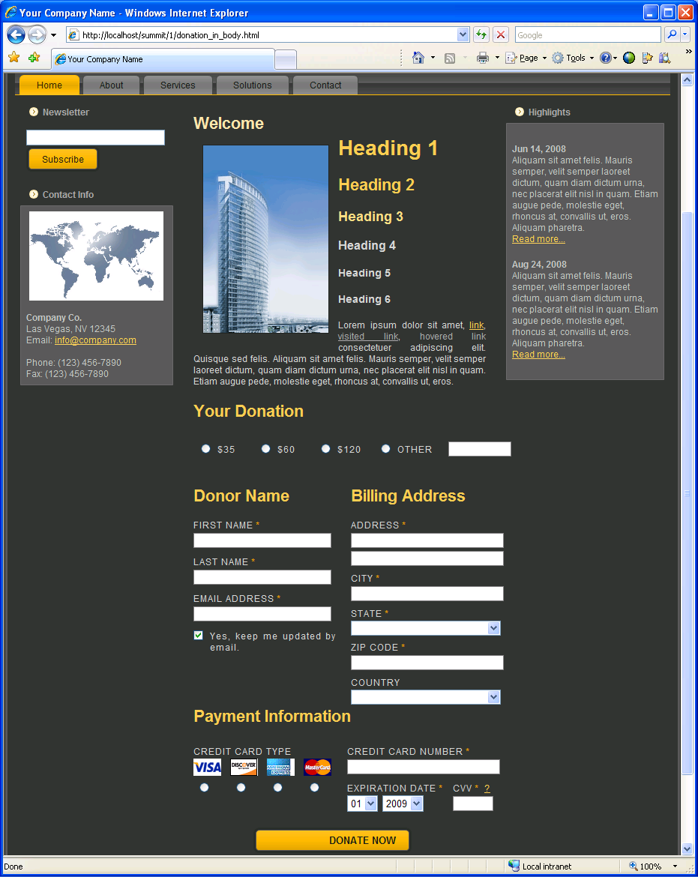
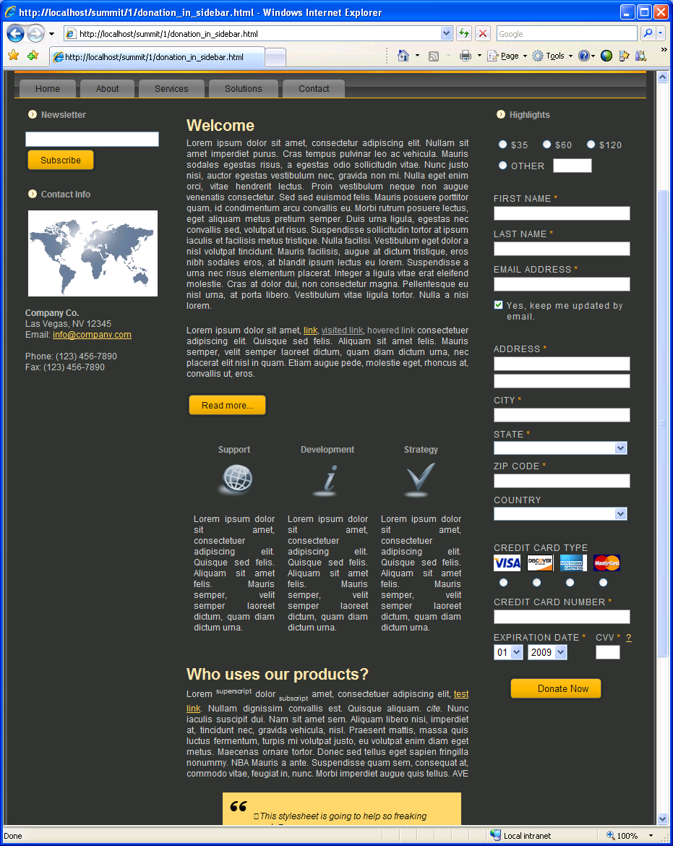
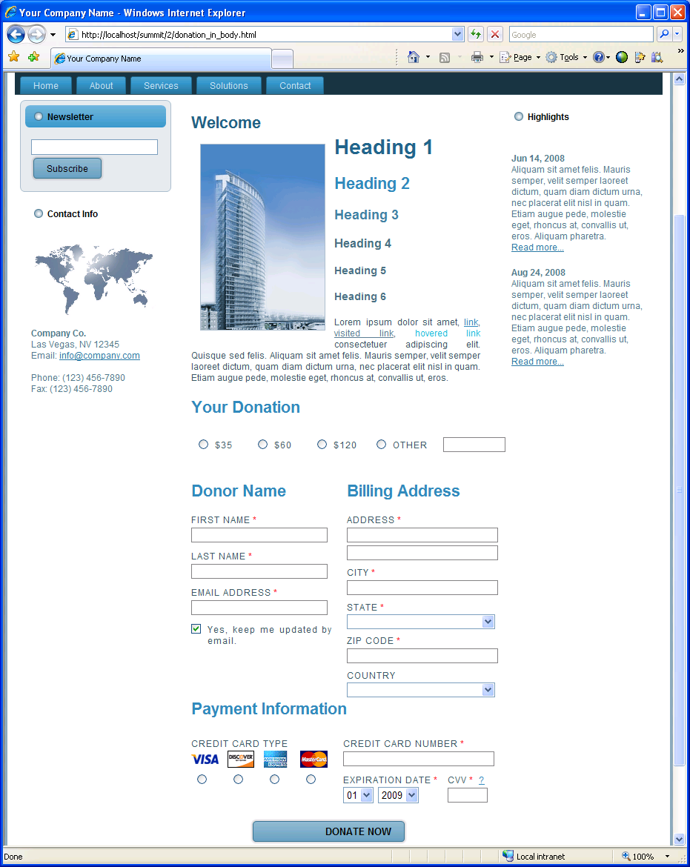
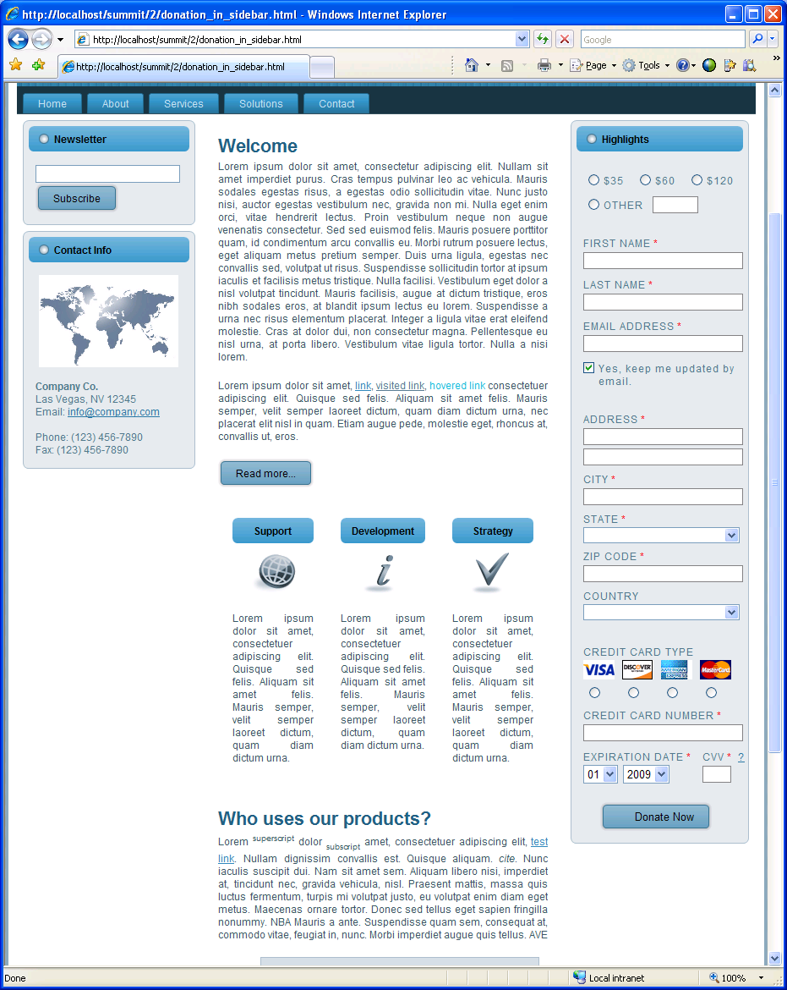
Donation Kiosk – Demonstration
36
Notes:
Dave to lead 30-45 minute tutorial & 30-45 minute class exercise
36

Slide 37
Donation Kiosk – Design Overview
Donation form HTML
  PageBuilder page that is pulled dynamically via JavaScript by the host page
JavaScript libraries
  Donation Form Helper (for validation, etc.)
  Dialogs (windows.js used; anything will work)
  ConvioAPI.js (for the actual AJAX calls)
CSS layout
  Two layout CSS files created for the form alternatives
37
Notes:
Dave to lead 30-45 minute tutorial & 30-45 minute class exercise
37

Slide 38
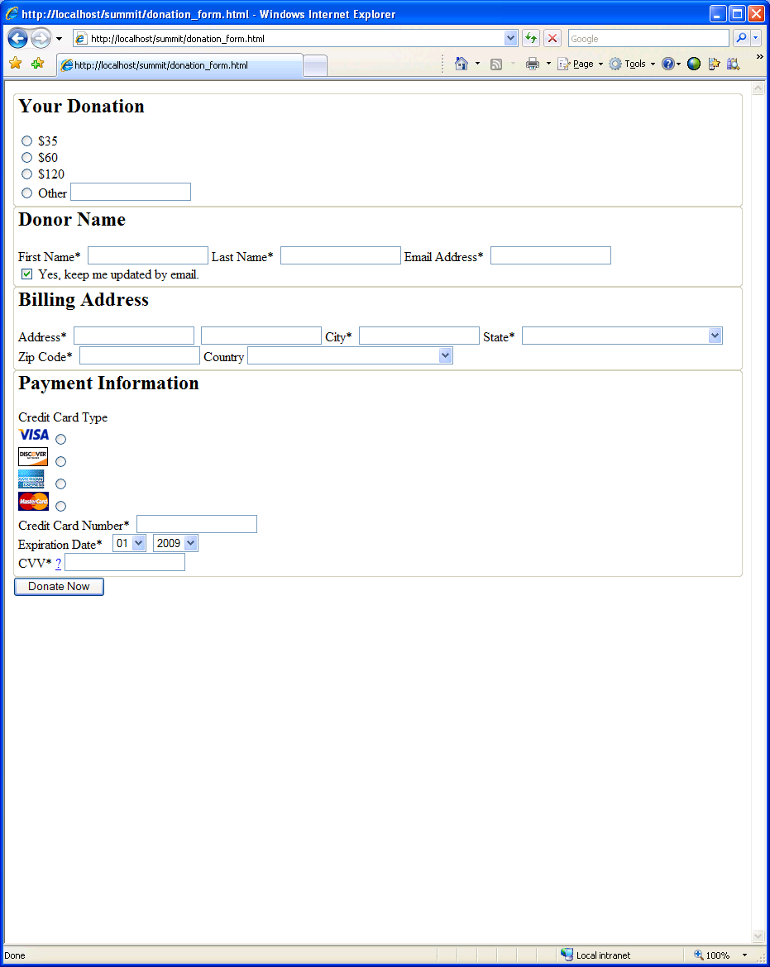
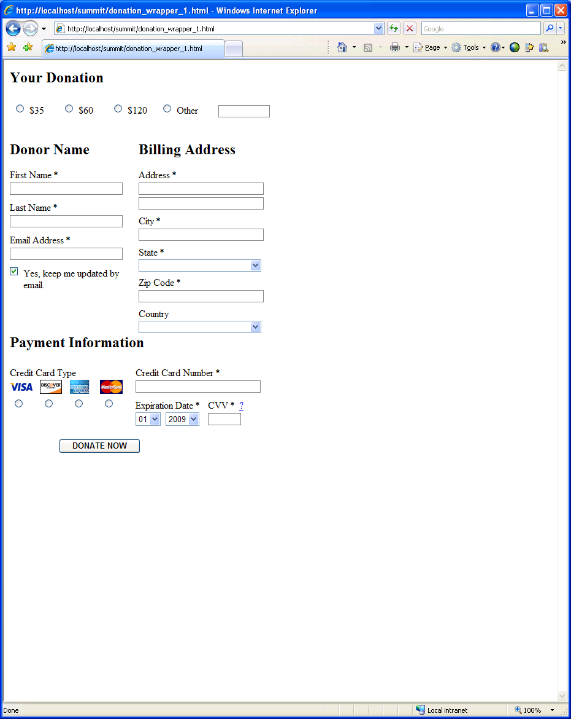
Donation Kiosk – Design Overview
Start with donation_form.html
Apply layout styling to make the form fit in body or sidebar
Embed in web page and take on the look and feel of that page
Embed in a different web page and take on that look and feel
38
Notes:
Dave to lead 30-45 minute tutorial & 30-45 minute class exercise
38

Slide 39
Fetching content from Convio via JavaScript
Create a PageBuilder page with this content named ContentFetcher
var page='[[T6:[[S334:render]]]]';
var target='[[T6:[[S334:target]]]]';
var content='[[T6:[[E51:[[S334:render]]]]]]';
function set_[[T6:[[S334:target]]]]_to_[[T6:[[S334:render]]]] () {
document.getElementById(target).innerHTML = content;
}
if (window.addEventListener) {
window.addEventListener ('load',
set_[[T6:[[S334:target]]]]_to_[[T6:[[S334:render]]]], false);
}
else if (window.attachEvent) {
window.attachEvent('onload', set_[[T6:[[S334:target]]]]_to_[[T6:[[S334:render]]]] );
}
39
Notes:
Dave to lead 30-45 minute tutorial & 30-45 minute class exercise
39

Slide 40
Fetching content from Convio via JavaScript
Add this to the container web page
<script language="JavaScript" type="text/javascript" src="http://localhost/site/PageServer?pagename=ContentFetcher
&pgwrap=n&render=donation_form&target=donation_form">
</script>
…
<div id="donation_form"></div>
pgwrap=n indicates no page wrapper
Note that any scripts will immediately run and the contained content has full access to the container page
40
Notes:
Dave to lead 30-45 minute tutorial & 30-45 minute class exercise
40

Slide 41
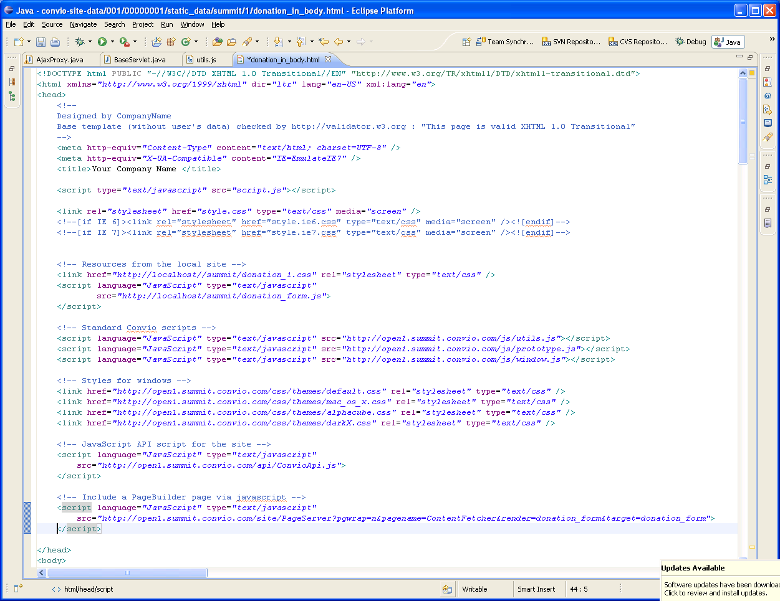
The final HTML

Slide 42
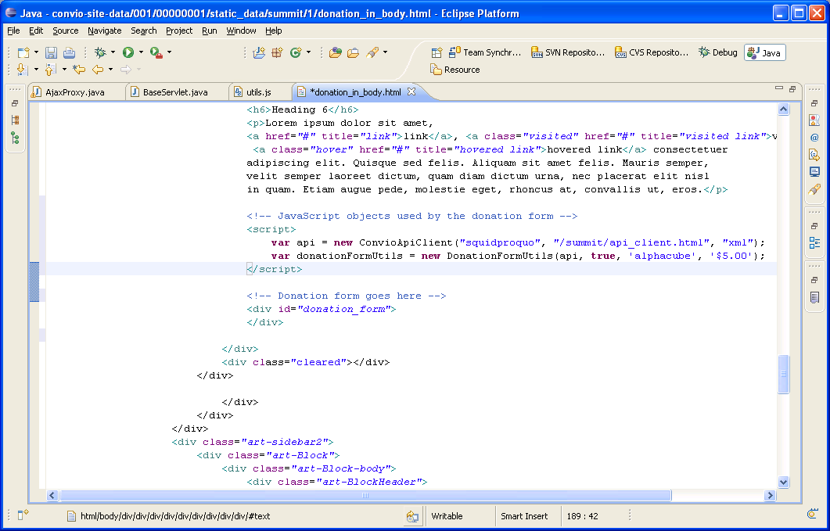
The final HTML

Slide 43
Cross-domain Access to Convio APIs
What is cross-domain access?
  At it’s simplest, it is just getting data from one web site and displaying it within a page from a different web site
  In more complex scenarios, it involves constructing business process that both read and update data on different web sites including sensitive data that may be tied to the specific user who is performing the transaction
  Example:
Web page on site A
Request for data (HTTP GET)
Web server on site B
Response (XML or JSON)
Update action (HTTP POST)
Response (XML or JSON)

Slide 44
Why is it so hard?
It’s hard to do because it has to be done securely.
  When the request comes to site B from a page on site A, it looks to site B like it came directly from your browser.
  Remember that the content you receive from a web server is a mixture of instructional code (e.g. Javascript) and data (e.g. HTML content).
  If the browser gave site A and site B access to each other’s content, then an evil site can steal or manipulate the data from the good site.
Isn’t this old news?
  The problem is as old as the web, and was initially solved in Netscape Navigator 2.0 with the same origin policy.
  Web pages used simple techniques like frames to pull together content from multiple sites.
  The solution worked fine with the web of the 90s, but now people want rich user interfaces .

Slide 45
What is the Same Origin Policy?
This is a limitation in all browsers that prevents a document or script loaded from one "origin" from getting or setting properties of a document from a different "origin".
Origin means the combination of domain, protocol (https or http) and port, so it applies to content that is from the same domain but some is served securely and some is not.
This policy prevents hostile code from one site from “taking over” or manipulating documents from another. Without it, Javascript from a hostile site could do any number of undesirable things such as snoop keypresses while you’re logging in to a site in a different window, wait for you to go to your online banking site and insert spurious transactions, steal login cookies from other domains, and so on.
This is not a “bug” or an implementation problem. It is an inherent limitation in the protocol because there’s no distinction between data and code.

Slide 46
What is AJAX?
AJAX is short for Asynchronous Javascript and XML (Extensible Markup Language)
With AJAX, web applications can retrieve data from the server asynchronously in the background without interfering with the display and behavior of the existing page.
XMLHttpRequest (XHR) is the API that can be used by Javascript in AJAX application to transfer XML and other text data between a web server and a browser.
Besides XML, data is also frequently exchanged in a more compact format called JSON (Javascript Object Notation).
The same origin policy prevents AJAX from being used across domains. Browsers will block the XMLHttpRequest when it is going across domains.

Slide 47
How do Mashups get around this policy?
Server-side proxies
Flash
JSONP (JSON with padding)
Javascript libraries using hidden iframes

Slide 48
Server-side pass through or proxy
Can’t go directly from web page on site A to server on site B, so you go through a proxy service on site A
  Web page from site A makes an AJAX call to a service on site A using an XMLHttpRequest
  Since this is within the same origin, it is okay
  The service on site A acts as a proxy and forwards it to site B which then responds.
  The service on site A then replies back to the browser with the response it got from site B.

Slide 49
Server-side proxies
Advantages
  Fairly easy to implement.
  Can be done in any server-side programming language.
  Some third-parties (like Google pages or IGoogle) have it built into their Javascript libraries.
Disadvantages
  Requires server-side programming, which may not be possible in some environments.
  Does not establish a connection between the browser and the service provider, so it’s difficult to create a seamless experience if the user can also navigate to the service provider site directly.
  Data has to pass through the both systems creating a potential security exposure (definitely a PCI DSS problem).

Slide 50
Using server-side proxies with Convio APIs
The APIs support separate Client and Server versions
Server APIs generally simulate administrator level privileges whereas Client APIs generally act with the privileges of an individual user or as the “anybody” (i.e. not logged in) user.
Server APIs use username/passwords on the request as well as IP address restrictions to verify that the request is coming from a trusted origin.
There is no support for server APIs where sensitive information (e.g. passwords, credit card numbers) would pass from the browser to the 3rd party server and then on to the Convio server. This is why there is no version of the Donation API for server-side.

Slide 51
Flash and Cross-domain Access
The Flash Player from Adobe (originally Macromedia) has its own security model.
  The default behavior is that cross-domain access is restricted to the same origin policy
  This can be overridden by the web site administrator by creating a policy file – the crossdomain.xml file.
  The crossdomain.xml file lists the other domains that can access resources at or below the level where that file exists.
  The domain being checked is the domain of the web page hosting the Flash movie not the domain that the Flash movie came from.

Slide 52
Flash and Cross-domain Access
Advantages
  Allows the service provider to specify which sites can access which services
  Flash player is 90% ubiquitous
  Flash proxy that allows access from Javascript is available
Disadvantages
  Flash player is only 90% ubiquitous
  Unless the domain is used exclusively for API access (like the Yahoo example), opening up access with a root level crossdomain.xml file is a big security problem.
  If the policy file is not at the root level of the web server, then clients need to explicitly load the relevant policy files.

Slide 53
Using Flash Player with Convio
Convio automatically creates a policy file for each of the APIs so that they can be accessed using Flash from other domains.
  To load the policy file for the CRConsAPI on organization xyz, you would use this URL:
  https://secure2.convio.net/xyz/site/CRConsAPI/crossdomain.xml
  The list of sites that should be allowed access is controlled by a site data parameter
  The policy for each API needs to be loaded separately by the Flash movie
  Calls to the API need to include a trailing slash (e.g. CRConsAPI/?v=1.0… not CRConsAPI?v=1.0…
Policy files that allow broader access are not allowed
  The APIs are secure by design so they require more than cookie authentication to disclose information.
  A meta-policy at the web server’s root enforces this constraint.

Slide 54
JSONP and Cross-domain access
JSONP or JSON with padding is a technique where a JSON object is wrapped with a function call by the server.
  Takes advantage of the fact that scripts from another domain can be executed if they are loaded by a <script> tag in the head element of a web page
  The web page uses javascript to dynamically insert the script tag into its own head element.
  The script tag calls the API with a special parameter (typically “callback”) that is then wrapped around the results (e.g. instead of {“data”} the return looks like myMethod({“data”}));
  The callback method is invoked when the API call returns and it can actually read and process the data.
This technique is also called script injection

Slide 55
JSONP and Cross-domain access
Advantages
  Very quick (and dirty)
  Pretty well understood in the community
  Many popular APIs support JSONP
Disadvantages
  Should only be used for read-only data because the script call will always be a GET operation
  Should not be used for any personalized data without additional security measures (i.e. don’t trust cookies)
  Not that easy to create a smooth AJAX experience
Not supported with Convio APIs
  We felt that this was too open to cross-site request forgeries to support with the Convio APIs

Slide 56
Javascript APIs using hidden iframes
Relatively new technique that emerged in early 2007.
Being widely adopted by companies like Microsoft, Google, Facebook, etc..
Basic principals of communication between frames
  Frames from the same origin can communicate with each other
  The only communication that is allowed between frames of a different origin is that the parent frame can set the location (i.e. the URL) of the child frame or via postmessage with HTML 5.
  The parent cannot read the location or any of the content within the child frame.
  Changing the location of the frame causes its “onload” action to be invoked, but changing the portion that follows the hash (#) does not cause a refresh of data from the server.

Slide 57
Hidden iframes (HTML 4)
Communication involves the main window, a child iframe from the server and a grandchild iframe on the same domain as the main window
HTML page served by site A
  Creates a hidden iframe from site B
  Passes a message to the frame by encoding it in
  the frame location following the #
  The message contains an API to call
  and a callback method to invoke on completion.
Site B Server
Hidden iframe on site B
  Reads the message from its location
  Makes the XHR call to its server
  Creates another hidden iframe on site A
  and passes the response in its location
Hidden iframe on site A
  Reads the response from its location
  Invokes the original callback with the
  response message

Slide 58
Hidden iframes (HTML 5)
Postmessage allows one window to send a message to another window
Windows register to receive message events
Supported in Opera 10, Chrome, Firefox 3 and Internet Explorer 8
HTML page served by site A
  Registers a message event listener
  Creates a hidden iframe from site B
  Passes a message to the frame using postmessage
  Processes the response message
Site B Server
Hidden iframe on site B
  Registers a message event listener
  Receives the request message
  Makes the XHR call to its server
  Passes the response back to the main
  window using postmessage

Slide 59
Javascript APIs using hidden iframes
Advantages
  An elegant solution that does not compromise the same origin policy and is compliant with HTML 5 while still working on older browsers
  Supports both POST and GET methods
  Because protocol uses directed messages rather than a request/reply semantics, the service provider can really know the identity of the calling site
Disadvantages
  Does require that you can create a static HTML page on the calling system for the grandchild frame to support older browsers

Slide 60
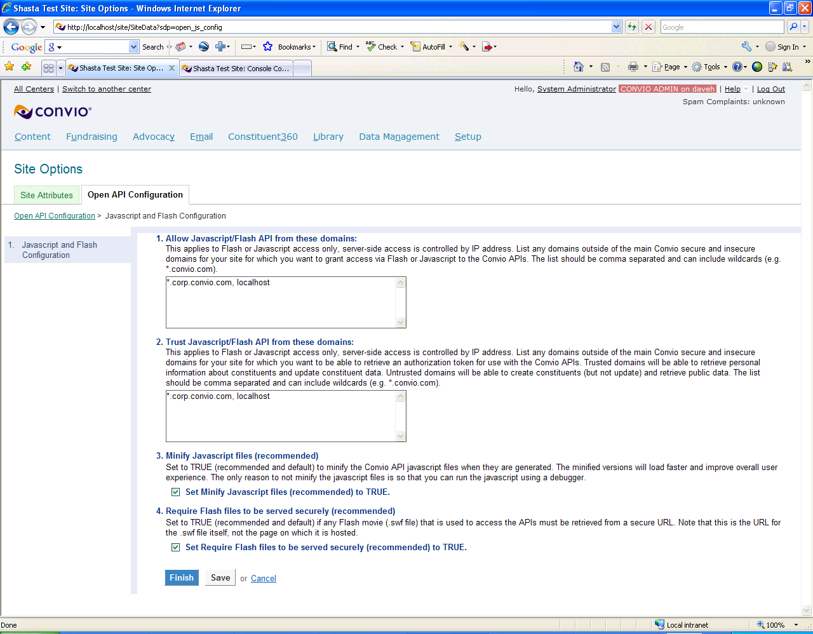
Javascript APIs and Convio
Convio is providing a Javascript library that uses this technique to allow access to APIs from outside domains
Prerequisites for using the API
  Include ConvioApi.js in the web page where you want to call the API
  Copy the HTML from api_client.html to a page in the same domain as where you will be calling the API
Configuring the API
  The API files are dynamically created for each client site
  The list of domains from which to accept API calls is managed via a Site Data parameter (also controls Flash access)
  The API files will be in the /api directory under the site’s root

Slide 61
Calling the Convio Javascript API
Create a ConvioApiClient object.
  var apiKey = "123";
  var format = “json";
  var clientChannel = "/api/api_client.html";
  var api = new ConvioApiClient(apiKey, clientChannel, format);
Setup a callback method to be invoked on completion (arguments are response and status)
  function getUserComplete (responseObject, status) {
    var email = '';
    if (status == 200) {
    email = responseObject.getConsResponse.email.primary_address;
    }
    else {
    alert ("Error calling API, status = " + status);
    }
  }
Call the API with the method, callback and additional arguments
  api.callConsAPI('getUser', getUserCompleteXml, 'fields=email');

Slide 62
AJAX Proxy
Project Requirements
How it works
Is it a security risk?
How to configure it
Demonstration
Questions?
62
Notes:
Dave to lead 30-45 minute tutorial & 30-45 minute class exercise
62

Slide 63
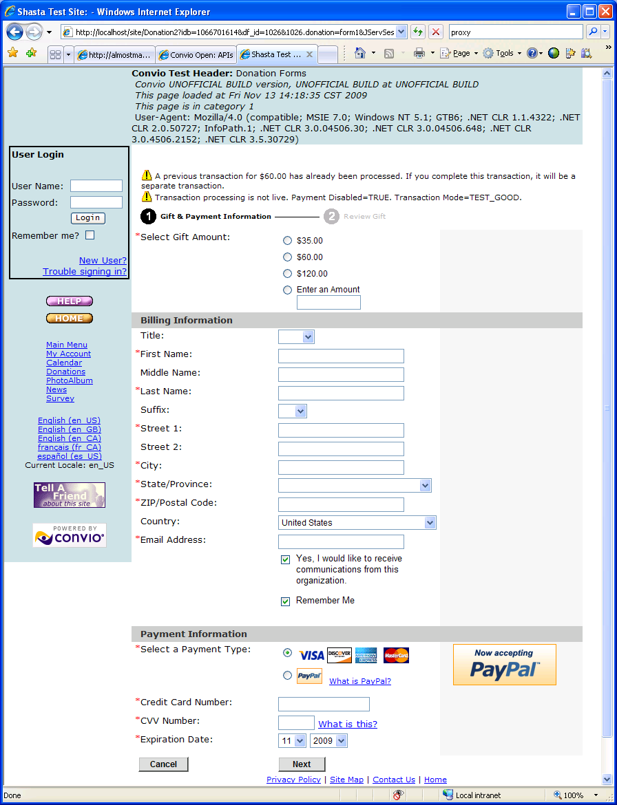
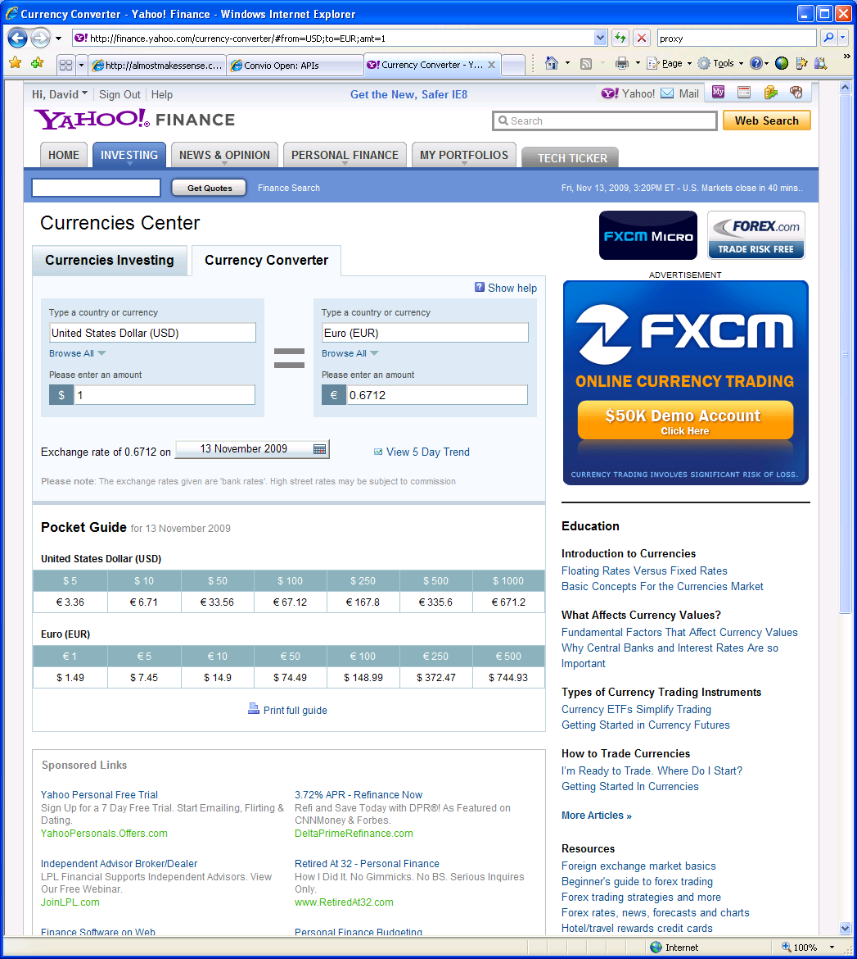
Add multi-currency to a donation form
+
Notes:
Dave to lead 30-45 minute tutorial & code review of AJAX Proxy example
Y! Search

Slide 64
How does the AJAX Proxy work?
Instead of calling the service directly, call AjaxProxy via your preferred AJAX library
  Pass the real URL in the argument cnv_url
Proxy service forwards the request
  Same HTTP method (POST or GET)
  All query string and POST arguments
    ${client_ip} will be replaced with the client IP address
  All HTTP headers (except…)
    Cookies only if configured and same domain
    Host header is modified to reflect the target

Slide 65
Is the AJAX Proxy a security risk?
Requires auth token avoid being an open relay
  Render auth token using [[S86]] tag
  Means the proxy can only be used from a Convio-powered page
Proxy access limited to the sites that you specify
  Open API configuration lets you limit the proxy service to only those sites that you are leveraging

Slide 66
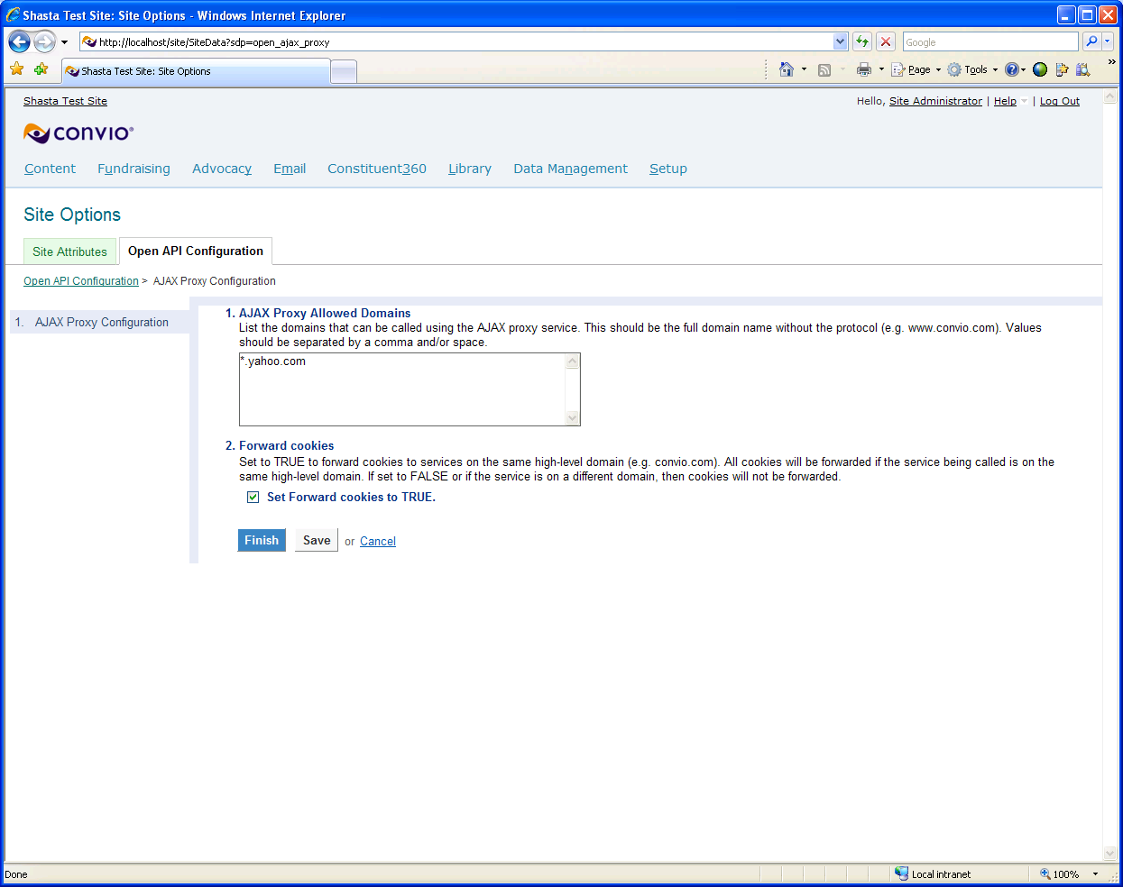
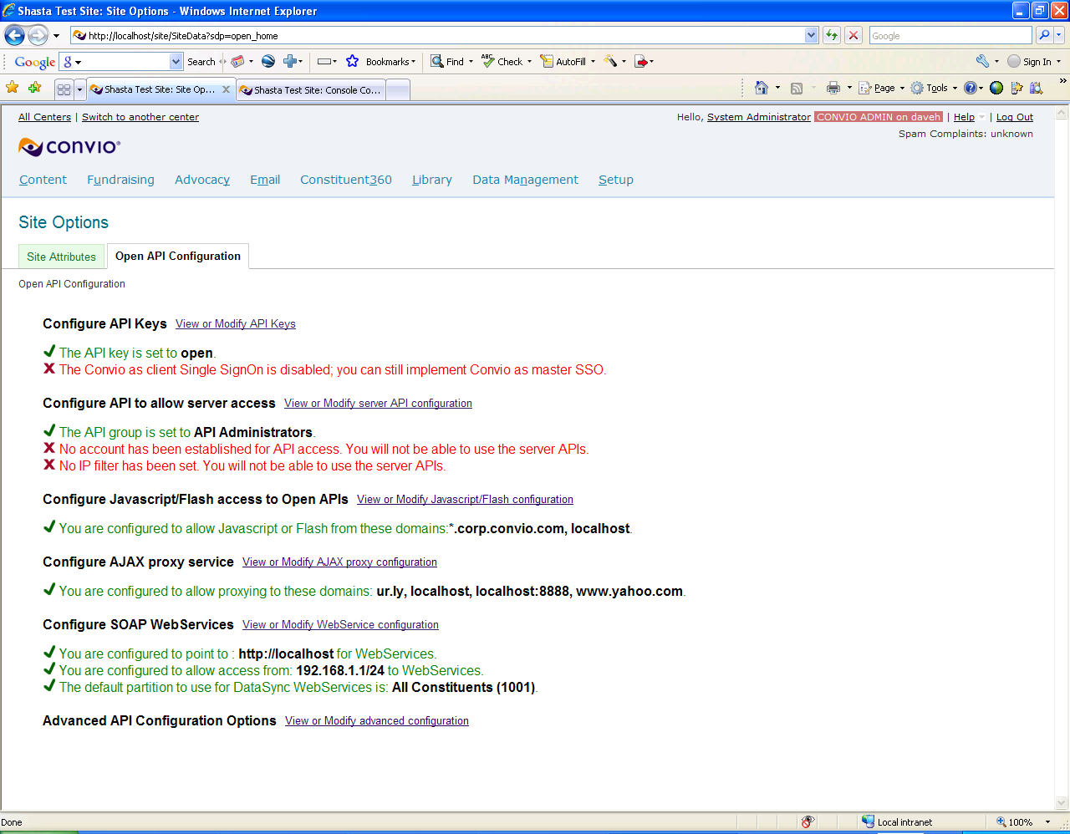
AJAX Proxy Configuration
66
Notes:
Dave to lead 30-45 minute tutorial & code review of AJAX Proxy example
Y! Search
66

Slide 67


Yahoo Finance
Exchanging GBP to USD
http://download.finance.yahoo.com/d/?s=GBPUSD=X&f=sl1ba
Returns:
"GBPUSD=X",1.669,1.6688,1.6692

Slide 68
Adding converter to a donation form
When the page loads
  Test to make sure the service is available
  Hide the donation amount input element
  Add a text field and select element for amount and currency code
When the user enters donation amount
  If the currency is not USD
  Call the service to get the exchange rate
  Display a message with the actual amount to be charged in USD

Slide 69
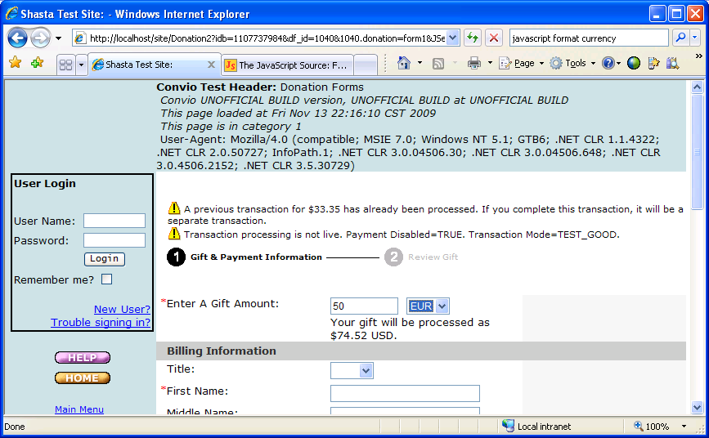
Donation Form with Currency Conversion

Slide 70
Invoking the AjaxProxy Servlet
function ap_mc_demo_get_exchange(_currency) {
var url = 'AjaxProxy'
  var args = 'cnv_url=http://download.finance.yahoo.com/d/';
  args += '&auth=[[S86:true]]&ts=';
  args += new Date().getTime();
  args += '&s=';
  args += _currency;
  args += 'USD%3dX&f=sl1';
  var myAjax = new Ajax.Request( url,
  {
  method: 'get',
  parameters: args,
  onSuccess: ap_mc_demo_get_x_success,
  onFailure: ap_mc_demo_get_x_failed,
  onException: ap_mc_demo_get_x_failed
  });
}

Slide 71
Don’t forget to visit the Expert Lab!
Thanks!
Text CNV101 to 30644
to take a quick survey
about this session.

