Slide 1
HFB Campaign & Program Resources
A look at your housefile building campaign and walkthrough
of program resources for monthly projects

Slide 2
Today’s Topics
Program Goals
Your Housefile Building Campaign
The moving pieces
Your feedback
Program Resources
Monthly projects
Campaigns: Up next – Sustained Giving!
Next Steps
Notes:
Program goals – reminders

Slide 3
Go! Program Key Goals
Increase online fundraising activity and results, ultimately increasing net new revenue.
Improve the experience of users engaging with ALA online.
Enhance the relationship between constituents and the ALA via meaningful communication and relationship pathways.
Equip all ALA staff with the training and tools needed to efficiently and effectively achieve the above.

Slide 4
Today’s Topics
Program Goals
Your Housefile Building Campaign
The moving pieces
Your feedback
Program Resources
Monthly projects
Campaigns: Up next – Sustained Giving!
Next Steps
Notes:
Agenda

Slide 5
HFB campaign revealed

Slide 6
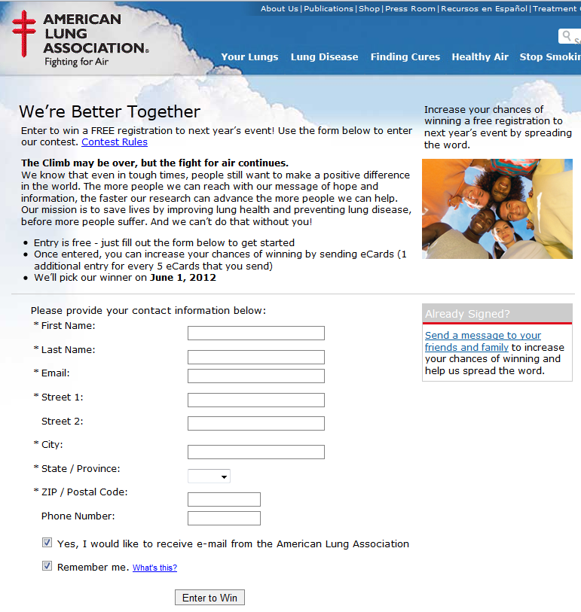
Campaign landing page
Constituent receives email and is prompted to visit the landing page
Sign up for incentive and to be a part of campaign & sign up for new constituents
Sign Up

Slide 7
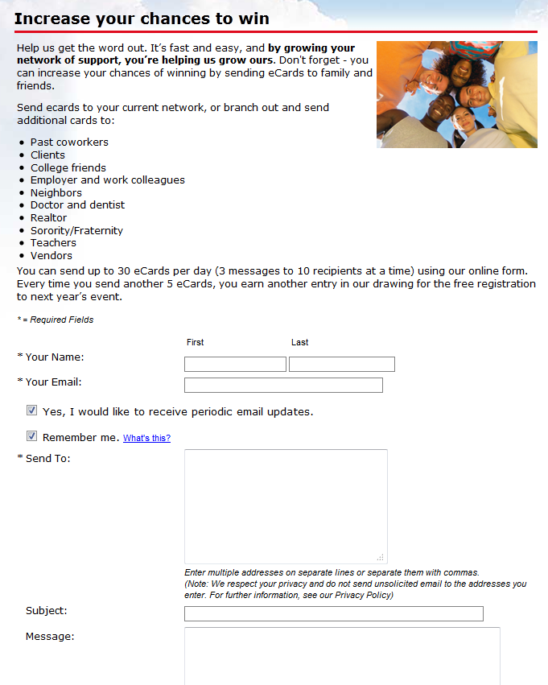
Send an e-Card
After constituent enters the contest
Prompted to send e-Cards / spread the word
Spread the word

Slide 8
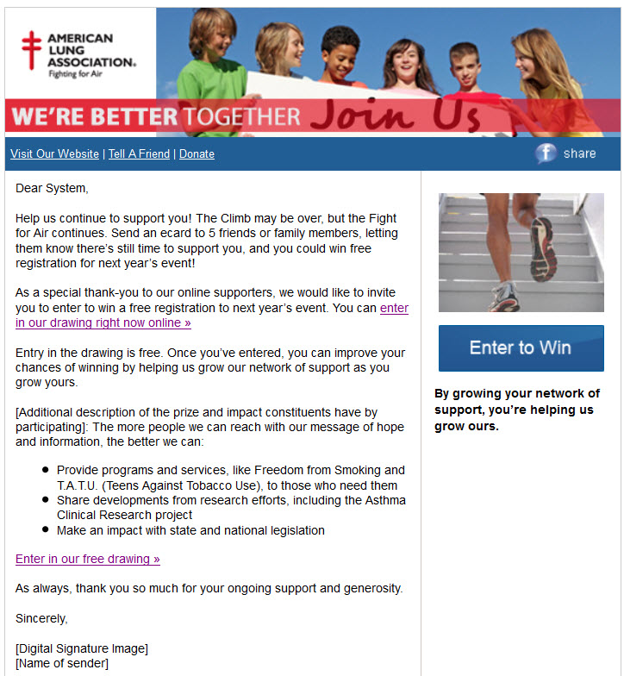
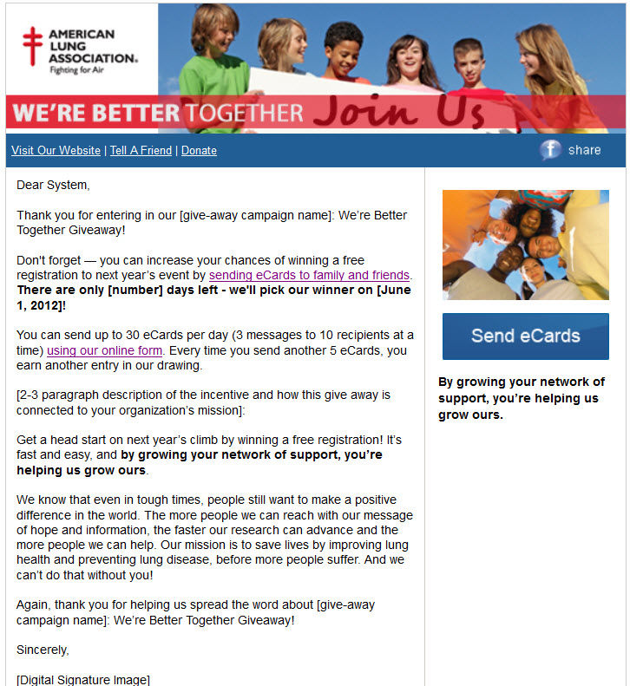
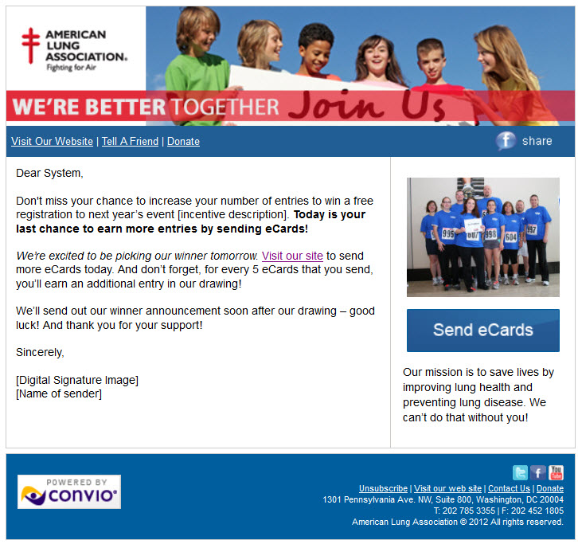
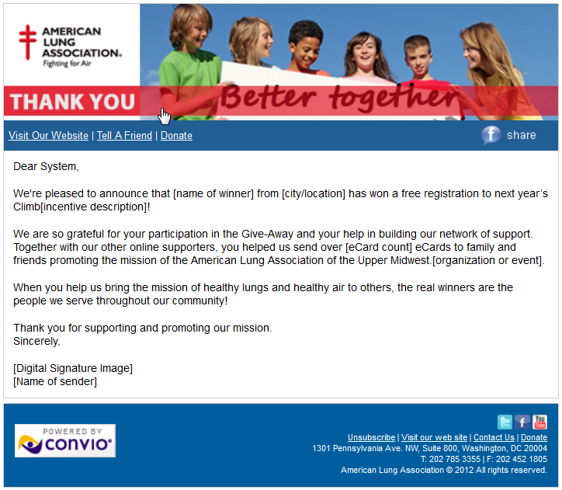
Email 3
Email 2
Email 4
Email 1

Slide 9
Today’s Topics
Program Goals
Your Housefile Building Campaign
The moving pieces
Your feedback
Program Resources
Monthly projects
Campaigns: Up next – Sustained Giving!
Next Steps
Notes:
Agenda

Slide 10
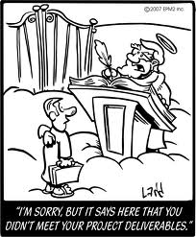
What are these projects you speak of?
Monthly projects are due the last week of the month
Each charter to should complete monthly project guide on their own
Each charter should complete at least 6 of the 9 available monthly projects

Slide 11
Monthly Projects
Once a month you can submit a guide for a monthly project. Guides should be downloaded from the Community.
http://community.convio.com/t5/Program-Documents/bd-p/ProgramDocuments
Choices include:
Email Communication
Standard enews (3-5 articles)
Shortened enews (1 article & a blurb at the bottom)
Postcard – vertical or horizontal eCard style
eBlast
Event Email
Fundraising
Donation form – standard or sustaining

Slide 12
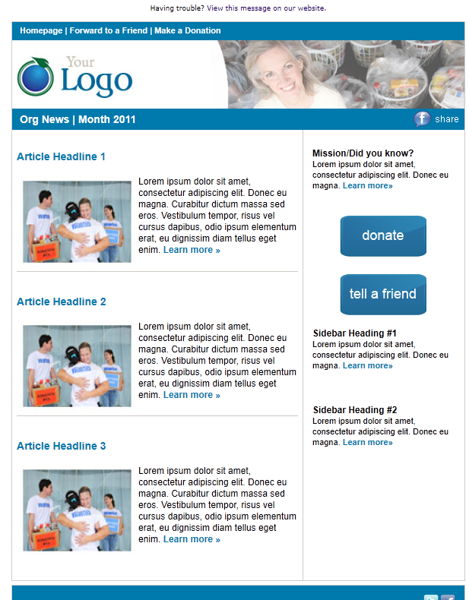
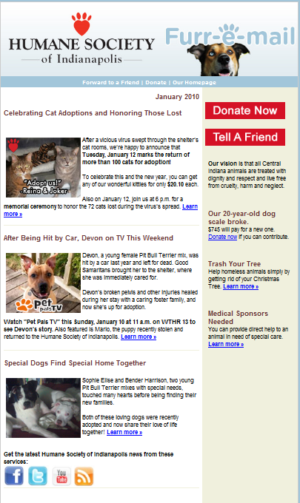
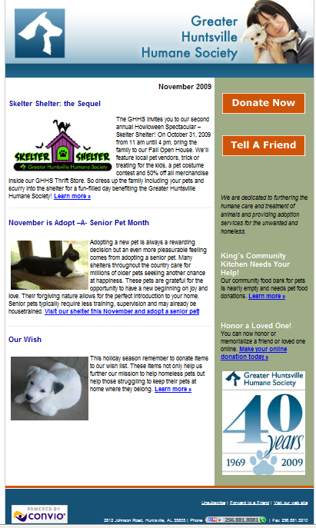
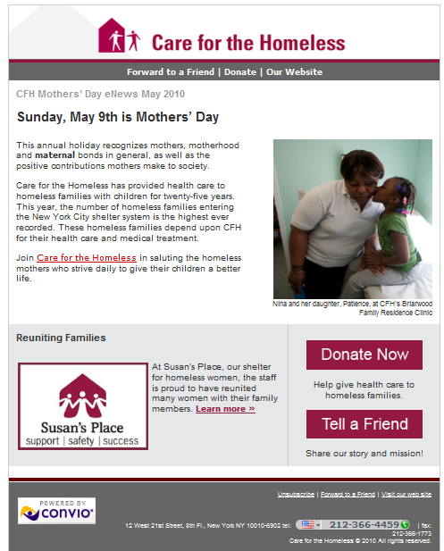
Examples of Standard eNews, Shortened eNews & eBlast
Notes:
Enews examples of past Go! clients and a standard enews template

Slide 13
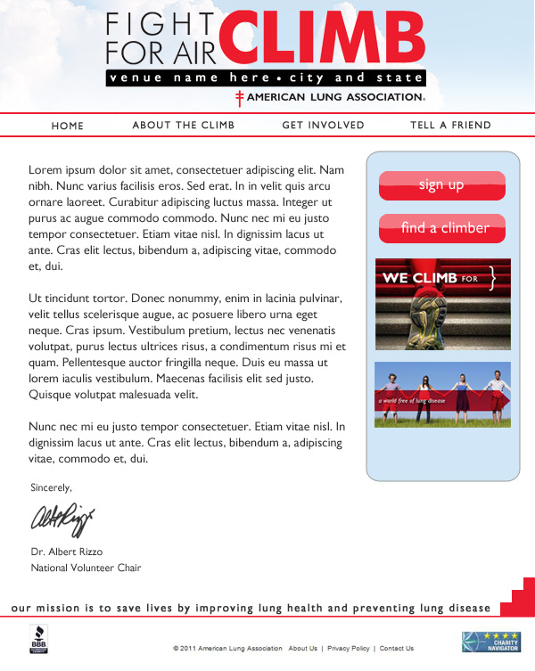
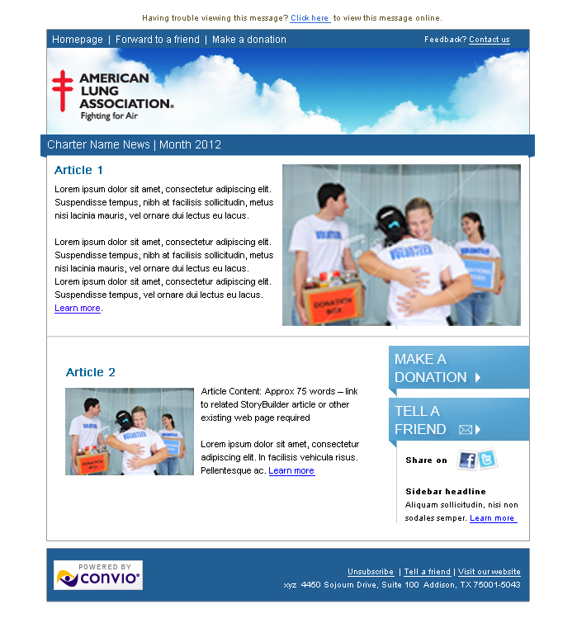
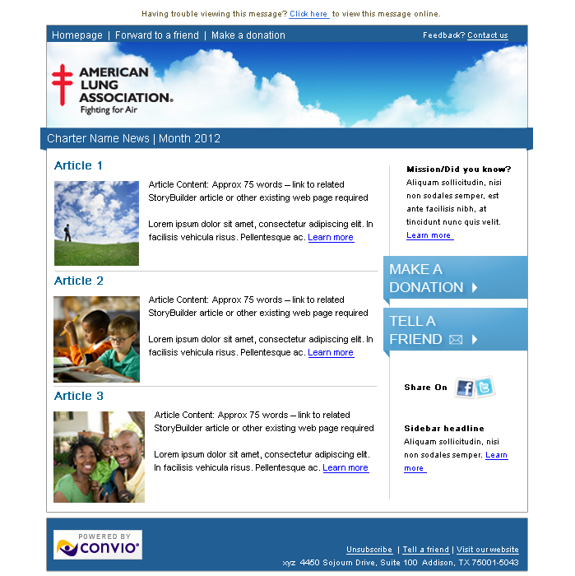
Your eNews Templates
Banner is customizable to your event type
Standard
Shortened
Event
Notes:
ALA enews templates that we have created for this program.

Slide 14
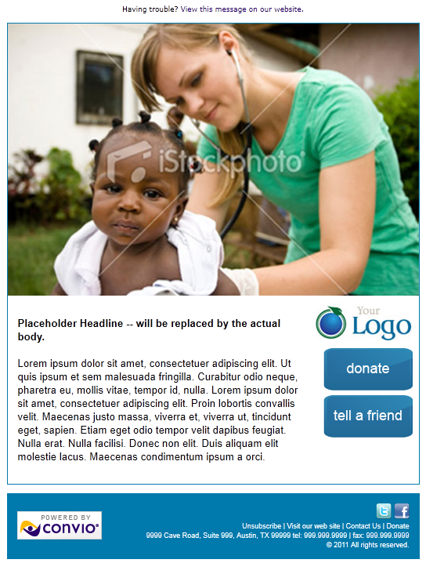
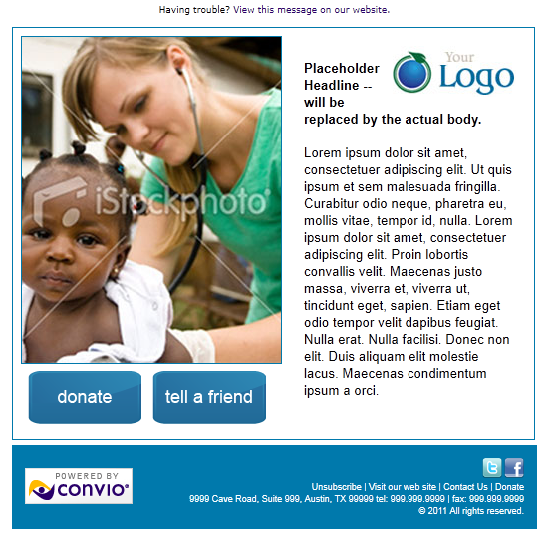
Examples of eCards
Notes:
Ecard examples of past Go! clients and a standard enews template

Slide 15
Your eCard Templates
Images are customizable to your event type
Standard
Event
Event

Slide 16
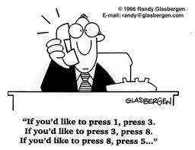
Instructions
Your group calendar includes the monthly deadlines for submitting a guide. But you can turn in a guide anytime before the deadline, just keep in mind we will only accept and build one (1) project a month.
Fill out the guide & submit images resized to the required dimensions to getready@convio.com
Your submission will be confirmed via email within 24 hours.
You will receive a test message in 5 business days to review.
Compile one list of edits/changes and submit within 5 business days to getready@convio.com.
You will receive your final message for review in 1-3 business days.
With your approval the email will be scheduled for launch, or the donation form will be available for use.
Notes:
Instructions for guide

Slide 17
Questions about monthly projects?

Slide 18
Upon Us: First Monthly Project
Up next: Sustainer Campaign
In Motion: Housefile Building

Slide 19
Today’s Topics
Program Goals
Your Housefile Building Campaign
The moving pieces
Your feedback
Program Resources
Monthly projects
Campaigns: Up next – Sustained Giving!
Next Steps
Notes:
Program goals – reminders

Slide 20
Next Steps
HFB campaigns
Review and revisions week of Feb 20 – Adam and Taylor working with the “HFB work team”
Monthly Project: First monthly project guide due Monday, Feb 27. See Guides on Community: http://community.convio.com/t5/Program-Documents/bd-p/ProgramDocuments
Adam & Taylor will work with Sustained Giving campaign work group
Next Webinar: Sustained Giving Campaign & HFB follow up - Wednesday, Feb 29 at 11am CT (12pm ET)
Notes:
Next steps and open up Q&A

