Slide 1
Functional Transfer of Information
Fall ‘09 Release
September 16, 2009

Slide 2
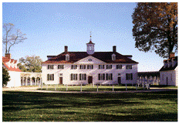
Overview of Fall ‘09 Release
What is it?
Enhancements in: TeamRaiser (TR), MultiCenter, Data Integration (DI), eCommerce, Data Integration with Common Ground (CG)
When does it go live?
October – November 2009
What is our current status?
Quality Assurance

Slide 3
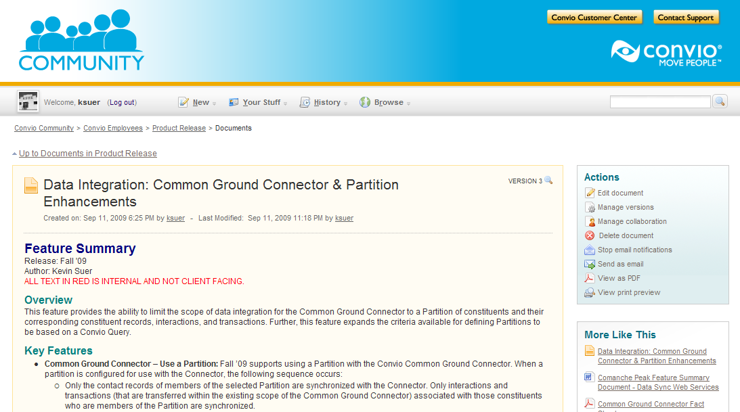
Feature Summary Documents
Available now!
Convio Community
Internal Version:
Convio Employees > Product Releases
Client-Facing:
Convio Platform Products

Slide 4
Fall ‘09 Contents
Features we’ll review today
New TeamRaiser Achievement Badges
Improved TeamRaiser Event Search Component and API
Email Filters in TeamRaiser Event Management Center
Personalization for TeamRaiser Participant Center Email
Sell Memberships in eCommerce
New Center-Level Configurations for MultiCenter
Permission Overrides by Security Category for Cross-References
Configure Common Ground Connector to use Convio Partitions

Slide 5
TeamRaiser Achievement Badges
What is it? Icons that display next to a participant’s name on public-facing TeamRaiser pages denoting a fundraising achievement
Why is it important? Foster competition between participants and emphasize the fundraising aspect of events
Who is it available to? All TeamRaiser clients
What does it cost? No additional fee
Notes:
TeamRaiser Achievement Badges are icons that indicate when a participant has performed a specific fundraising action, like hitting a milestone or making a gift toward their own fundraising goal. The goal of the badges is to spark competition between participants, and reward those who have achieved the desired fundraising action.

Slide 6
TeamRaiser Achievement Badges
Fundraising Milestone Badge Earned when a participant reaches a defined Fundraising Milestone
Personal Gift Badge Earned when a participant makes a gift towards their own fundraising goal

Slide 7
TeamRaiser Achievement Badges
Demo:
Enabling badges & uploading images
User view of badges

Slide 8
TeamRaiser Achievement Badges
Notes/Limitations:
This feature should only be used for new events, where participants have not yet begun fundraising
Notes:
NOTE: This feature should only be enabled for new events. If badges are enabled after participants have begun fundraising, the achievement badges will NOT appear retroactively for participants who have already made personal gifts or achieved milestones. Badges will appear correctly for every personal gift or milestone achieved after badges have been enabled.

Slide 9
TR Event Search Component & API
What is it? A new WYSIWYG component that will allow users to search for a TeamRaiser Event by name, city, county, and/or state, or perform a radius search by zip code. This search will also be available via API for searching on 3rd party sites.
Why is it important? National clients may have hundreds or thousands of events; this component will help users find the right one to register for.
Who is it available to? All TeamRaiser clients
What does it cost? No additional fee

Slide 10
TR Event Search Component & API
Demo:
Inserting an Event Search Component
Searching for an Event

Slide 11
TR Event Search Component
Notes/Limitations:
You must have Location Details properly populated for the event search component to search on location
API documentation will be available on http://open.convio.com

Slide 12
Participant Center Email Personalization
What is it? The ability for TeamRaiser event participants to use personalization to drop in the first name of address book contacts into the e-mails they send from their participant center.
Why is it important? Personalizing the “ask” when sending e-mail from the participant center may have more impact than sending a universal “Dear Friends” e-mail
Who is it available to? All TeamRaiser Clients
What does it cost? No Additional Fee

Slide 13
Participant Center Email Personalization
Demo:
Enabling/Disabling Personalization
Participant’s view in PC1 and PC2

Slide 14
Participant Center Email Personalization
Notes/Limitations:
This feature will be enabled by default, but the user will still need to check the box to use it.

Slide 15
Additional Email Filters in EMC
What is it? ACS requested that the “additional filters” available for segmenting coaching e-mail audiences by funds raised or e-mails sent be available to event managers in the EMC.
Why is it important? Event Managers can now target e-mails to motivate users to send e-mails and raise funds.
Who is it available to? All TeamRaiser clients
What does it cost? No Additional Fee

Slide 16
Additional Email Filters in EMC
Demo:
Locating/Using Additional Filters in EMC

Slide 17
eCommerce Membership
What is it?
Enhancement to allow clients to sell Membership as product
Why is it important?
Provides greater flexibility to clients
Who is it available to?
eCommerce clients interested in selling Membership
What does it cost?
No additional cost

Slide 18
eCommerce Membership
Demo:
Selling membership as a product

Slide 19
MultiCenter: Center Level Attributes
What is it?
Nine Center-Level Configuration Options
Tax ID Stored on Merchant Account
Why is it important?
Improves control of Centers over branding
Who is it available to?
All MultiCenter clients (default not active)
What does it cost?
No additional fee

Slide 20
MultiCenter: Center Level Attributes
Demo:
Edit Center-Level Options
Center Level Signup Autoresponder
Tax ID Stored on Merchant Account

Slide 21
MultiCenter: Cross-Reference Permissions
What is it? New permissions enable Center Administrator with the ability to manage cross-references for objects within a single Center
Why is it important? Enables Center Administrators to manage separate CRs
Who is it available to? All clients
What does it cost? No additional fee

Slide 22
MultiCenter: Cross-Reference Permissions
Demo
Center Level Cross References
New Permission Options

Slide 23
DI: CG Connector & Partitions
What is it? Limits the scope of data integration for the Common Ground Connector to a Partition of constituents. Expands Partitions to Query Criteria and Survey responses.
Why is it important? Controls amount of data synchronized with Common Ground
Who is it available to? All Common Ground Connector clients
What does it cost? No additional fee

Slide 24
DI: CG Connector & Partitions
Demo:
New Partition Criteria
Configure Common Ground Connector to use Partition

Slide 25
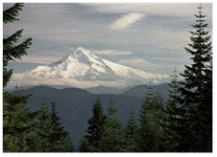
Thank you for attending today!
Questions & Answers with Convio Product Management

Slide 26
Appendix

Slide 27
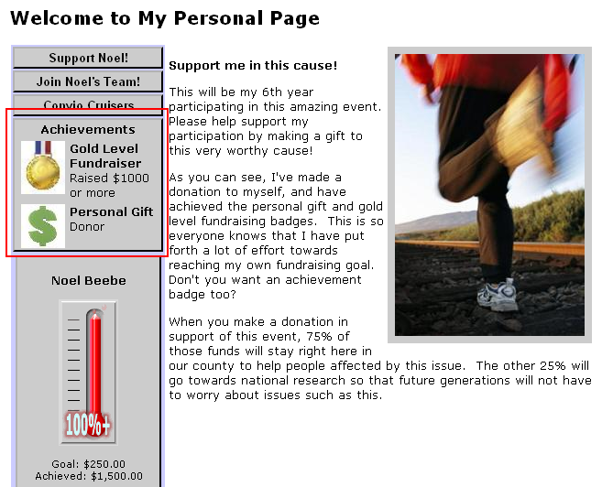
TeamRaiser Achievement Badges

Slide 28
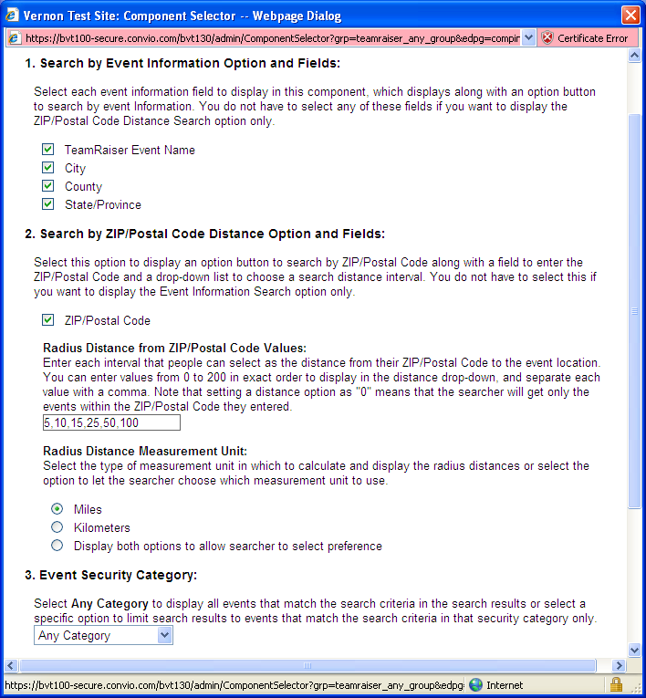
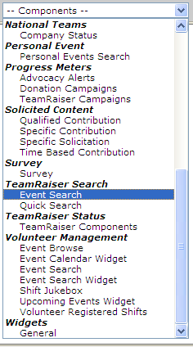
TR Event Search Component & API

Slide 29
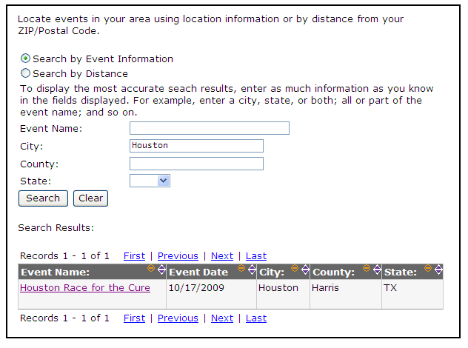
TR Event Search Component
Search by Event Information

Slide 30
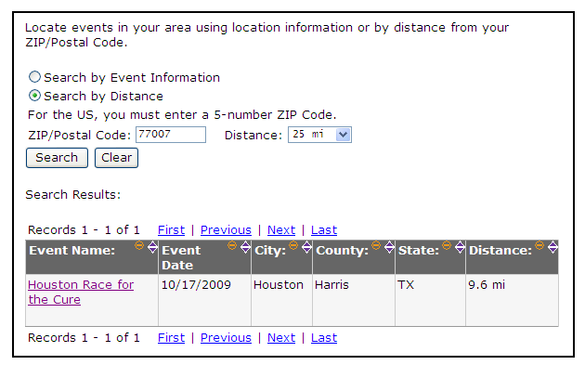
TR Event Search Component
Search by Distance

Slide 31
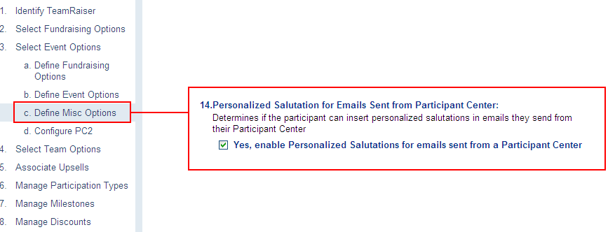
Participant Center Email Personalization

Slide 32
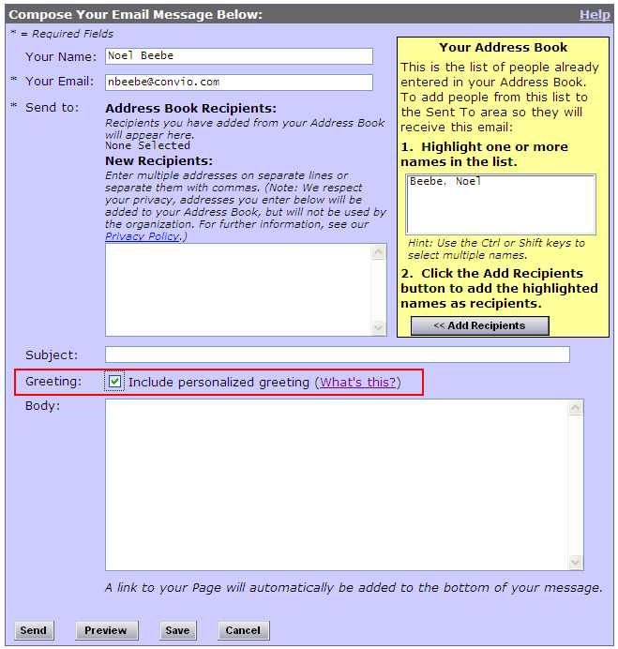
Participant Center Email Personalization

Slide 33
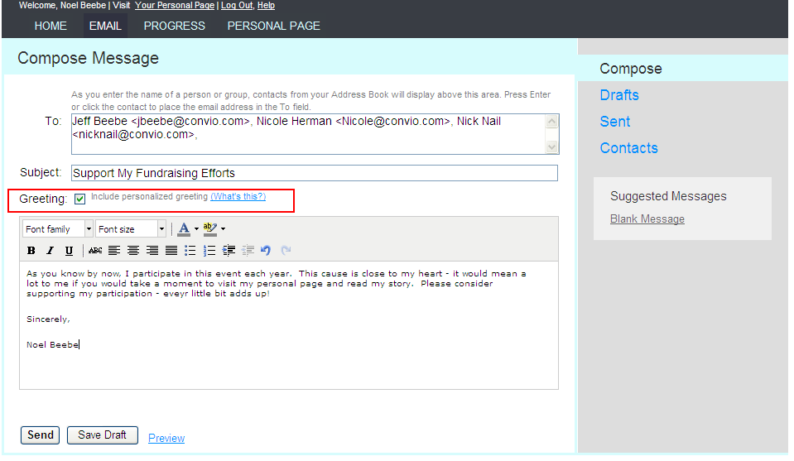
Participant Center Email Personalization

Slide 34
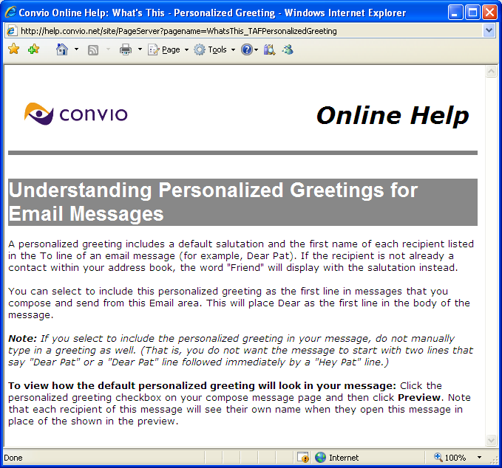
Participant Center Email Personalization

Slide 35
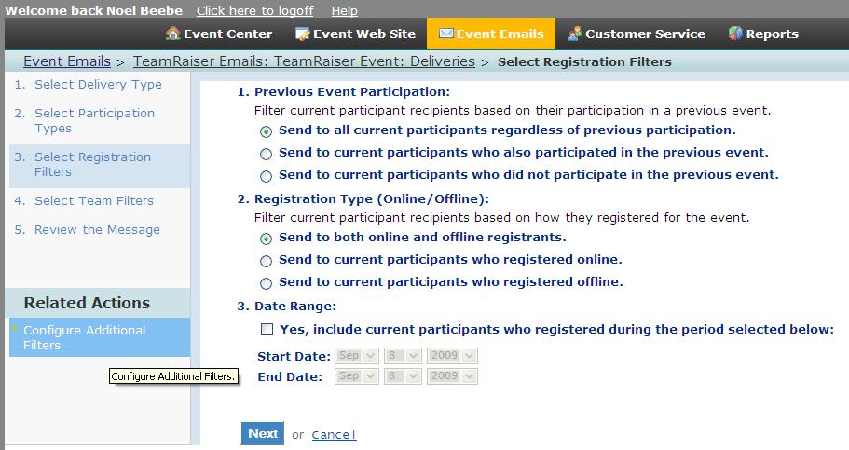
Additional Email Filters in EMC

Slide 36
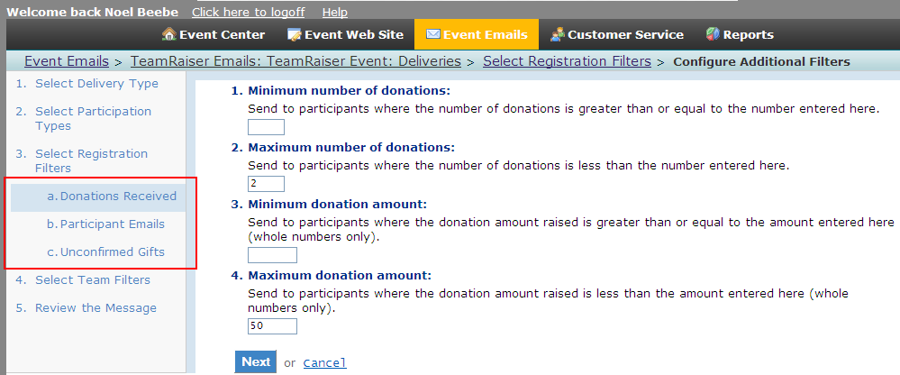
Additional Email Filters in EMC

Slide 37
eCommerce Membership- Screenshots

Slide 38
eCommerce Membership- Screenshots

Slide 39
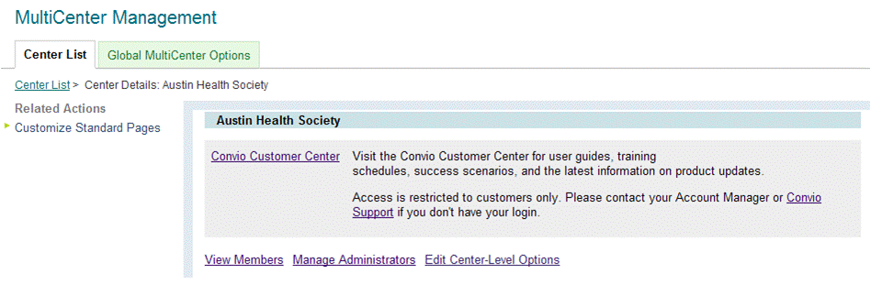
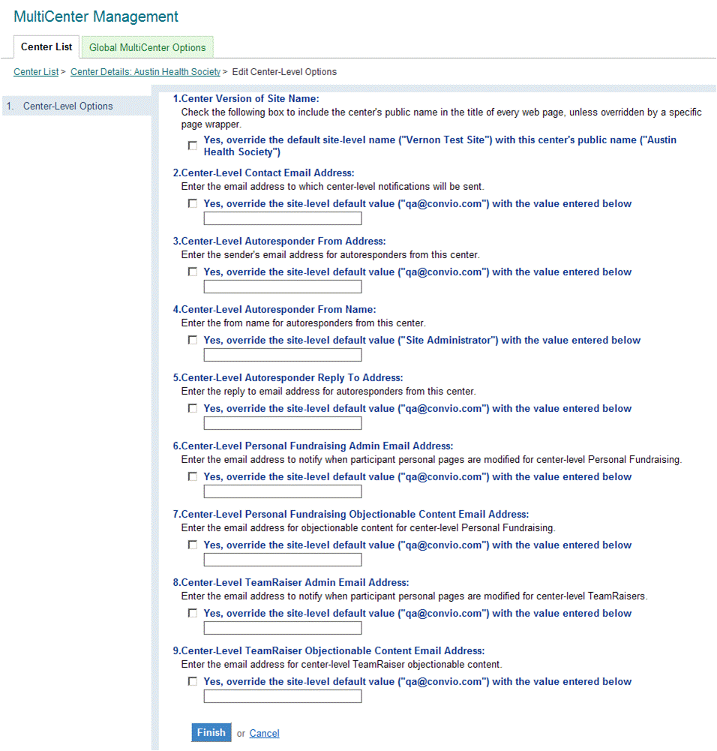
Feature Screenshot

Slide 40
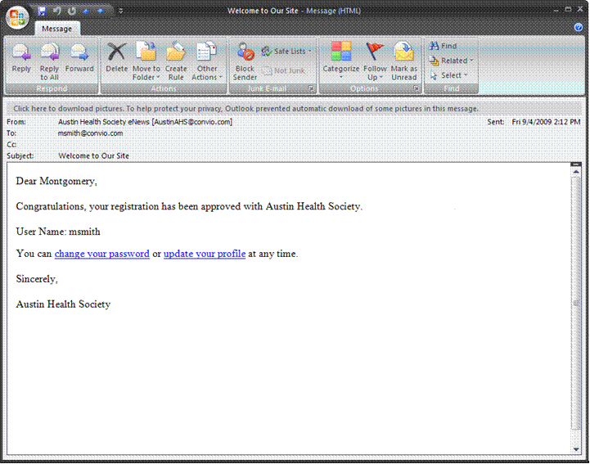
Feature Screenshot

Slide 41
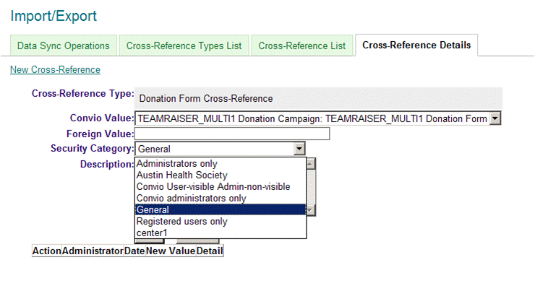
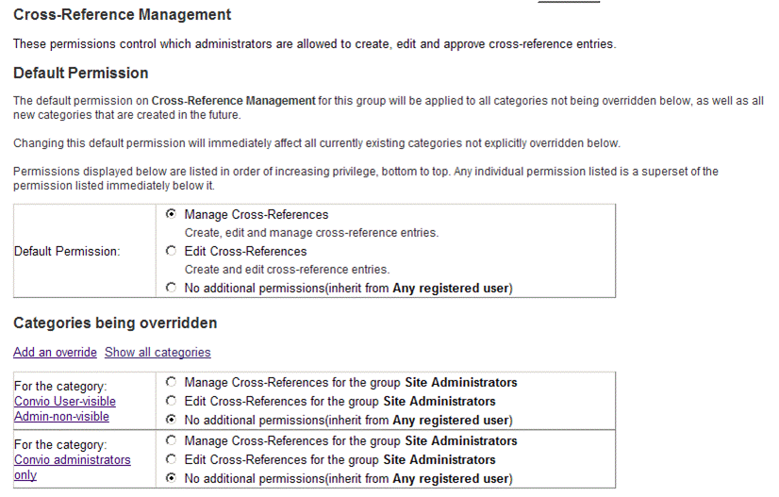
Feature Screenshot
Assign Security Category for Cross-References.
Add override on “Cross-Reference Management”
New permission type.

