Slide 1
BBCON 2013: Luminate Online Roadmap
Casey Flinn
Chris Kauffman
Michelle Shefter
THIS MATERIAL IS STRICTLY CONFIDENTIAL.
The information contained in this document, and any attachments thereto, is owned by Blackbaud and is strictly confidential. Unauthorized use, disclosure, or copying of such information is strictly prohibited.
FOR DISCUSSION PURPOSES ONLY.
This document contains forward looking information that is subject to change without notice. All rights reserved.
© 2013 Blackbaud

Slide 2
What You are about To Experience
What we have been working on in 2013…and why
What priorities and principles are driving us now and going forward
What cool new stuff is in discovery / development / early adopter programs

Slide 3
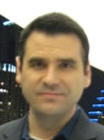
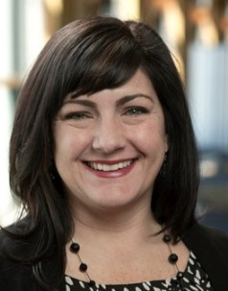
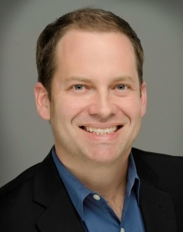
The Luminate Online Team
Casey Flinn
Group Manager, Product Management
Online Engagement & Outbound Marketing Portfolio
Nicki James
Product Manager
Products: Advocacy, calendar events, survey, email marketing, page builder, CMS
Peer-to-Peer Fundraising Portfolio
Chris Kauffman
Sr. Product Manager
Products: TeamRaiser, personal events, personal fundraising
Financials & Fundraising Portfolio
Michelle Shefter
Product Manager
Products: Payment processing, BBMS integration, online donations, sustainer giving, matching gifts, settlement, eCommerce

Slide 4
What have we Been working on all year?

Slide 5
Since we last met, we have been driving six BIG initiatives…

Slide 6
2013-14 Strategic initiatives
Implementation of the
Inspired Development Process
Answer these questions…
…With this process
Opportunity Analysis
User/Persona Development
Experience/Story Mapping
Prototyping & Validation
Engineering Development
Iterative Feedback & Learning
Valuable?
Usable?
Feasible?
We can transform your experience by transforming our process
Notes:
These are the 6 big things that have been driving our strategic engineering work in 2013

Slide 7
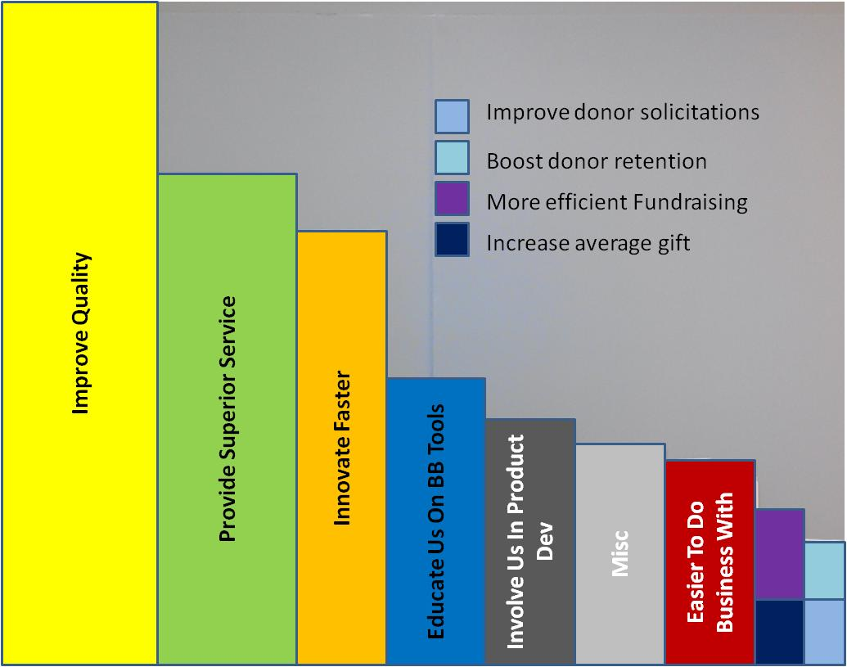
2013-14 Strategic initiatives
Product
Quality and
Performance
“What is most important to you?”
A customer feedback exercise from 2013
Quality is job #1
Notes:
These are the 6 big things that have been driving our strategic engineering work in 2013

Slide 8
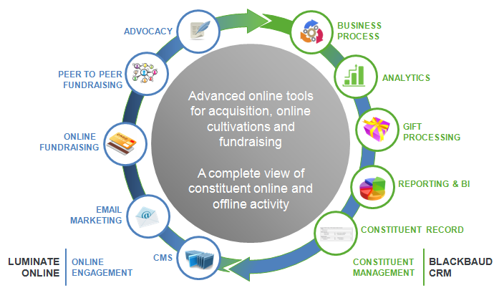
2013-14 Strategic initiatives
Integration of
Luminate Online to
CRM Solutions
Luminate Online is core to our Integrated Marketing strategy
Notes:
These are the 6 big things that have been driving our strategic engineering work in 2013

Slide 9
2013-14 Strategic initiatives
Unbeatable Online Giving
Successful Early Adopters
“Blackbaud has enhanced our fundraising efforts, simplifying our accounting and donor outreach activities and minimizing the time we spend on administrative tasks. And with Blackbaud Merchant Services, we’re paying less in fees so most of the money raised is going directly to care for our animals.”
Monica Leyba
Donor Services Manager, Arizona Humane Society
Blackbaud Merchant Services (BBMS) helps you increase revenue, and helps us innovate
Paving the Way to…
Credit Card Updater
One-click donations
ACH with BBMS
MobilePay Integration
Wealth Screening by Bin
Simplified Reconciliation
Notes:
These are the 6 big things that have been driving our strategic engineering work in 2013

Slide 10
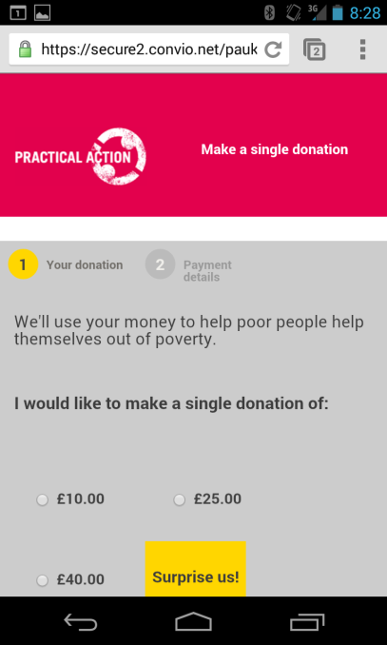
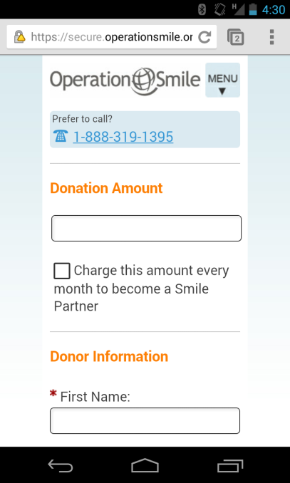
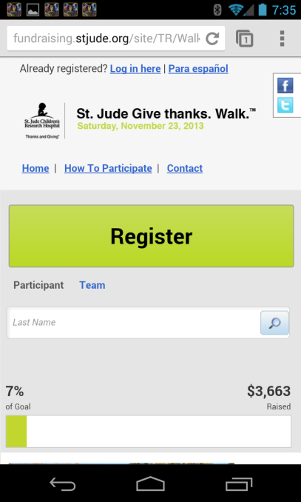
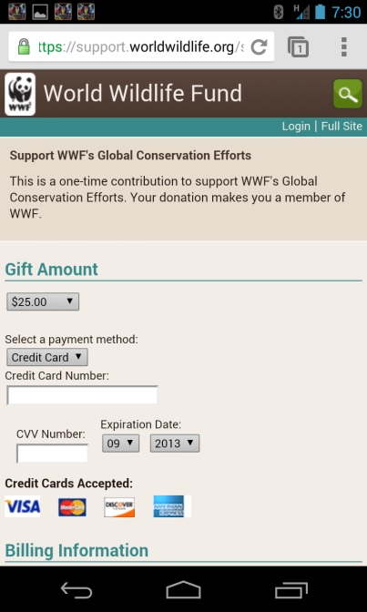
2013-14 Strategic initiatives
Meet Constituents
in the Mobile World
Responsive design is a ongoing platform investment
Notes:
These are the 6 big things that have been driving our strategic engineering work in 2013

Slide 11
2013-14 Strategic initiatives
Organizations as Constituents
Define and build the data model
Connect online and offline data
Organizations are high value constituents, and we will help you demonstrate that value
Apply to business process
(donate, fundraise, take action…)
Conduct “total impact” analysis
Notes:
These are the 6 big things that have been driving our strategic engineering work in 2013

Slide 12
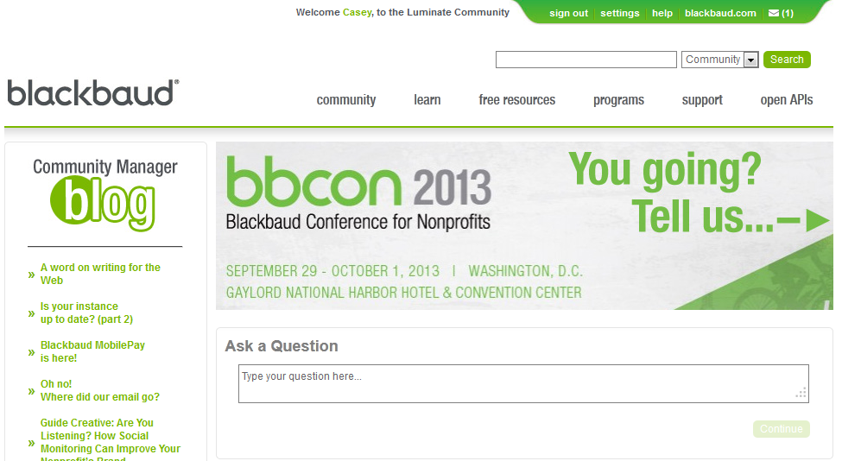
a lot of Enhancements were released…
We touched:
Admin Records/Security
Advocacy
CMS
eCommerce
Email
PageBuilder
Payment Processors
Survey
TeamRaiser
Ticketed Events
Get the details on the Community Website:
community.convio.com

Slide 13
Looking Forward…

Slide 14
Getting there: The Long View
Foundation
Integrate & Optimize
Constituent Experience
Online Fundraising
Integrated Online
Integrated Multichannel
Retool, Rethink, Re-Envision
???
Mobile, Social, Gamification
We are here

Slide 15
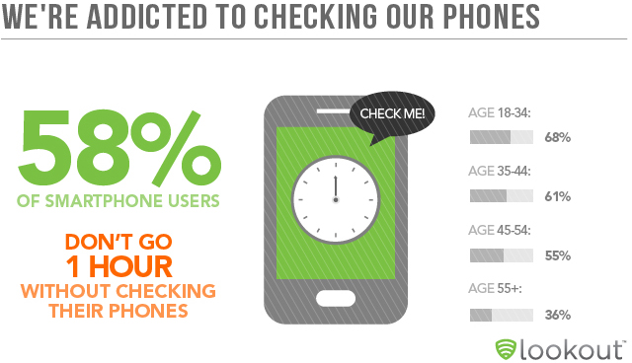
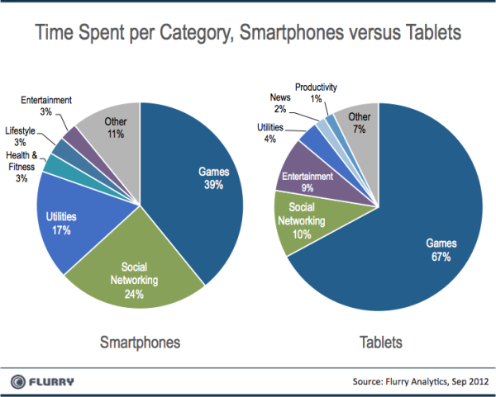
Mobile

Slide 16
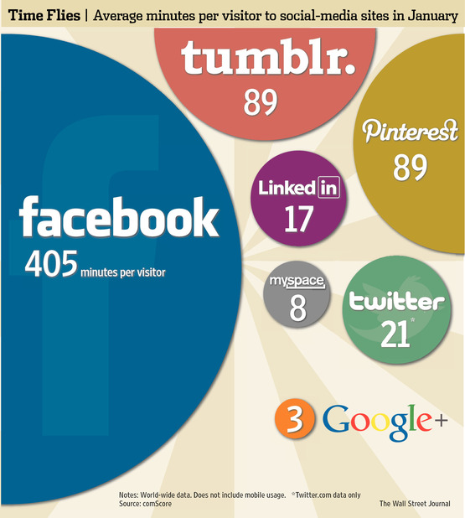
Social

Slide 17
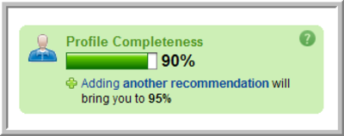
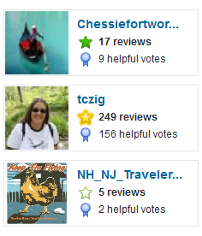
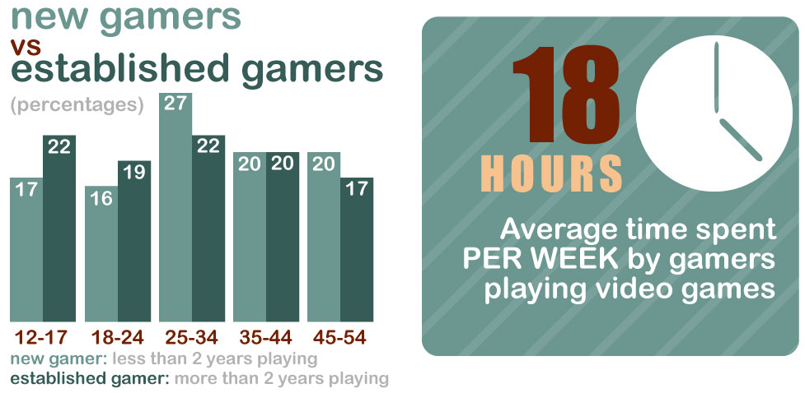
Gamification
Notes:
In 2012, the average American spent 142 hours per year playing video games. This is a steep rise from 2005 when the estimated time spent playing video games in the United States averaged roughly 78 hours. - Statistia.com, March 2012
http://www.onlineeducation.net/videogame

Slide 18
Our Target
A World Where:
I have status
I choose / opt into my relationships
I bring my network with me
I want it delivered to me
I want it in my hand
I need consistent exposure
I need it to be irresistible

Slide 19
Additional Priorities for 2014 and beyond
Time Saving
Admin Experience
Modern Constituent Experience
Express Functionality
Click Reduction
Surface Most Relevant Info
Mobile First Design
Consolidate Tasks
Social In : Social Out
Reward / Recognize
APIs for Customization

Slide 20
Guiding Principles
Always Reliable and Available…
Growing our customers requires the essentials done right every day
Ensure Customer Satisfaction & Trust…
Satisfied & trusting customers don’t churn
Deliver what’s valuable…
Satisfied & successful customers have complete and compelling solutions
Create the backbone for success…
Remove the issues that constrain our ability to grow

Slide 21
Closing Comments

Slide 22
Key Takeaways
Convert donation forms and TeamRaiser events to responsive design
If you have sustainer giving programs – check out Blackbaud merchant services (BBMS)
BBCRM, LCRM, Raiser’s Edge – we have an integration for you
Organizational constituents are moving forward
Advocacy is getting some great usability enhancements
We are simplifying and mobilizing the participant fundraiser experience

Slide 23
Thank you
Complete the session survey using the BBCON 2013 App
Please provide your feedback on the session
customer.convio.com/PostShow
Post your questions to the Product Management team in Community
www.blackbaud.com/discovery
Register and participate in discovery
Monday 9/30
1:30pm – Blackbaud CRM and Luminate Online Integration Roadmap
3:00pm – Blackbaud CRM Roadmap
Can’t get enough Luminate? Check out these roadmap sessions

