Slide 1
Fun with Adaptive Cards
Ashley Moose
June 2026

Slide 2

Ashley Moose
Senior Principal Business Consultant

Slide 3
What is an Adaptive Card?
Adaptive Card HOST SPA
Adaptive Card
Power Automate
Adaptive Cards are platform-agnostic snippets of UI, authored in JSON, that apps and services can openly exchange.
When delivered to a specific app, the JSON is transformed into native UI that automatically adapts to its surroundings.
Developed by Blackbaud to embed this JSON and display the UI within Blackbaud Solutions.
Low-code tool with built-in Blackbaud Connectors that makes it easy to work with and manipulate the JSON as needed to support many display requirements.

Slide 4
Adaptivecards.io

Slide 5
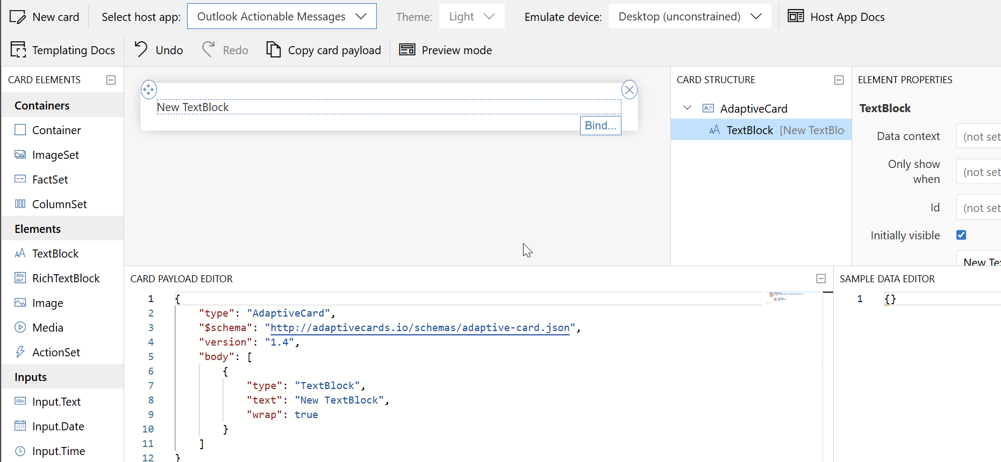
Drag and Drop Editor

Slide 6
Using the Designer
Designer helps to build the JSON for you
Host App = Outlook Actionable Messages
Target Version = 1.4
Cannot Save on this page
Do not use the New Adaptive Card Designer

Slide 7
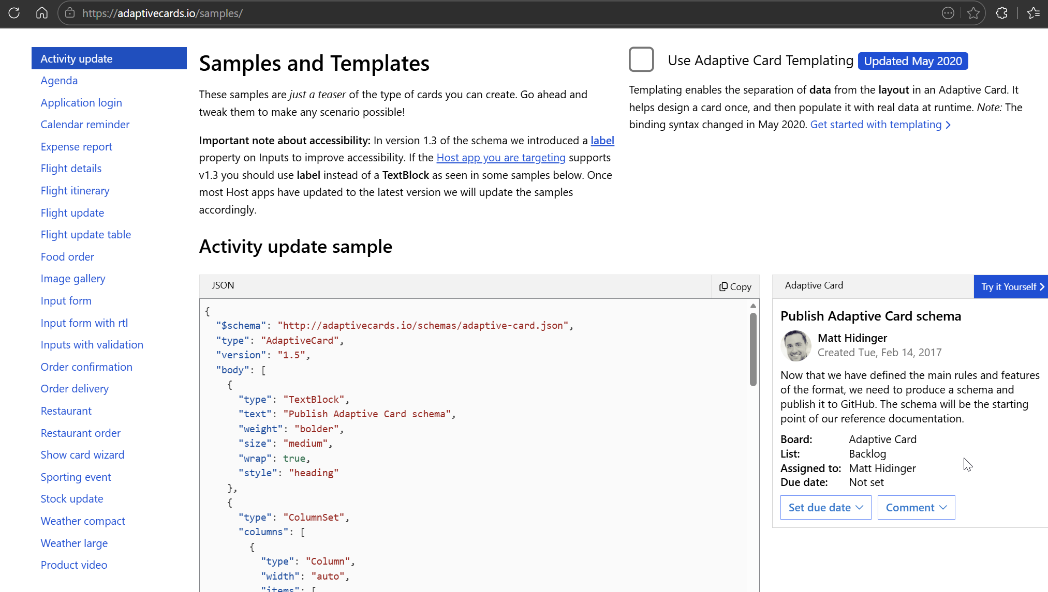
Samples in the Designer
Turn off Templating
Try It

Slide 8
Adding an Adaptive Card as a SKY Add-in

Slide 9
Types of Add-ins
Tiles
Actions
Displays as a section/square on the page
Connected to Tile extension points
Used to display data from some other source within your SKY solution
Available under the Add-ins drop-down on a page
Connected to Action extension points
Commonly used as a type of Input form for the associated record
Notes:
Think of the end user and what is going to create the optimal experience for them
Need to also consider what extension points are available

Slide 10
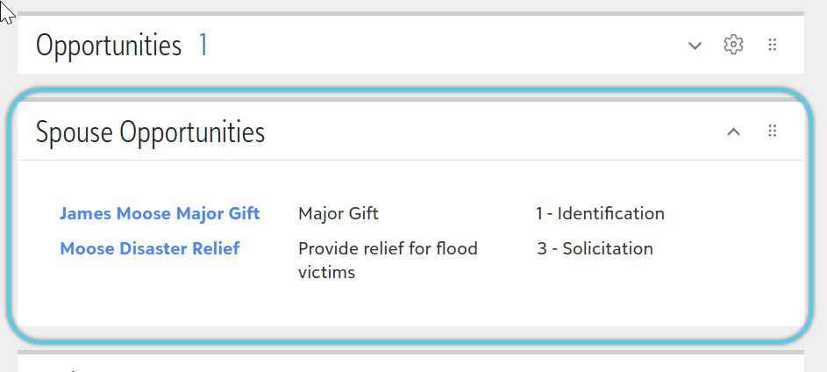
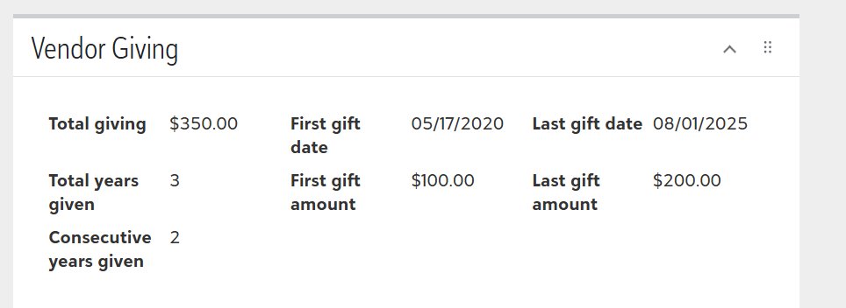
Tiles

Slide 11
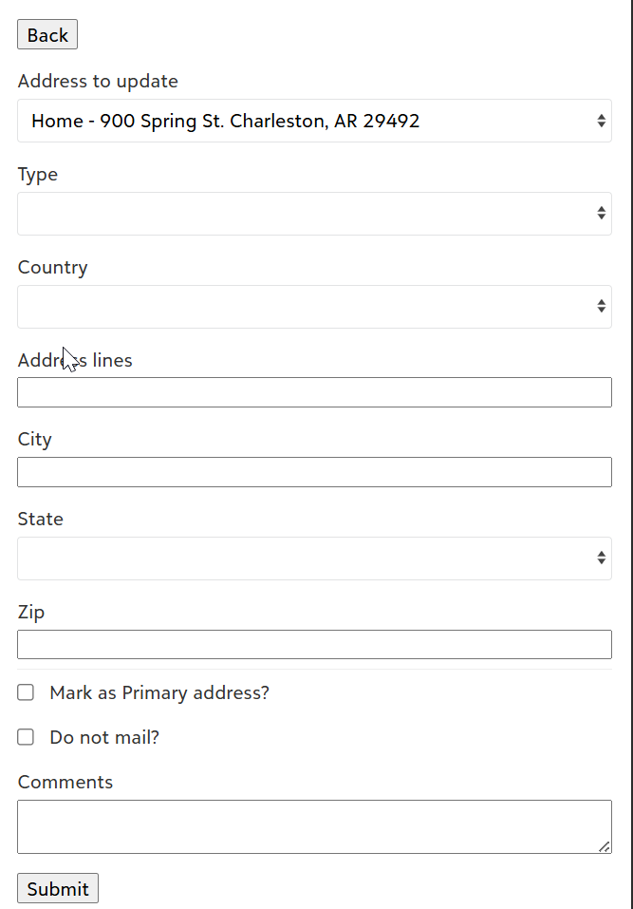
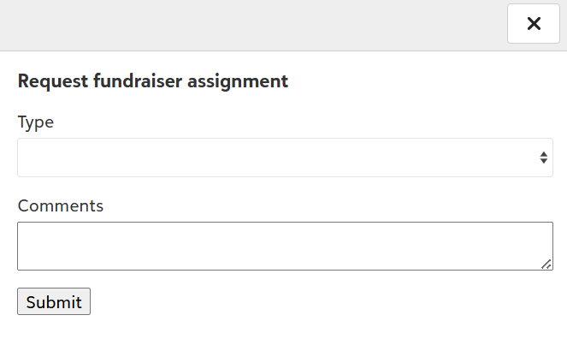
Actions

Slide 12
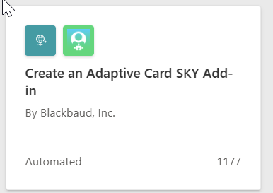
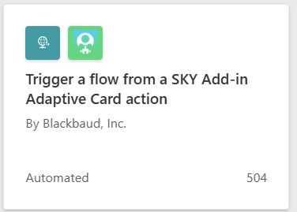
Power Automate Templates
Create an Adaptive Card SKY Add-in
Trigger a Flow from a SKY Add-in Adaptive Card Action

Slide 13
Designing the Card

Slide 14
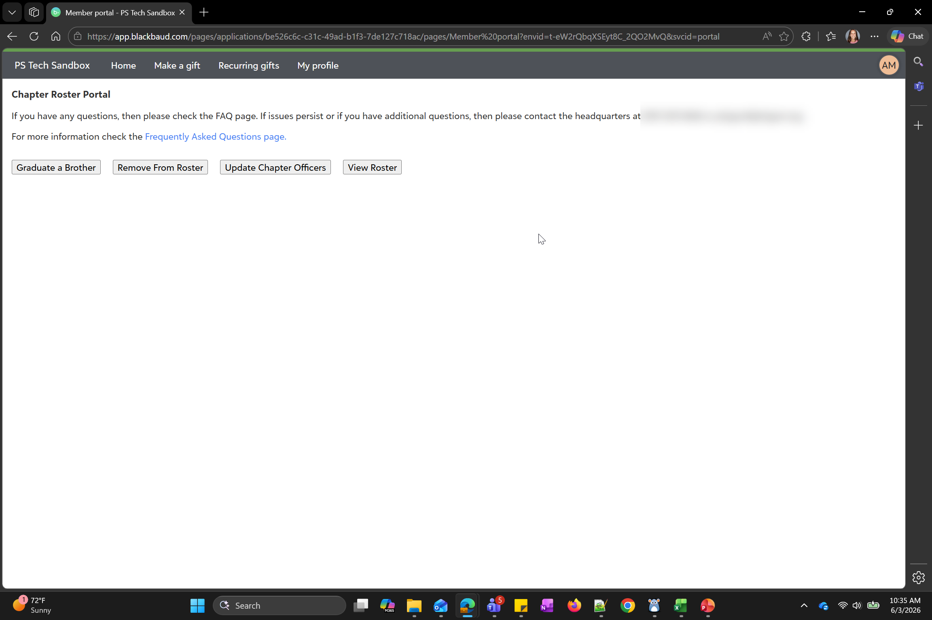

Slide 15
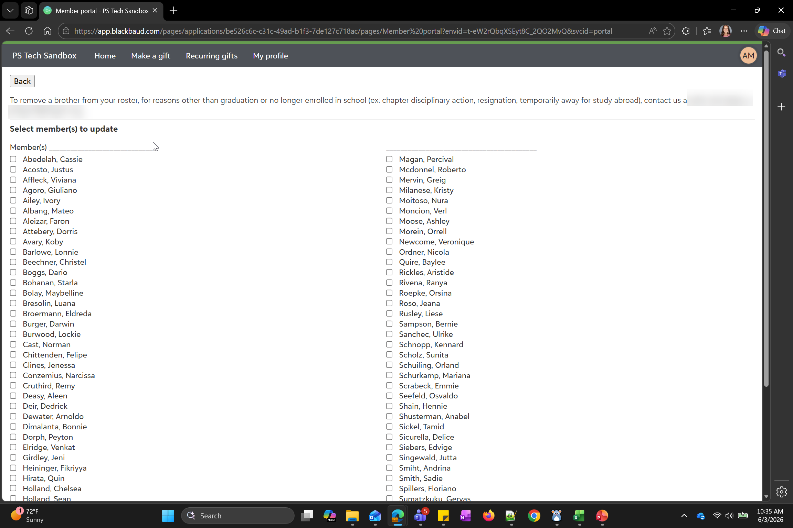

Slide 16
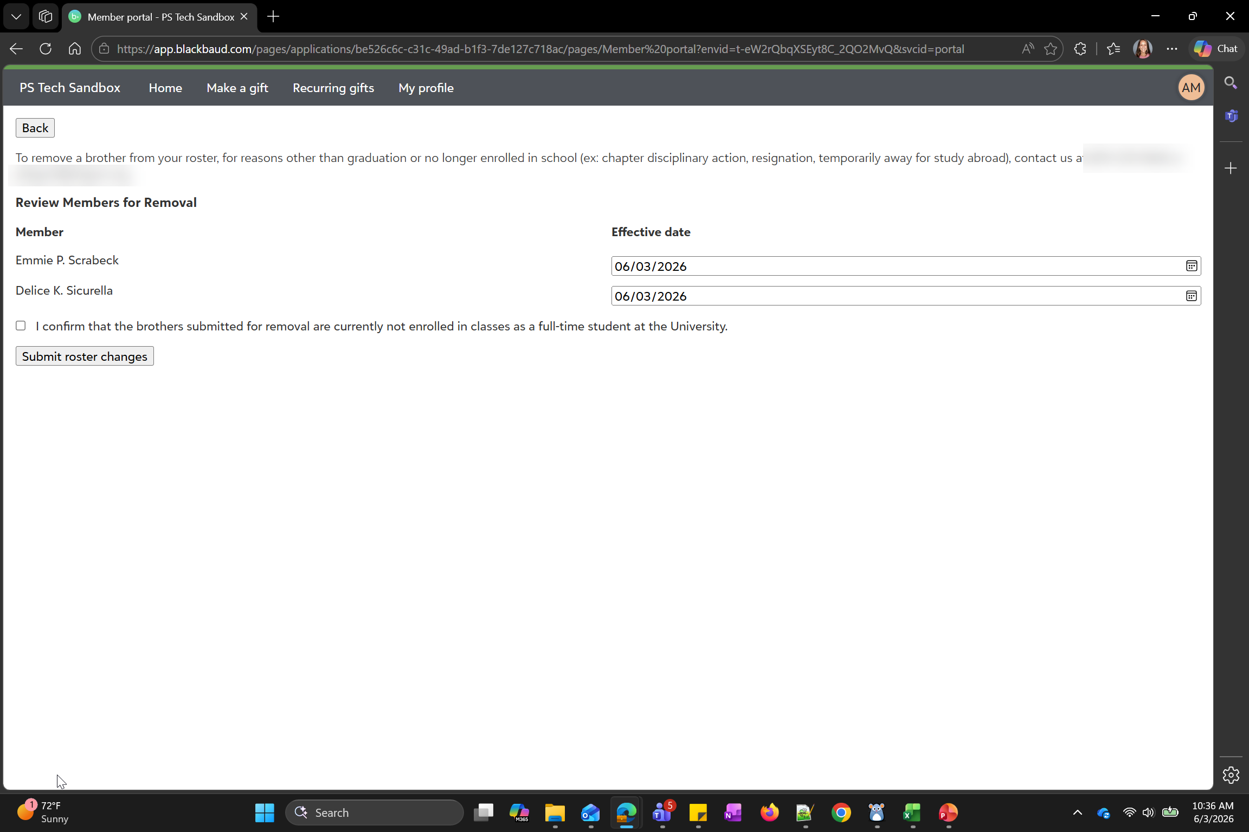

Slide 17
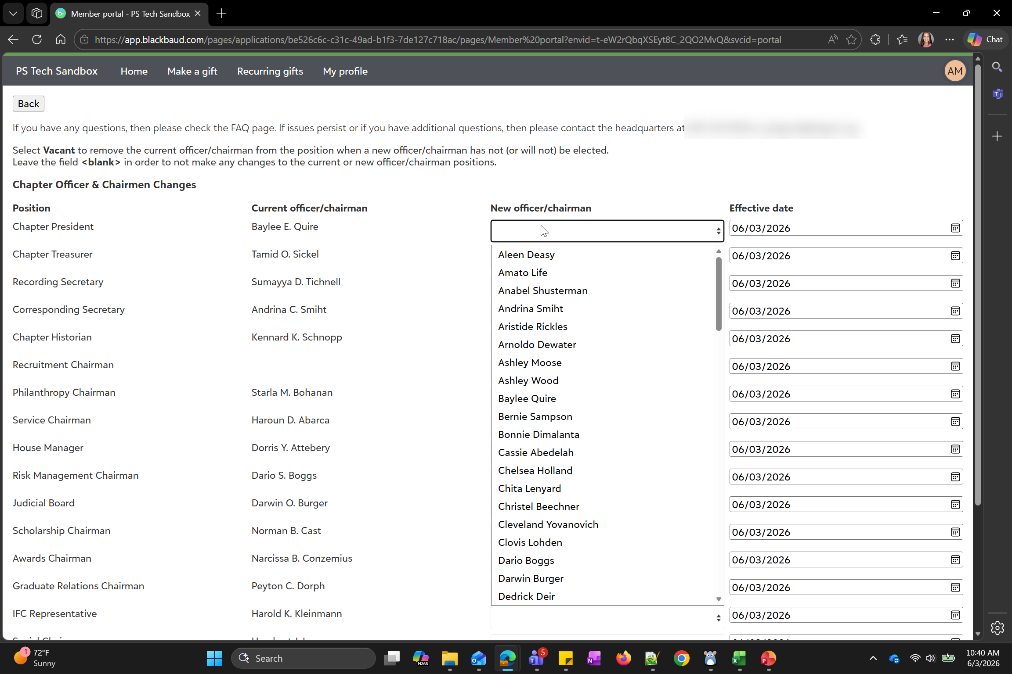

Slide 18
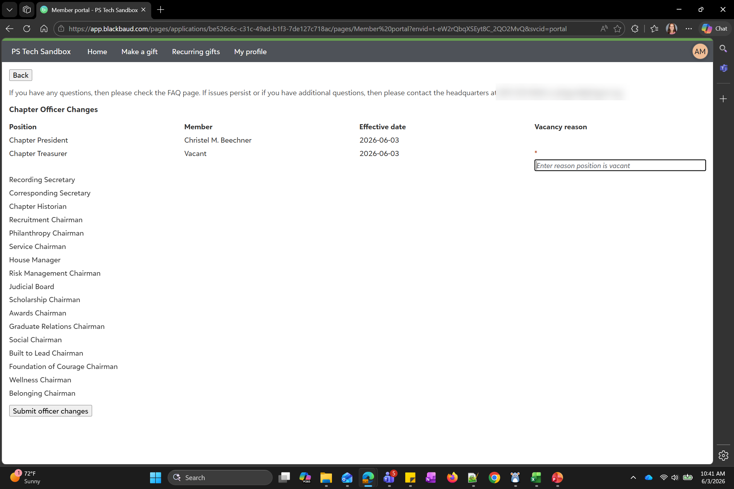

Slide 19
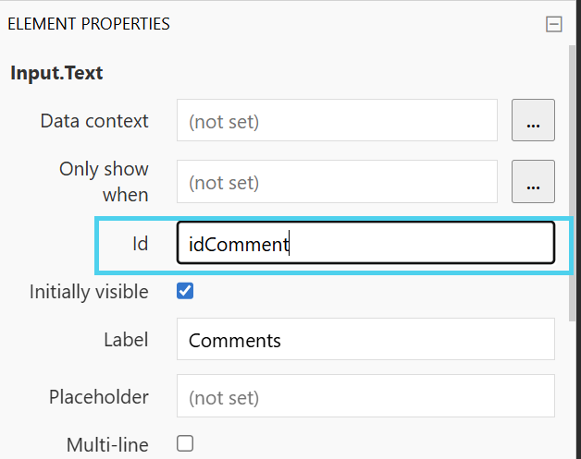
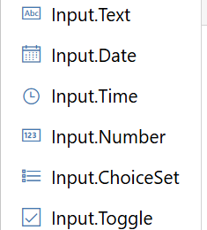
Input Fields
Anytime an Input field is used, the Id parameter must also be set. The Id parameter is what sends the inputted value into Power Automate.
Input fields are what enable you to design the Adaptive Card to serve as a “form”

Slide 20
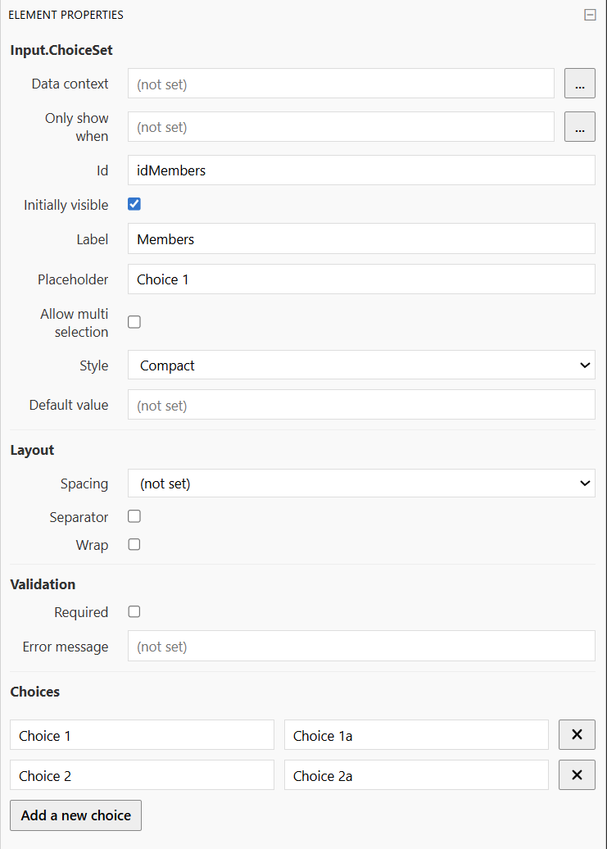
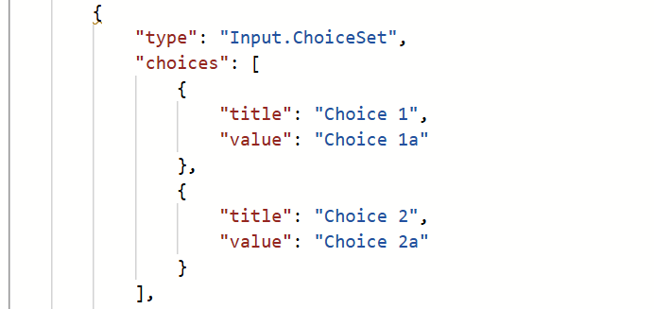
Input.Choiceset
This is what allows you to show a drop-down of live data from your Blackbaud solution, including:
  code table entries
  a list of corresponding options such as a list of addresses for the constituent
Title = the value seen from the Adaptive Card.
Value = the value sent to Power Automate.

Slide 21
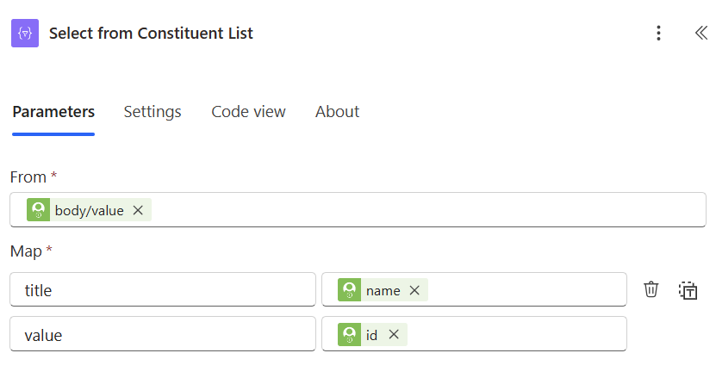
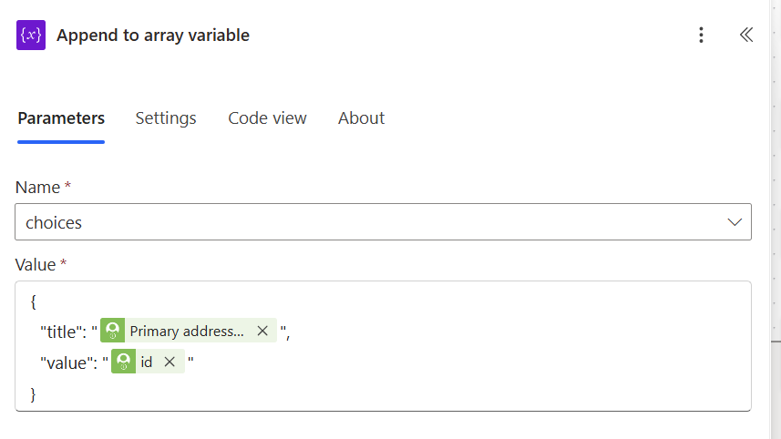
Input.Choiseset
Select
Array Variable
Notes:
Choices correspond to an Array in Power Automate. Can build out by using a Select action or an Append to Array variable.

Slide 22
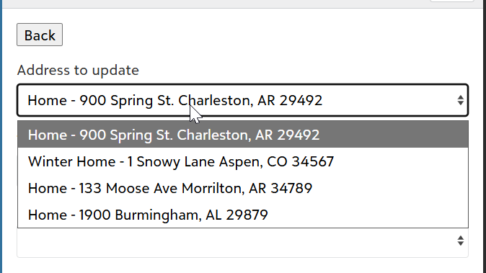
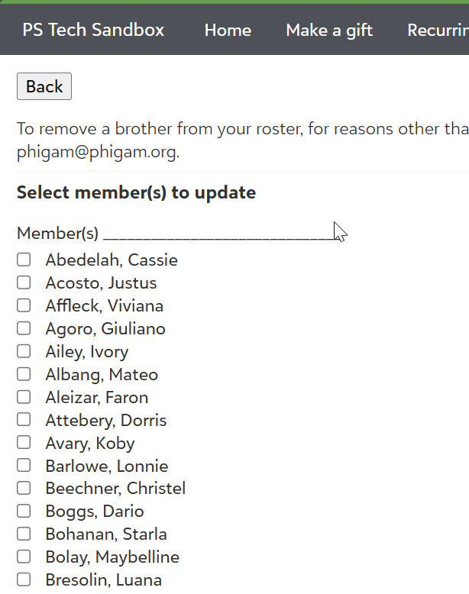
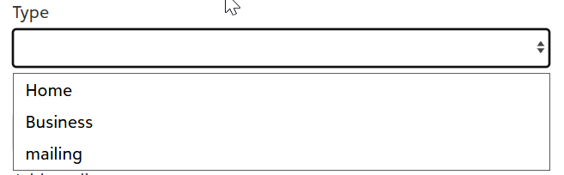
Input.Choiceset
Placeholder parameter
Allow Multi Selection Parameter
VS
Notes:
Set a placeholder value to force users to select something in the field without having to use the ‘Required’ parameter. To do this with dynamic content in Power Automate, use the first() expression
Allow multi-selection changes the field to operate more as a multi-toggle

Slide 23

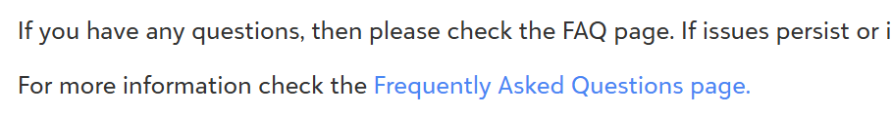
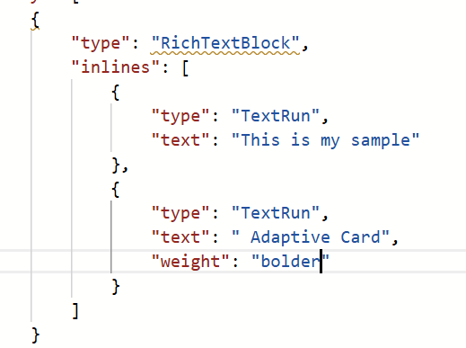
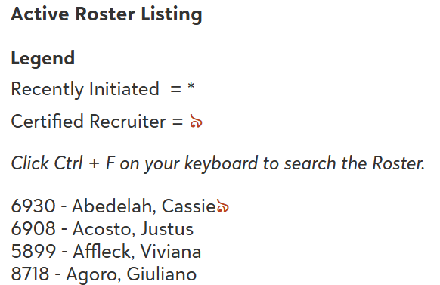
RichTextBlock
Examples
Use a RichTextBlock when you have a line of text with different words requiring different formats.

Slide 24
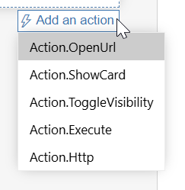
Actions available in SKY
Adaptive Card Actions
SKY Actions
Action.Webrequest
Action.OpenUrl
Action.Toast
Action.Modal
Action.ShowCard
Action.Webrequest
The action to use as your ‘Submit’ button.
When designing, use Action.Execute and manually update the card JSON to Action.Webrequest when moved to Power Automate.

Slide 25
Show Card vs Displaying a new Card
Both
Used to display additional data or fields outside of the initial card
Show Card
Uses Action.Showcard
Data that displays is limited to information known when the first card was viewed
Separate Card
Uses Action.Webrequest to trigger Power Automate to run and display a different Card
Can retrieve data inputted on the first card to conditionally determine what to display on the second card

Slide 26
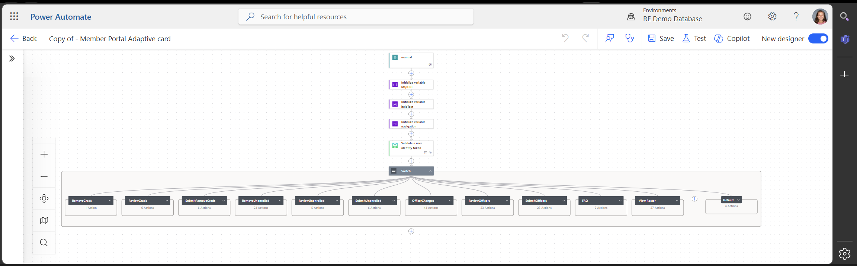
One Flow for a Multi-Card Scenario

Slide 27
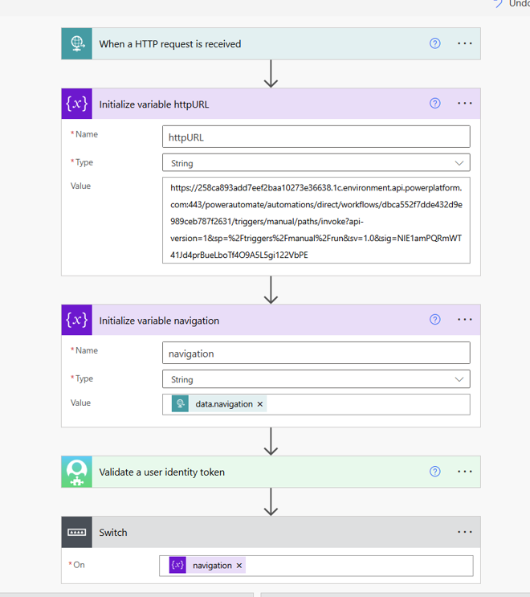
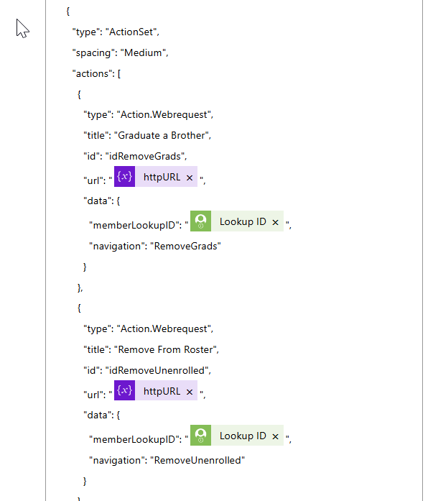
One Flow for a Multi-Card Scenario
Notes:
Switch statement supports the one flow requirement
The Data parameter is embedded into each Action.Webrequest action
Within that there is a set Navigation option that is telling Power Automate which card to show the next time
Use a Variable for the HTTP URL for ease of updating in case the URL changes

Slide 28
Resources

Slide 29
Adaptive Card SKY Add-ins
Adaptive Card Designer
SKY Add-ins Extension Points
Create an Adaptive Card SKY Add-in template
Trigger a Flow from an Adaptive Card SKY Add-in action
Notes:
https://developer.blackbaud.com/skyapi/docs/addins/adaptive-cards
https://adaptivecards.io/designer/
https://developer.blackbaud.com/skyapi/docs/addins/concepts/extension-points
https://make.powerautomate.com/environments/Default-31fa3fc8-0d67-4b00-8f5a-3a9a69c281b8/galleries/public/templates/bde8ccbdb03047f99476f7b35d2c26d0/create-an-adaptive-card-sky-add-in
https://make.powerautomate.com/environments/Default-31fa3fc8-0d67-4b00-8f5a-3a9a69c281b8/galleries/public/templates/2a8dcec3efa348a4925fcbf6b410dd9c/trigger-a-flow-from-a-sky-add-in-adaptive-card-action

Slide 30
Ashley.Moose@blackbaud.com

