Slide 1
Results of Frequencies

Slide 2
Trial 1
Start Frequency: 1*10^9 or 1GHz
End Frequency: 3*10^9 or 3GHz
Number of Frequencies: 200
Frequency Increments: 10.05 MHz

Slide 3
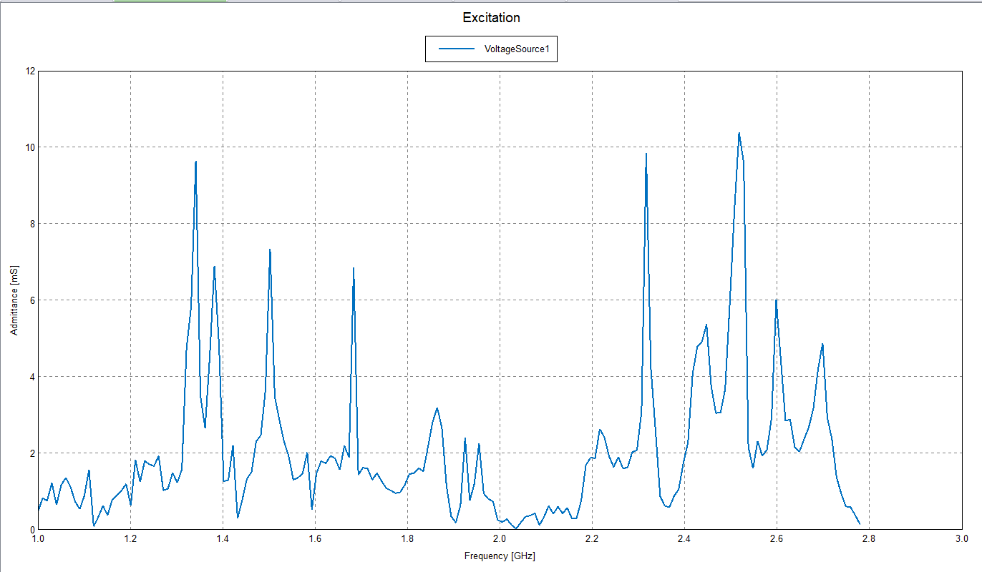

Slide 4
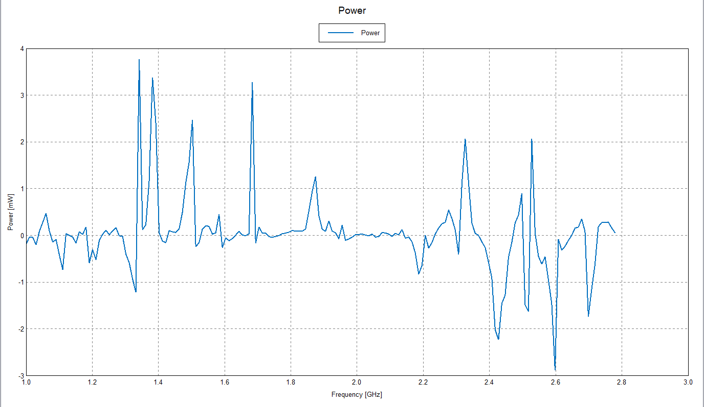

Slide 5
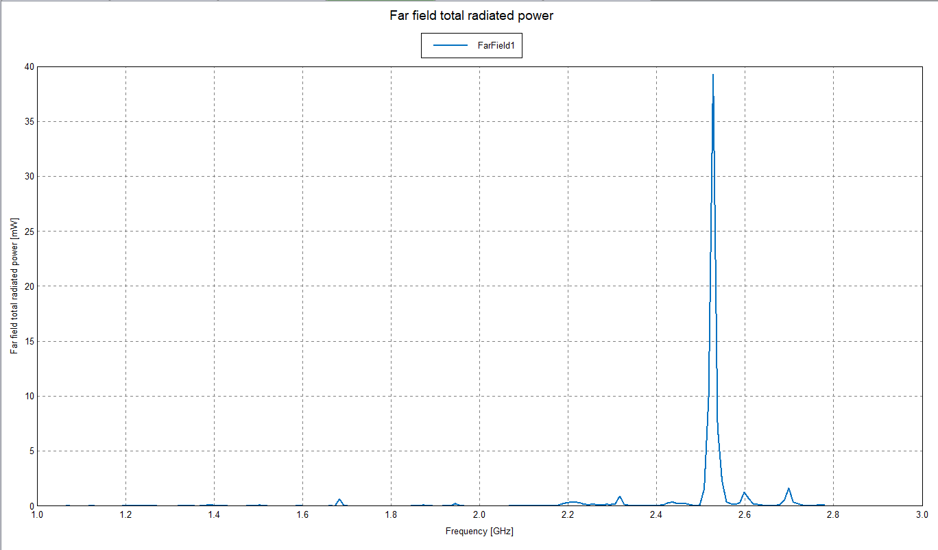

Slide 6
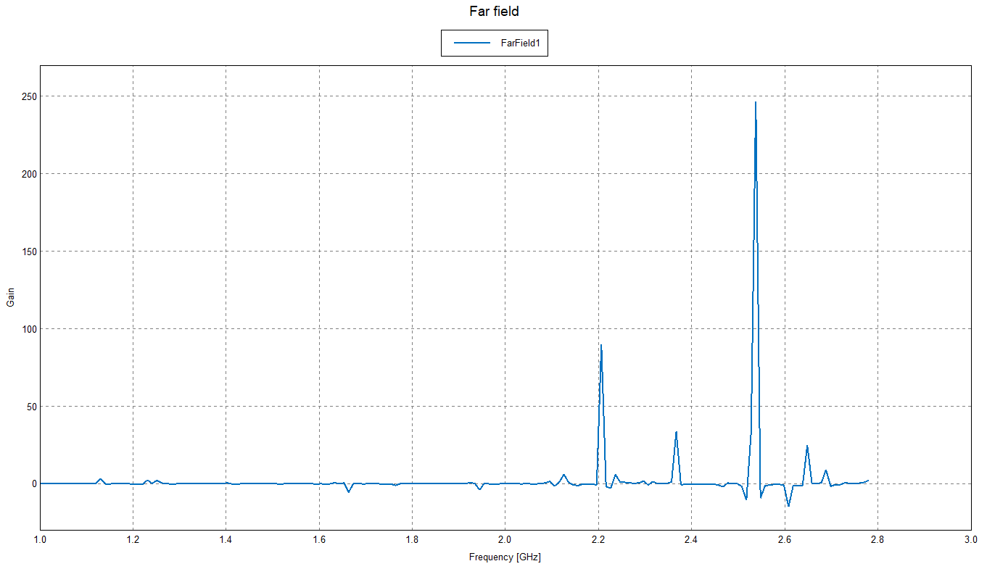

Slide 7
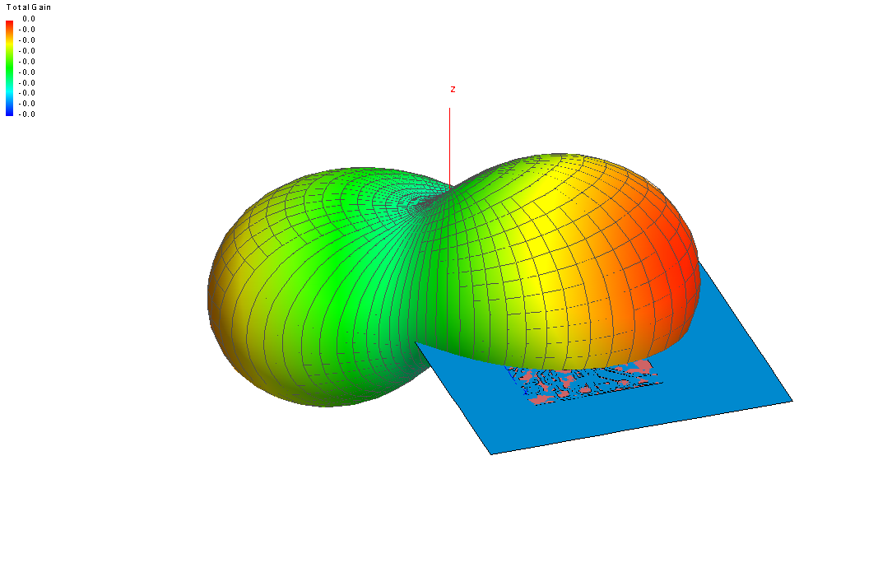

Slide 8
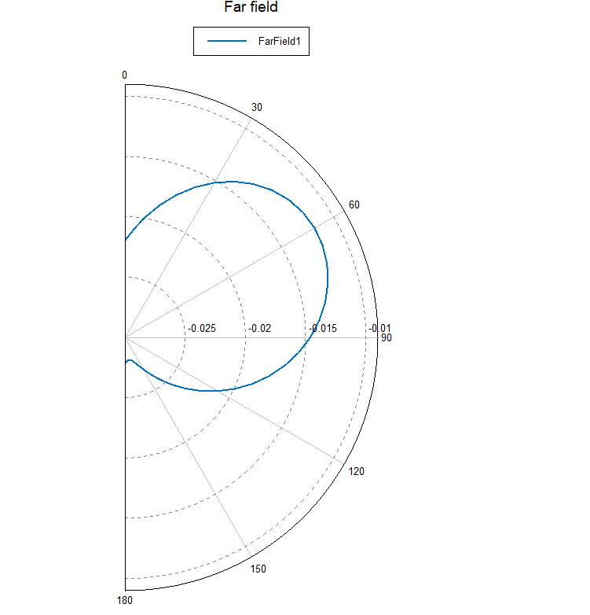

Slide 9
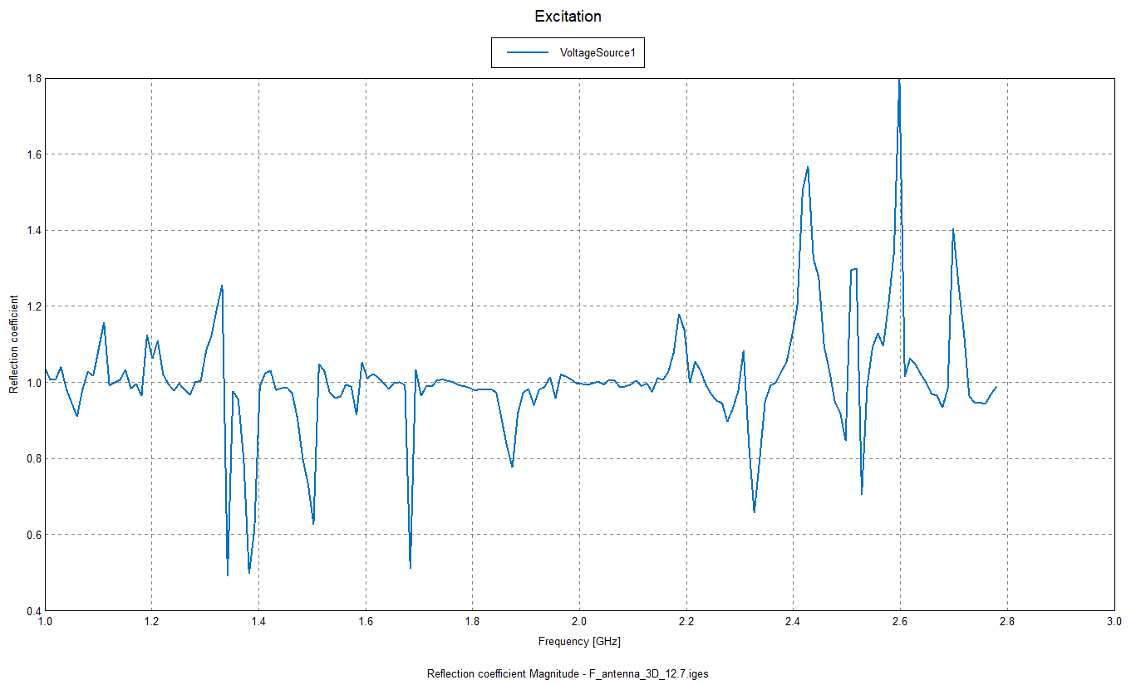


Slide 10
Notes
When I returned this morning (Dec. 20), FEKO gave me a message that the simulation had quit unexpectedly. I am assuming that is because the computer had gone into sleep mode.
Although the simulation was not able to finish, these are the results I got.
I am thinking of trying 100 frequencies with frequency increments of 20.202MHz instead of 200 frequencies with frequency increments of 10.05MHz; which is the simulation that was previously done.

Slide 11
Trial 2
Start Frequency: 1GHz
End Frequency: 3GHz
Number of Frequencies: 100
Frequency Increments: 20.202MHz

Slide 12
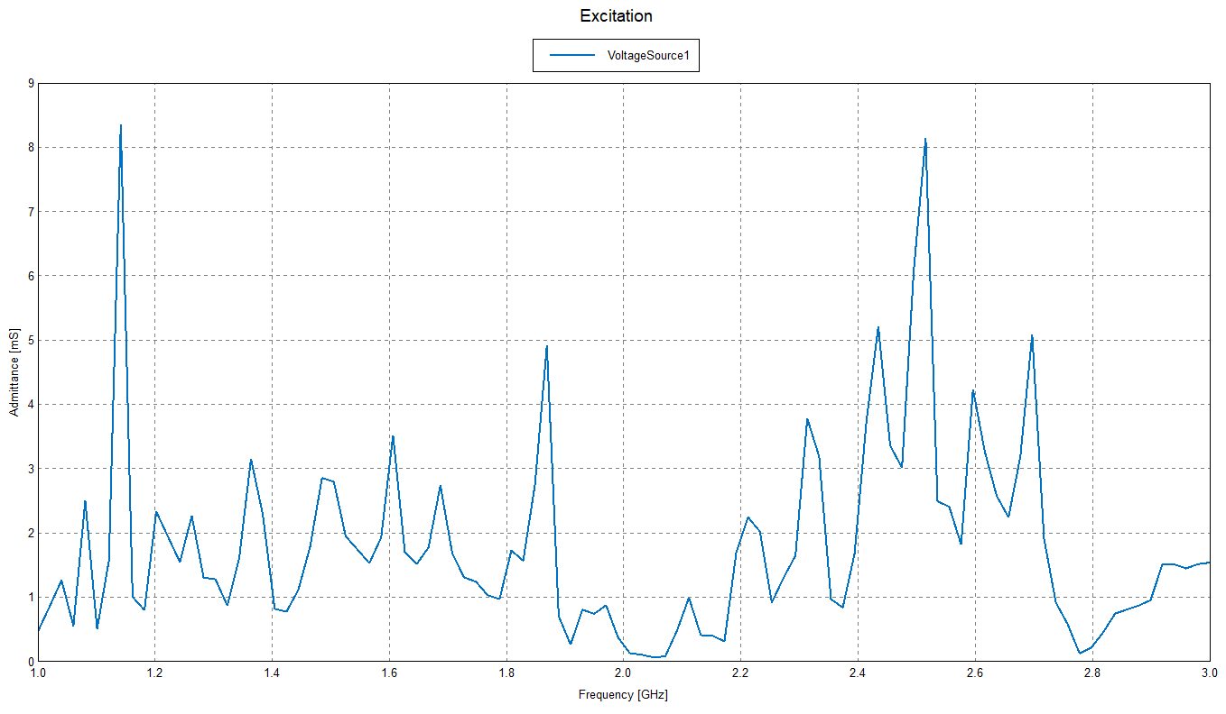

Slide 13
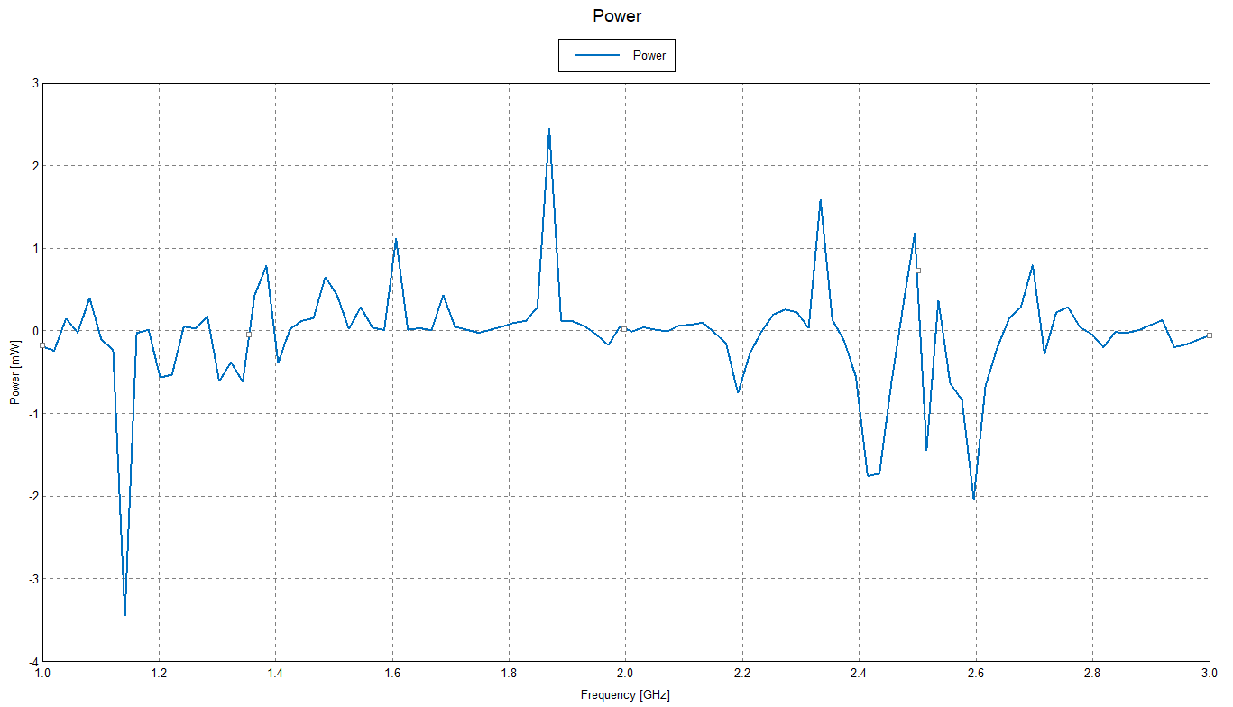

Slide 14
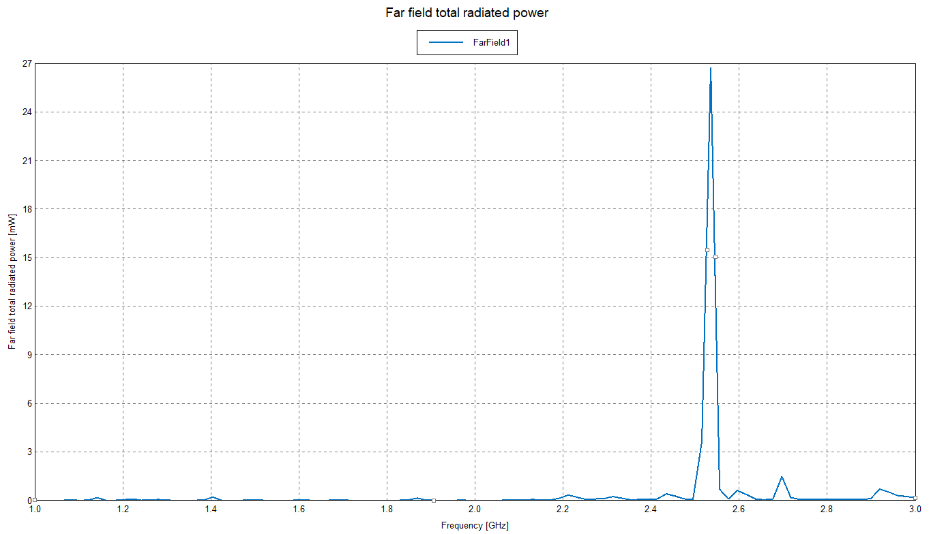

Slide 15
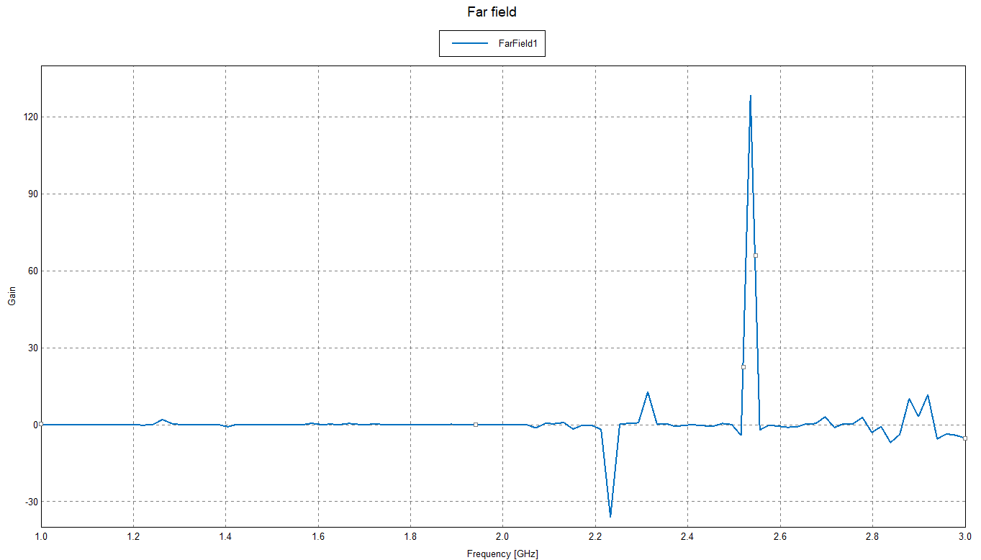

Slide 16
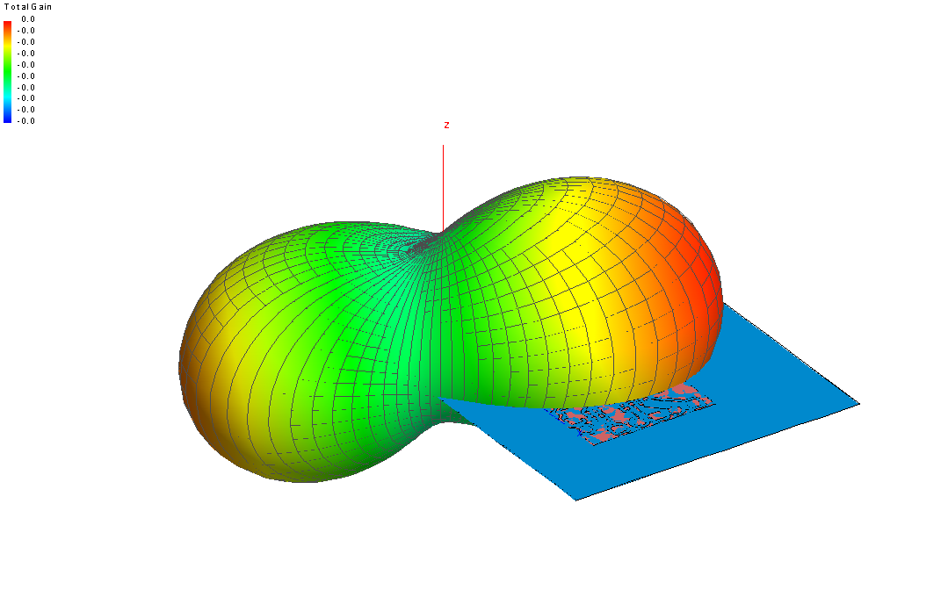

Slide 17
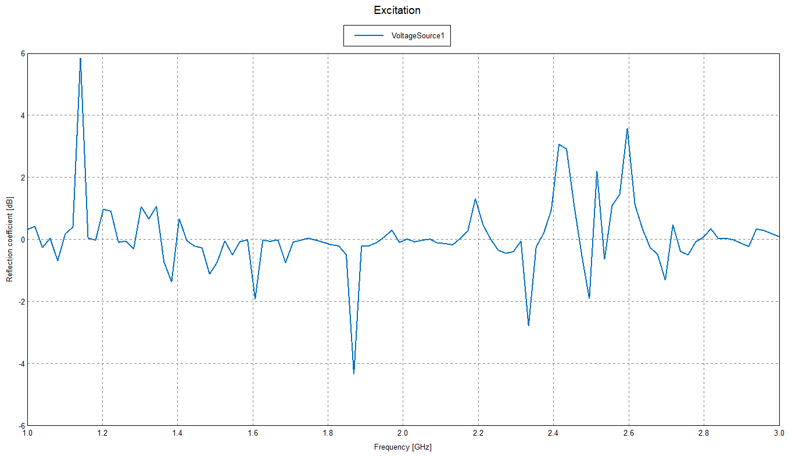

Slide 18
Notes
The reflection coefficient graph still doesn’t match the experimental results.
Some of the results are different than the ones from Trial 1. I think this is because it calculated 100 frequencies instead of 200.
This simulation was able to complete successfully which means that the simulations should run and complete without an issue when the computer goes into sleep mode.

Slide 19
Trial 3 (Edge port on opposite side)
Start Frequency: 1GHz
End Frequency: 3GHz
Number of frequencies: 100
Frequency increments: 20.202MHz

Slide 20
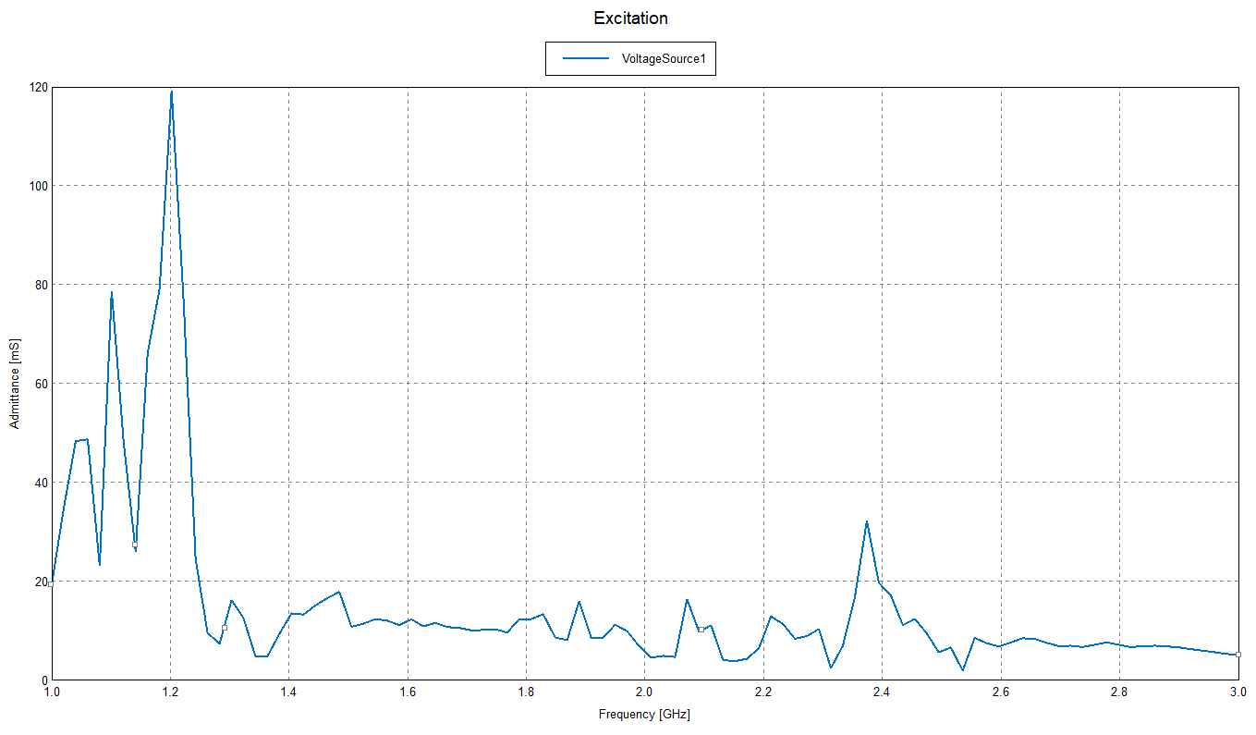

Slide 21
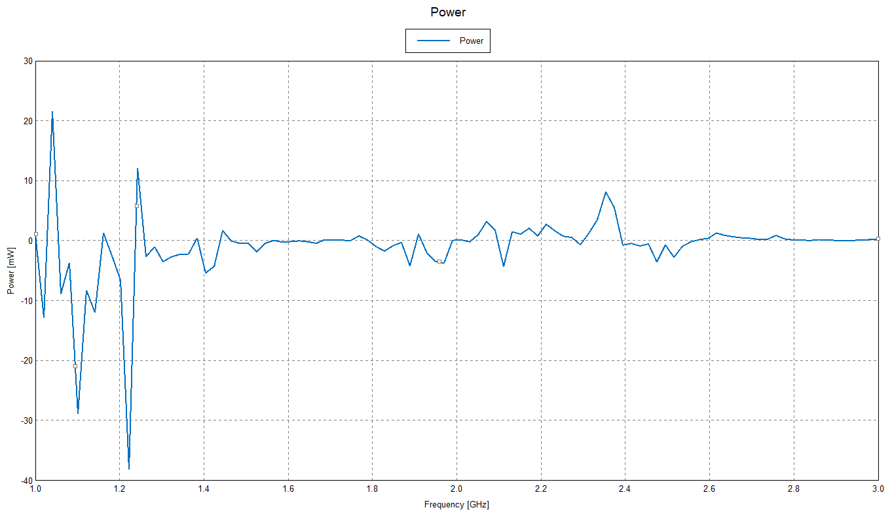

Slide 22
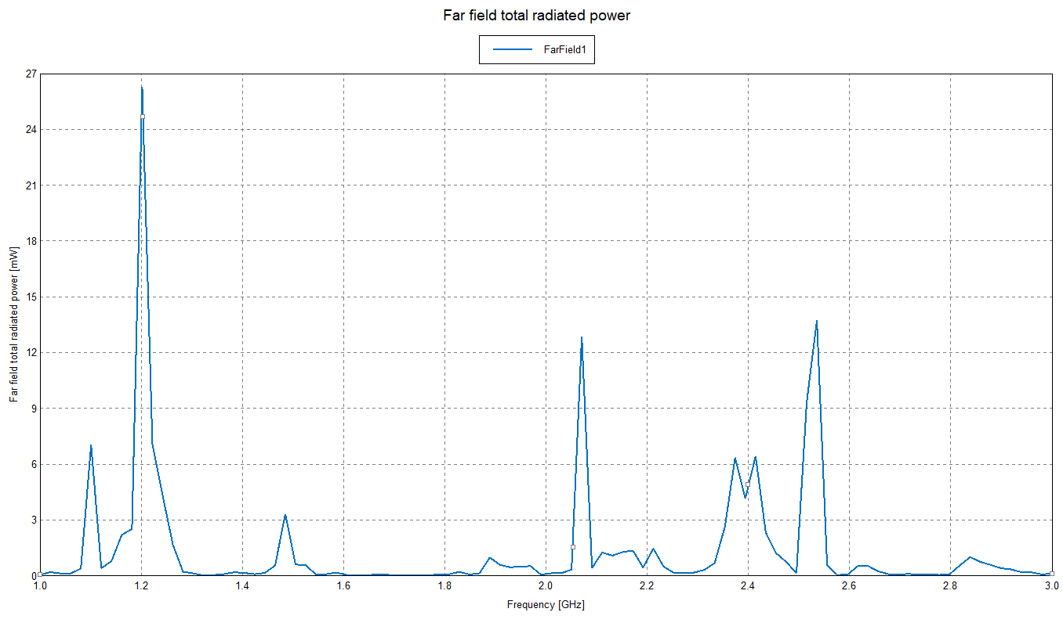

Slide 23
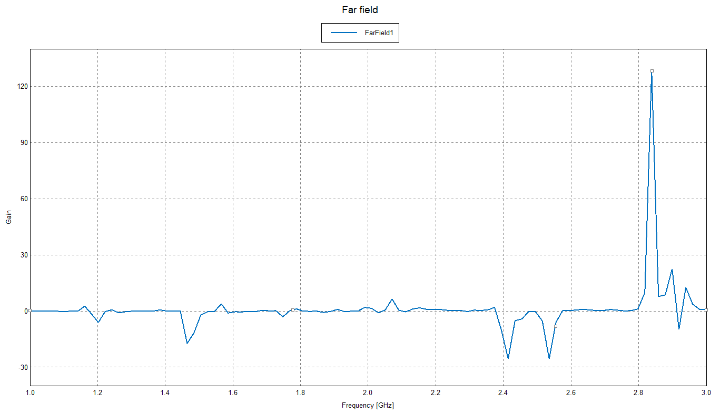

Slide 24
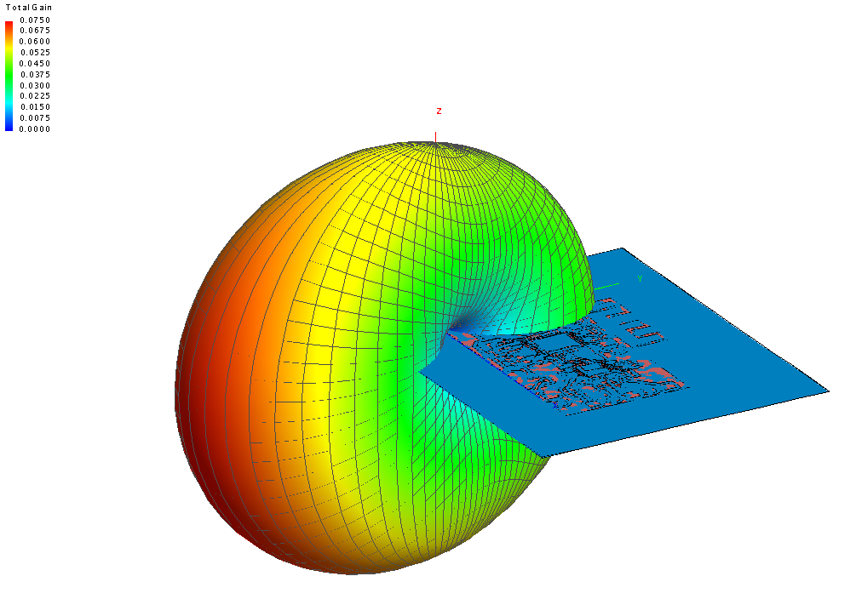

Slide 25
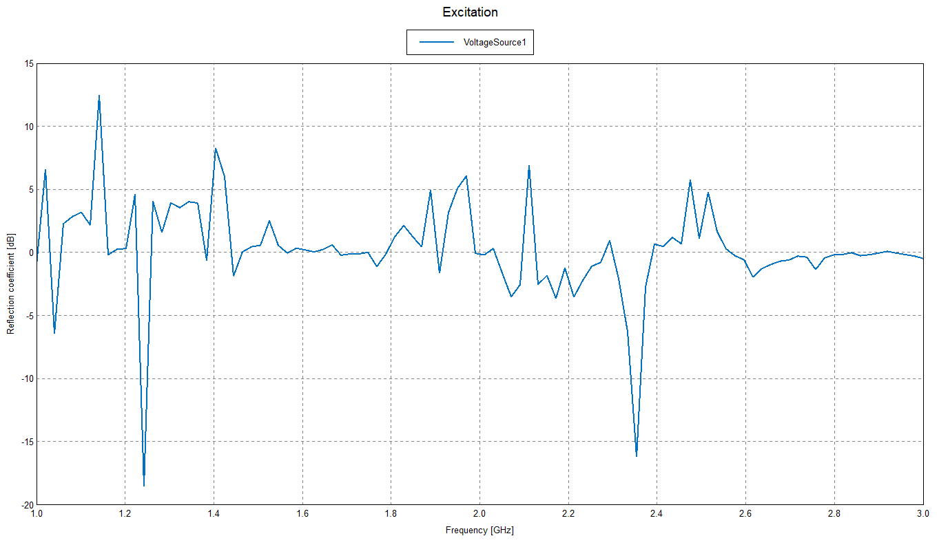

Slide 26
Notes
There are some noticeable changes in the graphs compared to the others. For example the 3D illustration of the FarField looks completely different than the previous two.
The cause of these changes is the placement of the edge port.
There is also a noticeable difference in the Reflection Coefficient graph compared to the other two Reflection Coefficient graphs (Although it still doesn’t match the experimental results)

Slide 27
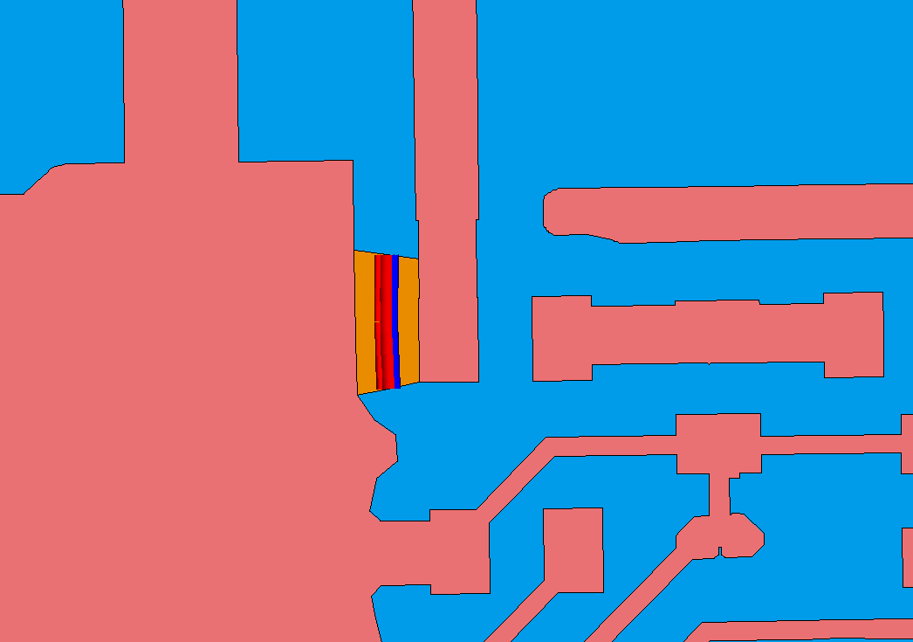
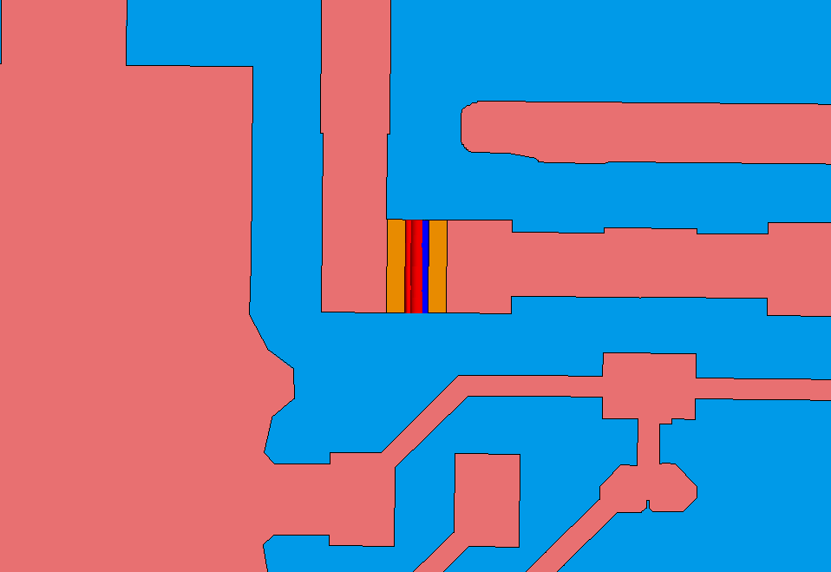
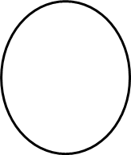
Difference In Edge Port Placement
New Placement
Old Placement

