Slide 1

HCM User Id = jdoe
Email = jdoe@company.com
OAC User Id = jdoe@company.com
Employee = John Doe
Is User Id = jdoe@company.com valid?
Is User Id jdoe valid?
IDCS
SSO
HCM
OAC
User Id = jdoe@company.com is authenticated
Is User Id jdoe having email jdoe@company.com is authenticated
OAC is set up to be externally facing to our customers
User id in OAC is user’s company email Address
HCM is internal application
User id is same as Company Network Id
SSO authenticates the user and returns email id
HCM is able to translate the email jdoe@company.com to the user jdoe and determine authorization

Slide 2

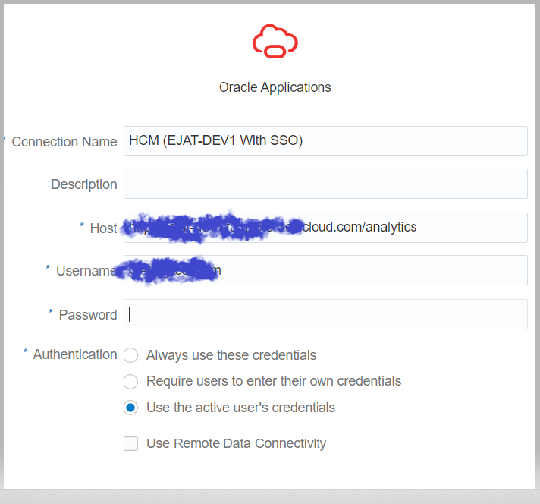
OAC User Id = jdoe@company.com
HCM User Id = jdoe
Email = jdoe@company.com
Employee = John Doe
Is User Id = jdoe@company.com valid?
IDCS
Ping SSO
HCM
User Id = jdoe@company.com is authenticated
OAC
OAC Connection with Generic HCM user with Impersonator Role
Connection passes current user jdoe@company.com
Connectivity does not work when I use “Use Active User’s Credentials”

Slide 3

OAC User Id = jdoe@company.com
HCM User Id = jdoe@company.com
Email = jdoe@company.com
Employee =John Doe
Is User Id = jdoe@company.com valid?
IDCS
Ping SSO
HCM
User Id = jdoe@company.com is authenticated
OAC
OAC Connection with Generic HCM user with Impersonator Role
Connection passes current user jdoe@company.com
Connectivity does work when I use “Use Active User’s Credentials”
Work Around Implemented To Resolve The Connectivity Issue:
A user was created in HCM against employee John Doe with user id jdoe@company.com.
In this scenario employee John Doe has two user ids in HCM:
  jdoe
  jdoe@company.com
Question: Is there a way to make the HCM connector know that jdoe@company.com in OAC is same as jdoe in HCM?

