Slide 1



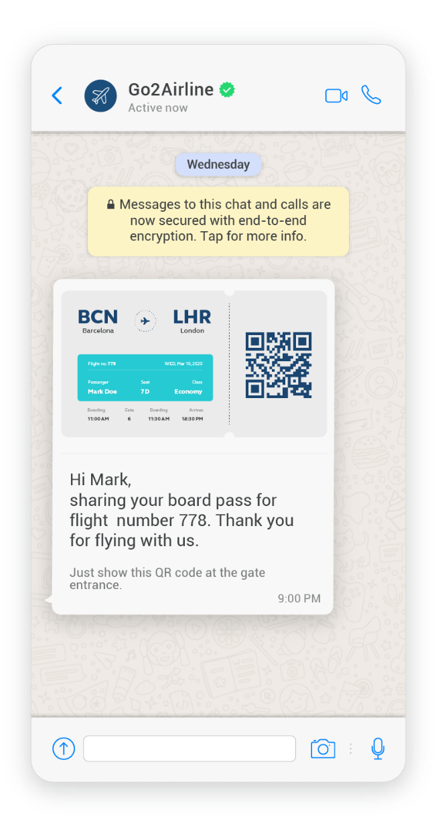
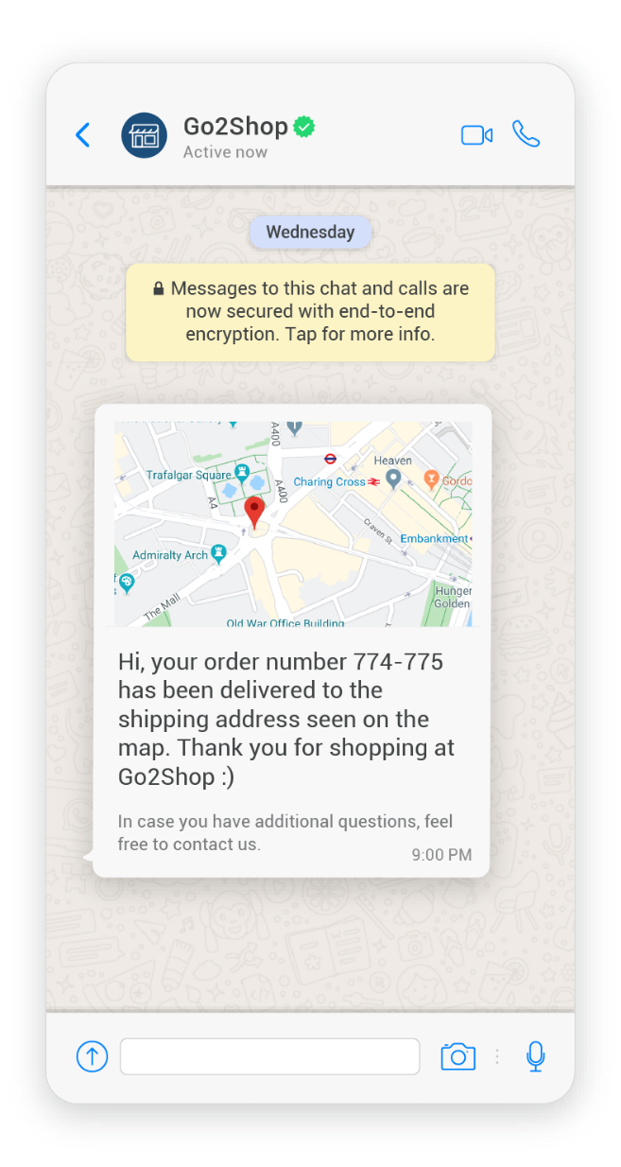


Real-time intelligent experiences at scale
Responsys + WhatsApp: Cross-Channel Orchestration App
Orchestrate communication with your customers on WhatsApp in conjunction with other native channels of Responsys.
Be where your customers are and positively impact KPIs
  Increase opt-in rates
  Increase delivery, open, & conversion rates
  Increase customer retention rates
Get started quickly with pre-built message templates for branded, rich communication across the customer journey
Notes:
Certainly our customers want to be where their customers are!
2 billion people, 180 countries, 60 languages…Be where your customers are
The average user checks WhatsApp more than 23 times per day.
68% of users agreed that WhatsApp is the easiest way to connect with a business.
Part of the ongoing innovation we are delivering through our CX Apps platform.
These apps are developed by infobip and link mobility. Customers have a choice on which one they want to use, and they will need a relationship with one of those providers.

Slide 2


Deliver important, timely notifications & reminders at every touchpoint
Common Use Cases:
Package delivery notifications
Account information
e-Receipts & order confirmations
Booking confirmations & boarding passes
Loyalty points reminders
Loan documents, change in interest rates
Monthly statements and more

Slide 3
Where to learn more:
Link Mobility:
  Marketplace listing: https://cloudmarketplace.oracle.com/marketplace/en_US/listing/85278257
Infobip:
  Marketplace listing https://cloudmarketplace.oracle.com/marketplace/en_US/listing/87280132

