Slide 1
Problem with DPM

Slide 2
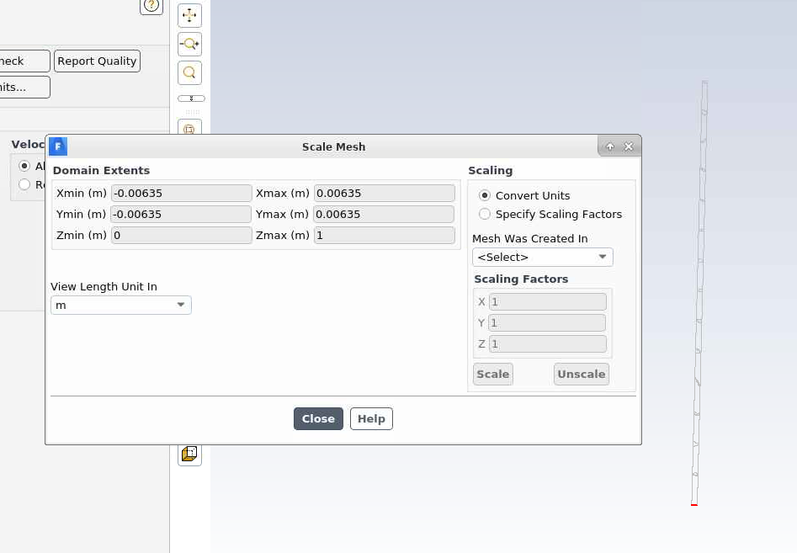
Geometry:
A straight pipe
Length = 1m
Diameter = 0.0127m

Slide 3
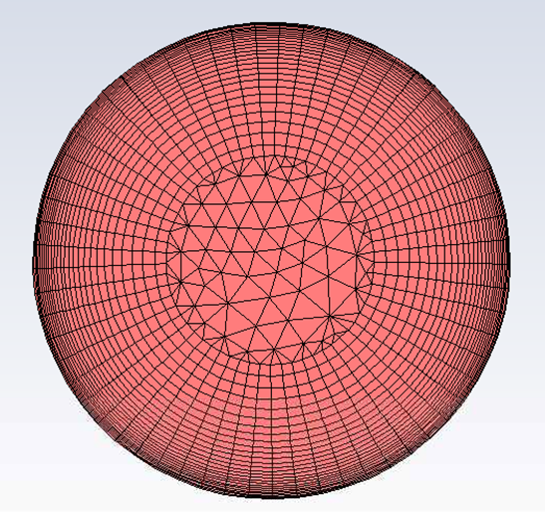
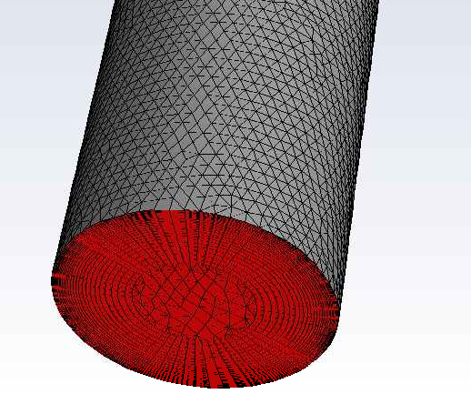
Mesh:
Meshing:
Inflation on entire wall
6.8M cells

Slide 4
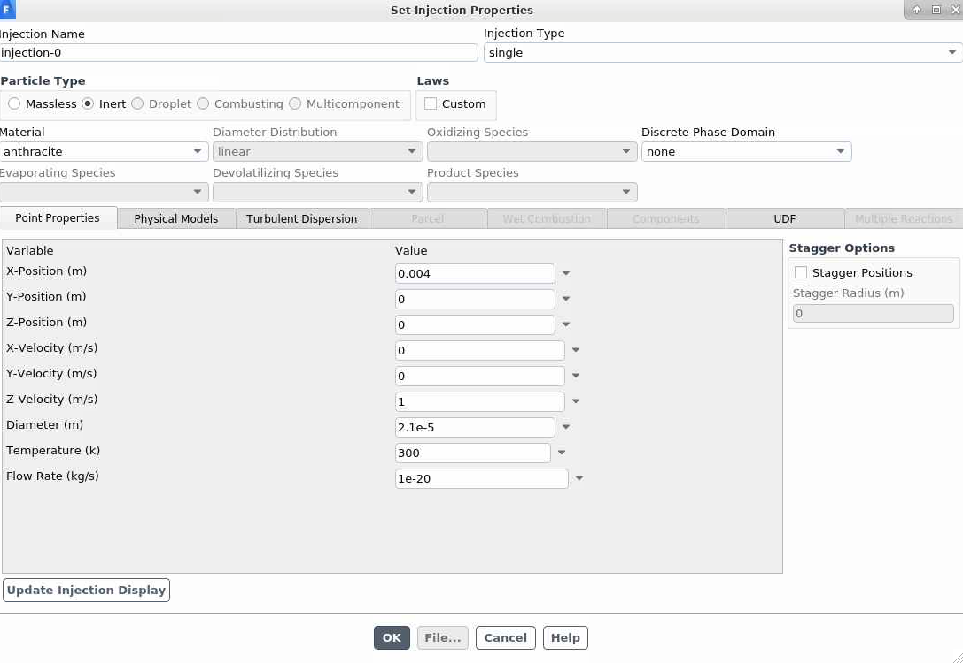
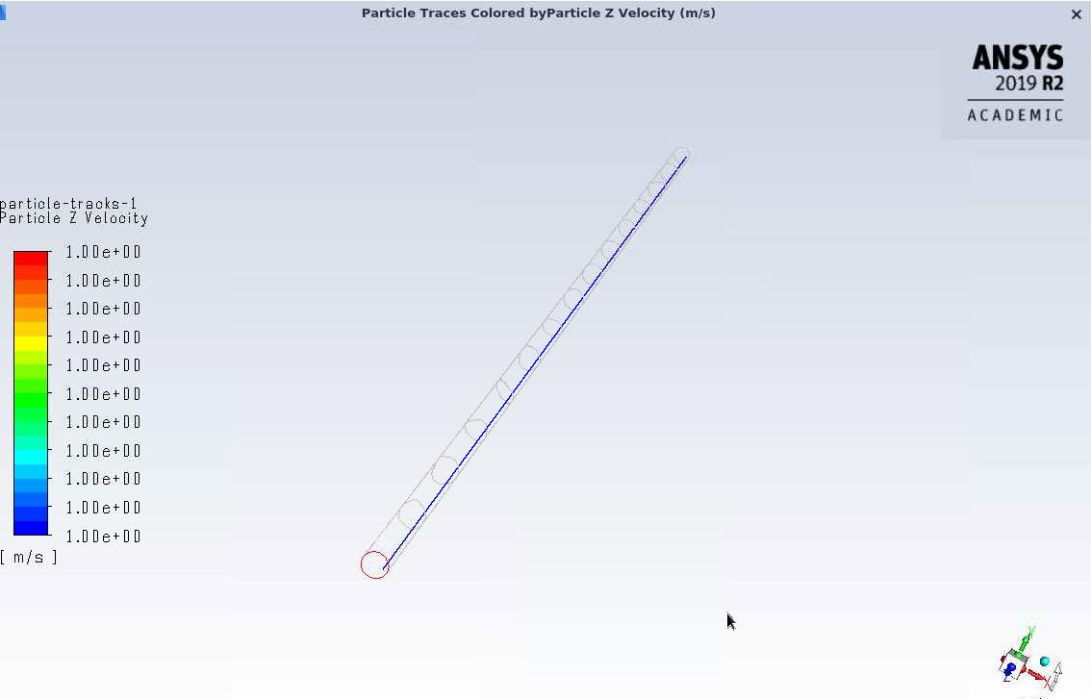
Particles injected at constant velocity (v=1m/s)

Slide 5
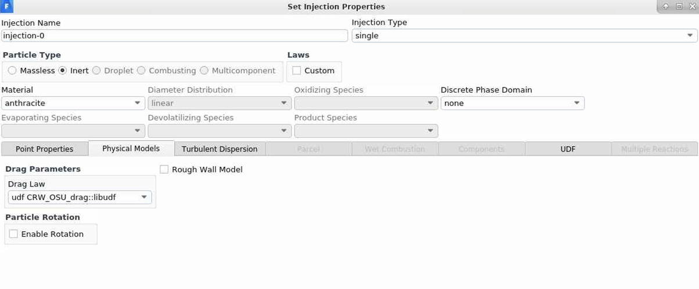
Let Cd=0 by using UDF (UDF is attached at last page) to keep particle velocity a constant.

Slide 6
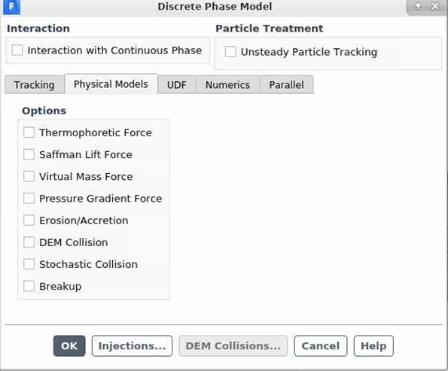
Turn off all additional force

Slide 7
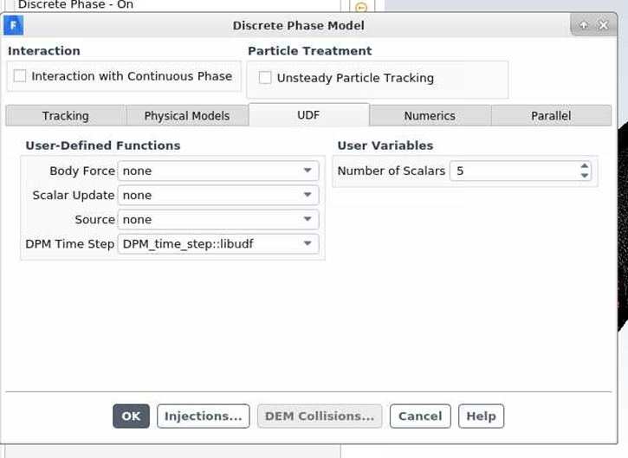
Assigned time step by UDF

Slide 8
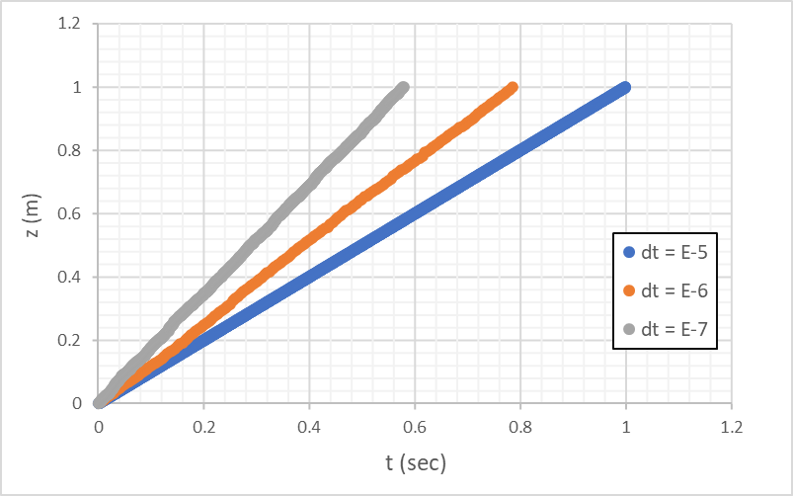
Particles injected at constant velocity (v=1m/s) and c_{d} = 0.
The length from inlet to outlet is 1m.
It supposes to reach the outlet by 1 sec.
But the results show that it is dependent on time step size.
For time step > E-5, it is normal.
But for time step < E-5, it is nonphysical

Slide 9
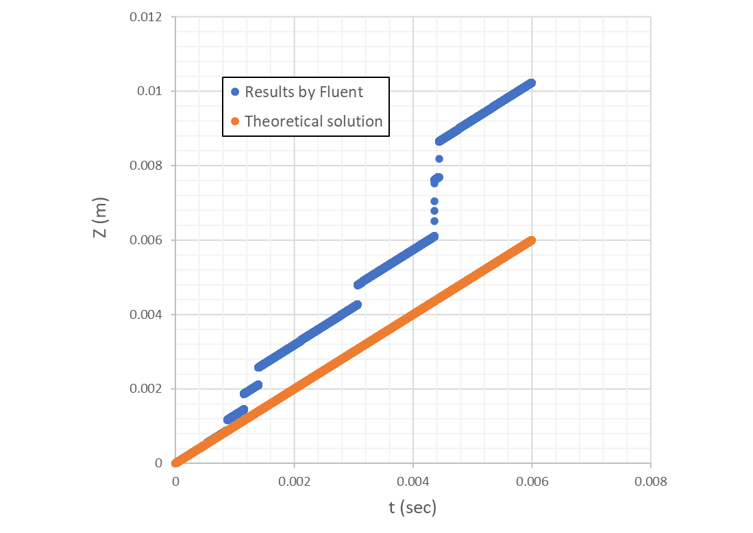
If we look closer.
The slope is ok, but particles jump in axial coordinate when they flow cross some cells.

Slide 10
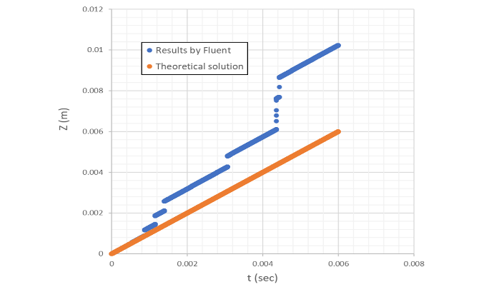
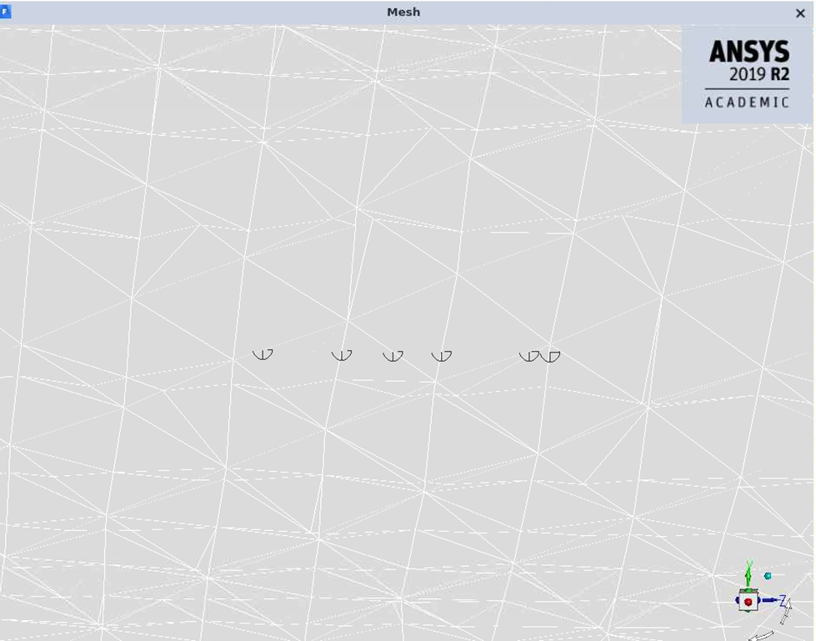
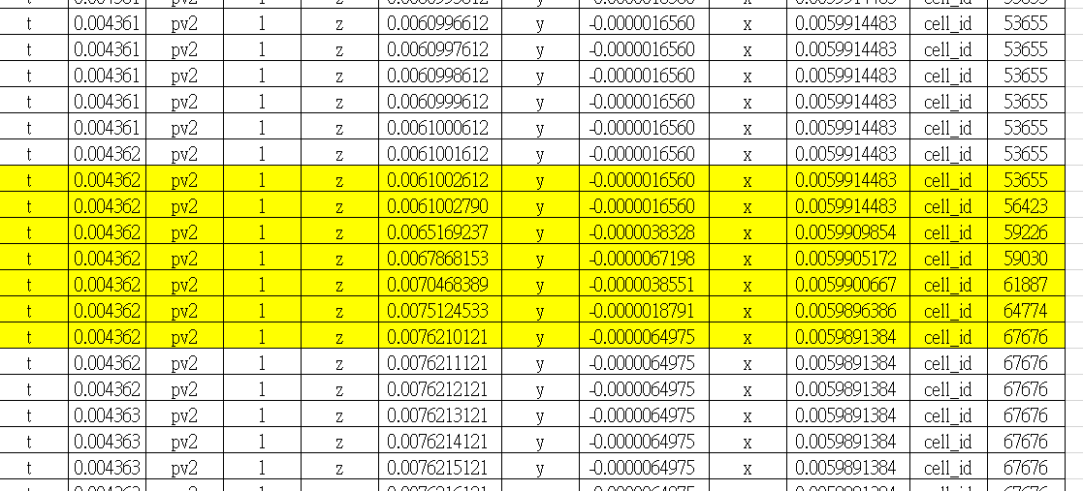
As shown in the figures. The particle flows non-physically when it is on the edge of a cell.
Jump non-physically in a short time

Slide 11
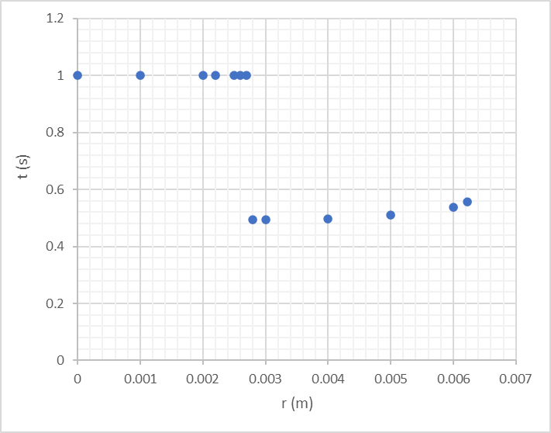
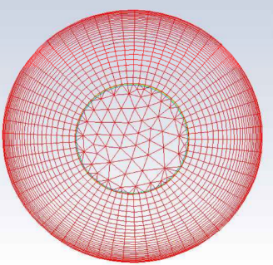
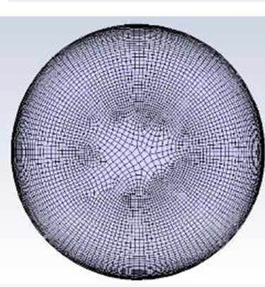
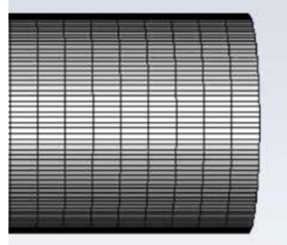
The problem only shows with small time step.
The problem only shows when particles flow in the inflation layers.
If the grid is in parallel to the streamwise direction, no issue is seen.
Inflation layers
Non-physical transit time
For example, when we use inflation on the inlet, and use inlet face as source face to sweep for the body. The transit time for a particle to flow from inlet to outlet is as theoretical.

Slide 12
#include "udf.h"
#include "dpm.h"
#include "mem.h"
#include "sg.h"
#include "stdlib.h"
#include "stdio.h"
#include "math.h"
#include "cxsurf.h"
#include "random.h"
DEFINE_DPM_TIMESTEP(DPM_time_step, p, dt)
{
dt = 1.0*pow(10,-7);
return dt;
}
/********************************************************************************/
DEFINE_DPM_DRAG(CRW_OSU_drag,Re,p)
{
real x[ND_ND];
cphase_state_t *c = &(p->cphase); /* cell information of particle location */
cell_t c0 = RP_CELL(&(p->cCell)); /* index of cell in which currently tracked particle is in */
Thread *t0 = RP_THREAD(&(p->cCell)); /* cell thread to which above cell belongs */
real pp[3] = {0.,0.,0.}; /* particle position vector */
real pv[3] = {0.,0.,0.}; /* particle velocity vector */
int i;
C_CENTROID(x,c0,t0);
for(i=0;i<3;i++)
{
pp[i] = P_POS(p)[i];
pv[i] = P_VEL(p)[i];
}
/*
p->state.V[0] = 0;
p->state0.V[0] = p->state.V[0];
p->state.V[1] = 0;
p->state0.V[1] = p->state.V[1];
p->state.V[2] = 1.0;
p->state0.V[2] = p->state.V[2];
*/
if(P_USER_REAL(p,3)>10001.0){
Message("t=%.10g pv2=%.10g z=%.10g y=%.10g x=%.10g cell_id=%d \n",P_TIME(p),pv[2],pp[2],pp[1],pp[0],c0);
/* Message("t=%.10g z=%.10g y=%.10g x=%.10g cell_id=%d \n",P_TIME(p),x[2],x[1],x[0],c0);
*/
P_USER_REAL(p,3)=1.0;
}
P_USER_REAL(p,3) += 1.0; /* iter count for particles*/
return 0;
}
DEFINE_DPM_INJECTION_INIT(initPuserReal,I)
{
Particle *p;
loop(p,I->p)
{
/* Fluctuations in the previous time step */
P_USER_REAL(p,0) = 0;
P_USER_REAL(p,1) = 0;
P_USER_REAL(p,2) = 0;
/* Particle iteration count */
P_USER_REAL(p,3) = 0;
/* Particle impact count */
P_USER_REAL(p,4) = 0;
}
}
UDF

