Slide 1
SOAP API Call
（In case normal result）

Slide 2
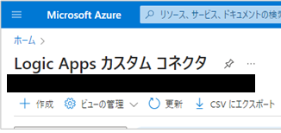
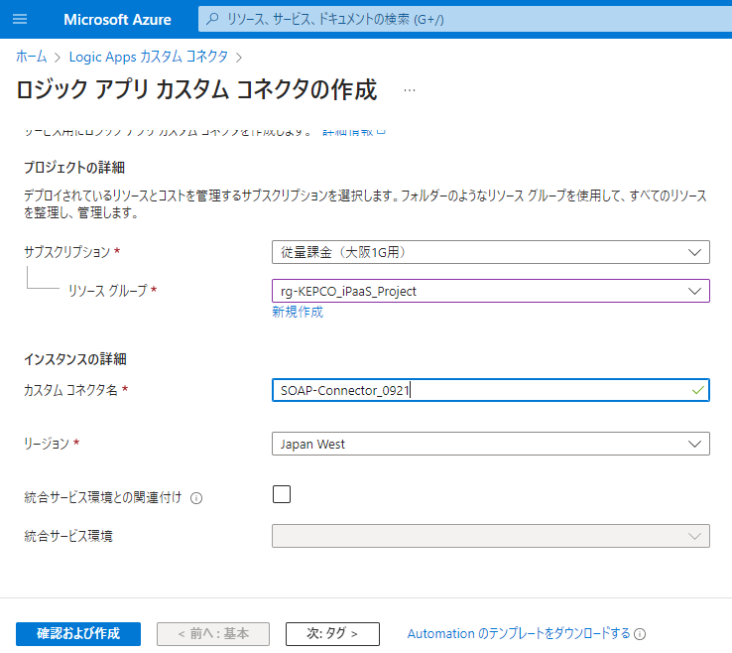
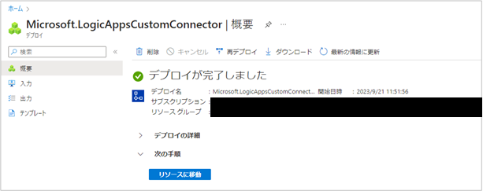
1 Create new “SOAP Custom connectors” from Azure portal
Create
Name of custom connector
Complete deployment

Slide 3
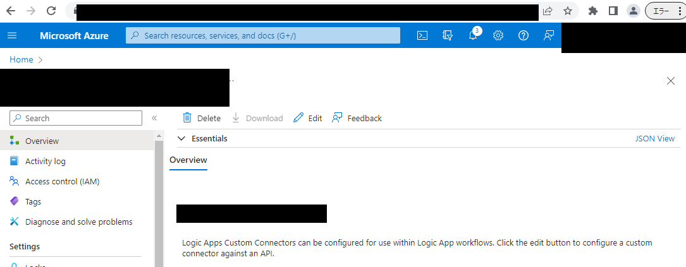
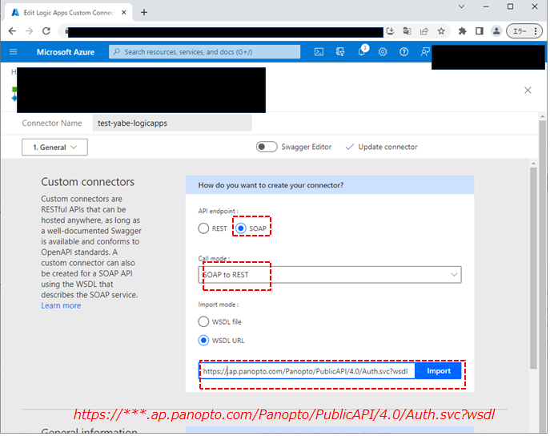
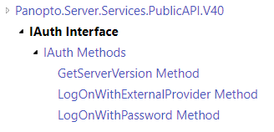
2 Configure “logic apps custom connector” Overview menu (1.General)
Edit
Import SOAP API wsdl file”this case is iAuth API”

Slide 4
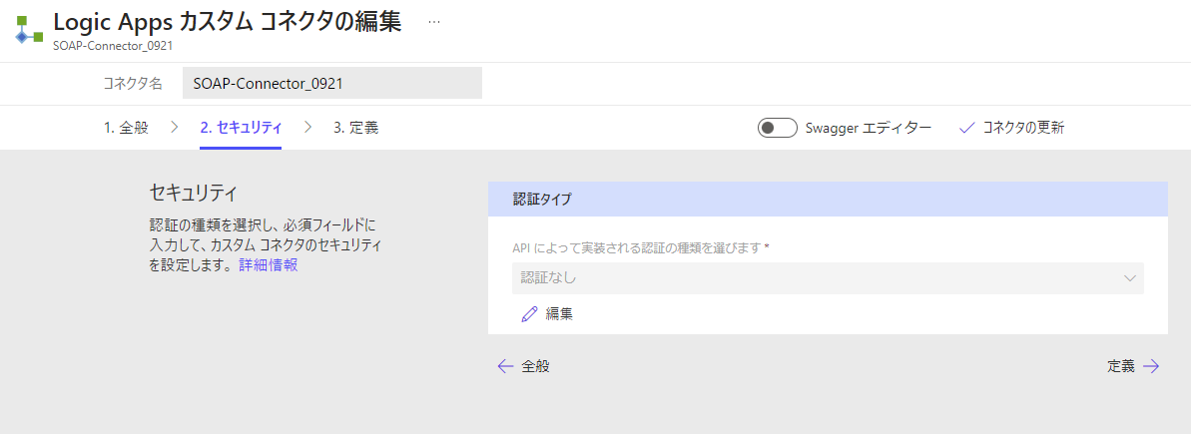
3 Configure “logic apps custom connector” Overview menu ( 2.security)
Security
Stay default value “ no authentication”

Slide 5
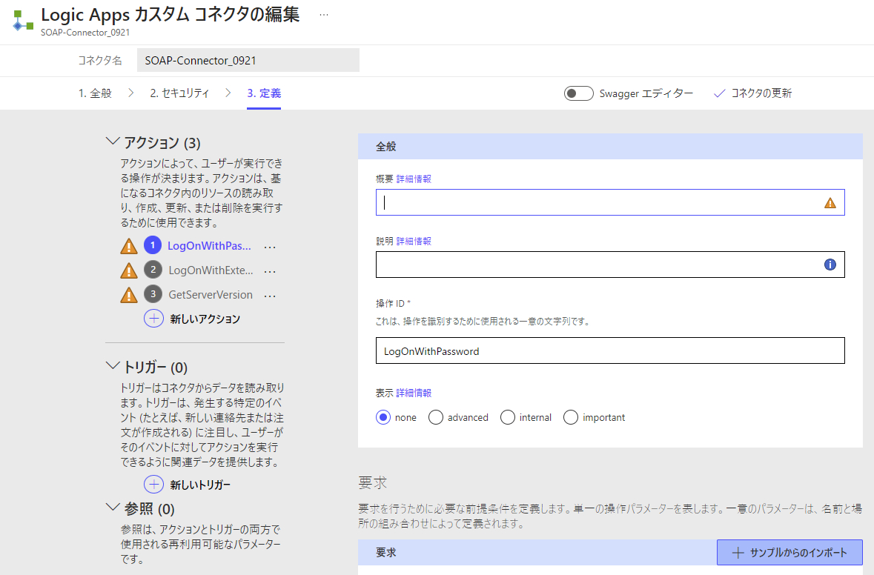
4 Configure “logic apps custom connector” Overview menu ( 3.definition)
Update connector without any change
List API that can be used

Slide 6
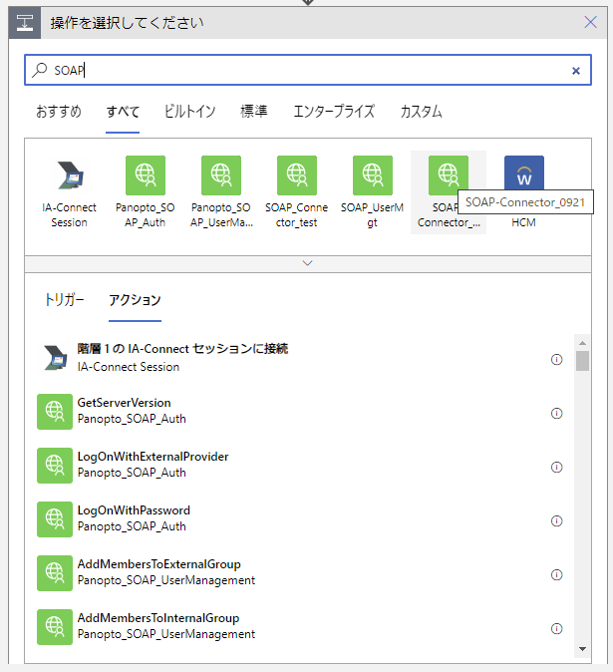
5 Select “SOAP Custom connector” at Logic Apps Designer

Slide 7
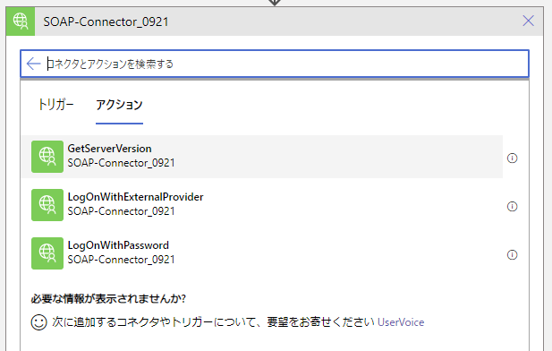
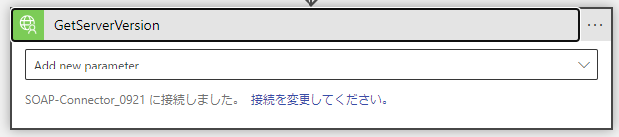
6 designate action “GetServerVersion”
Action

Slide 8
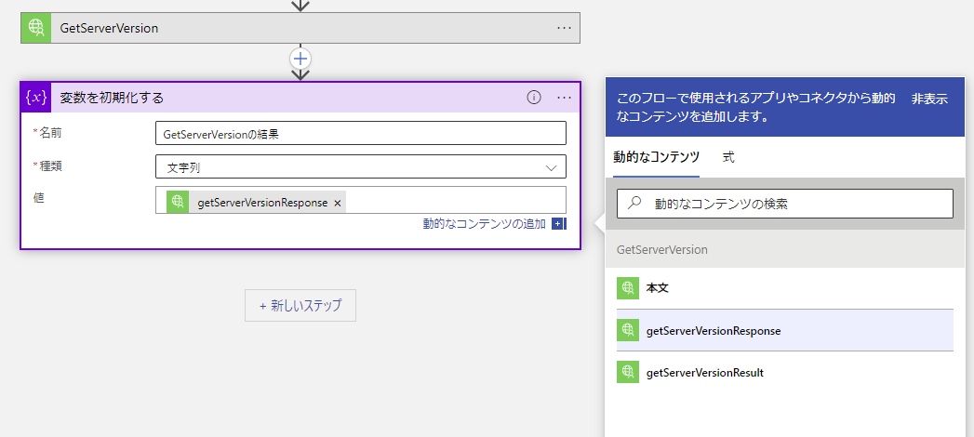
7 Store return code
Initialize valiable

Slide 9
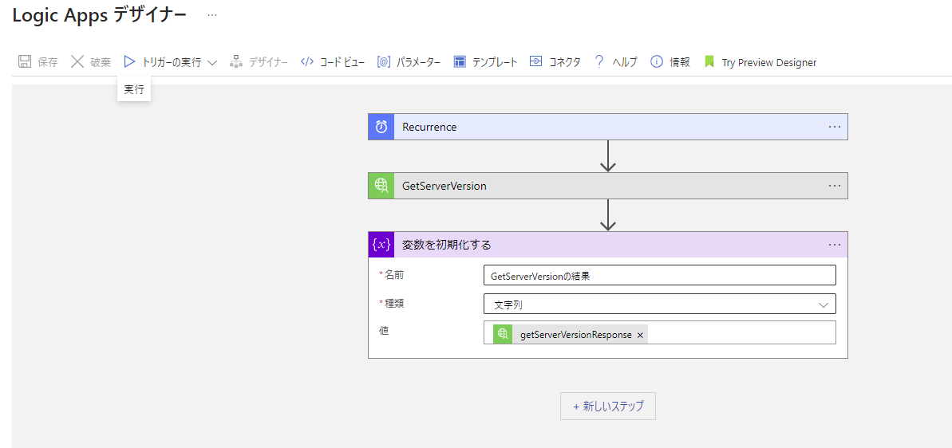
8 Save and run
Run

Slide 10
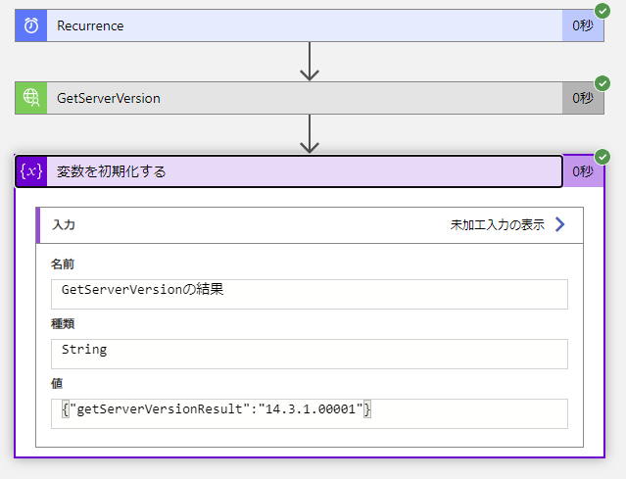
9 check normal return code

Slide 11
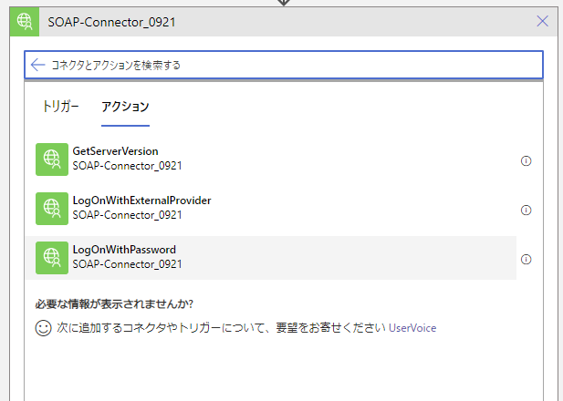
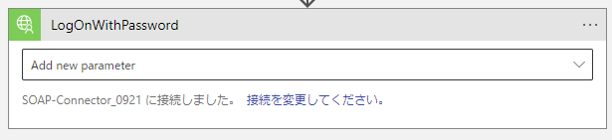
10 designate action “LogOnWithPassword”
Action

Slide 12
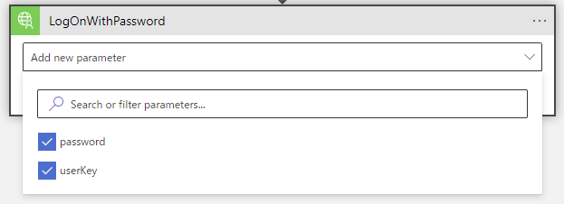
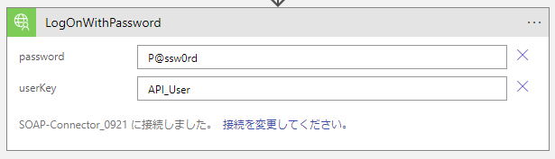
11 Designate password and userkey at “LogOnWithPassword”

Slide 13
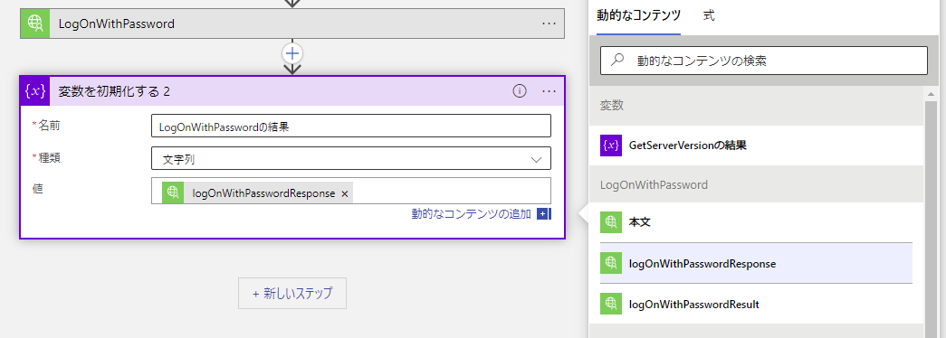
12 store return code
Initialize valiable

Slide 14
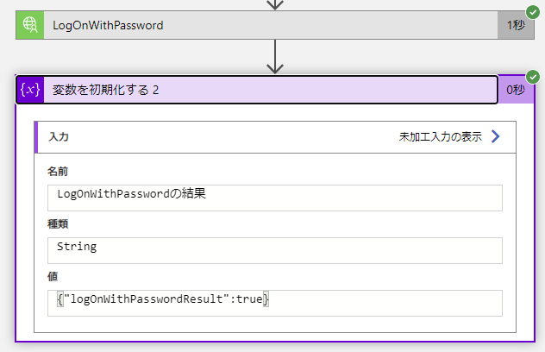
13 save and run , and check getting normal result

Slide 15
SOAP API Call
（error/not correct case）

Slide 16
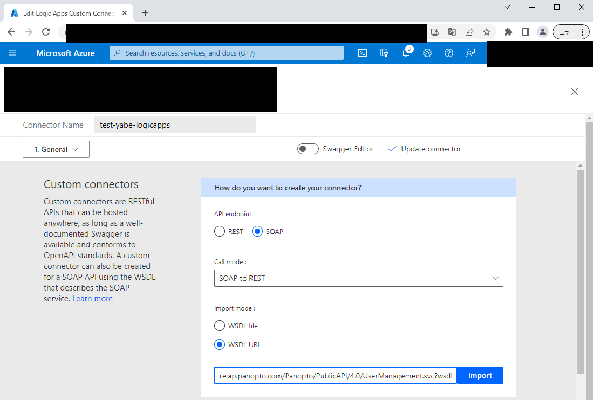
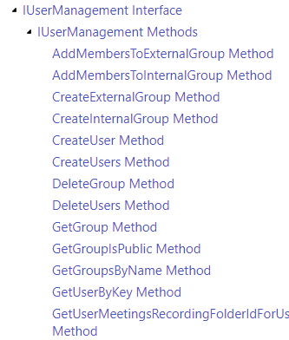
1 Configure “logic apps custom connector” Overview menu (1.General) :UserManagement wsdl file
wsdl ファイルを指定してインポートする。
https://*.ap.panopto.com/Panopto/PublicAPI/4.0/UserManagement.svc?wsdl

Slide 17
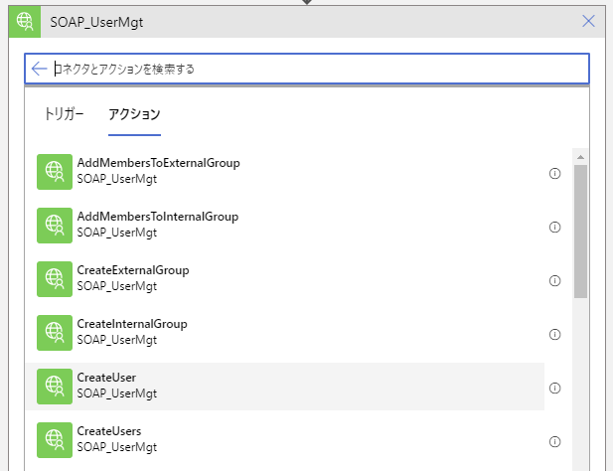
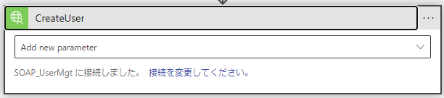
2 Select “SOAP Custom connector” at Logic Apps Designer and designate “CreateUser”

Slide 18
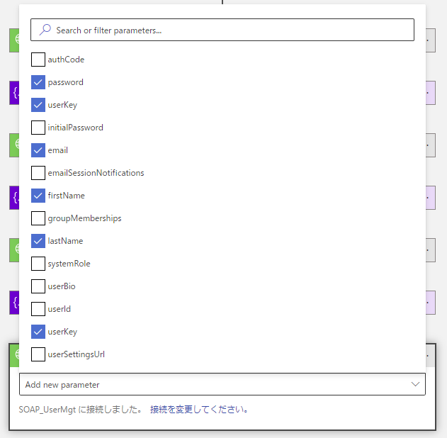
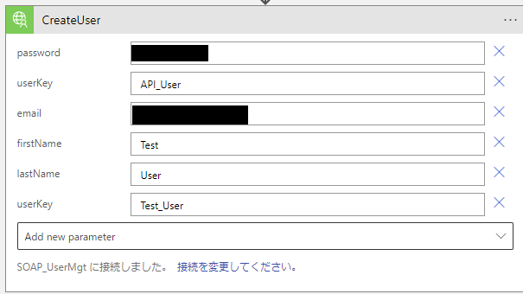
3 designate parameter as below

Slide 19
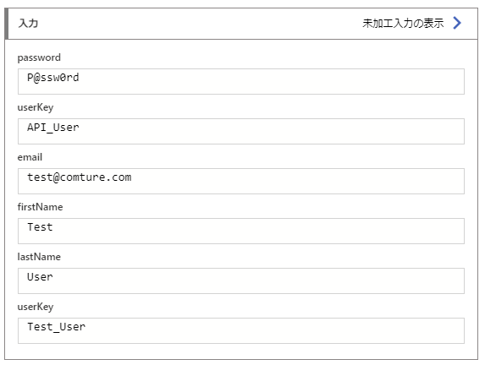
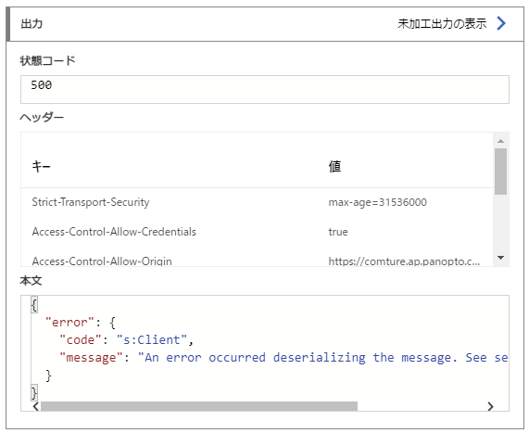
4 save, run and check result
Fail response
{
"error": {
"code": "s:Client",
"message": "An error occurred deserializing the message. See server logs for details"
}
}

